Slide 1
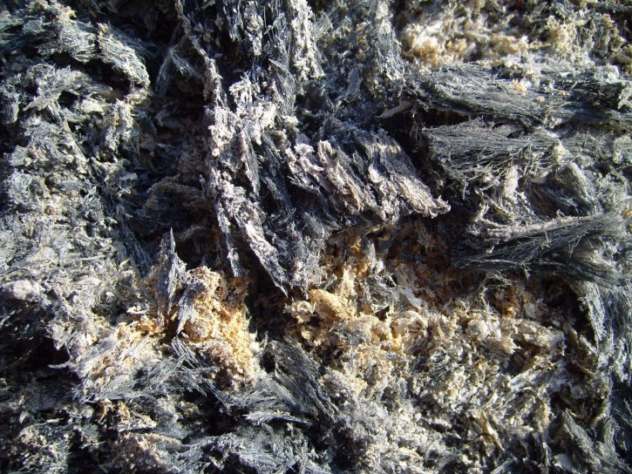

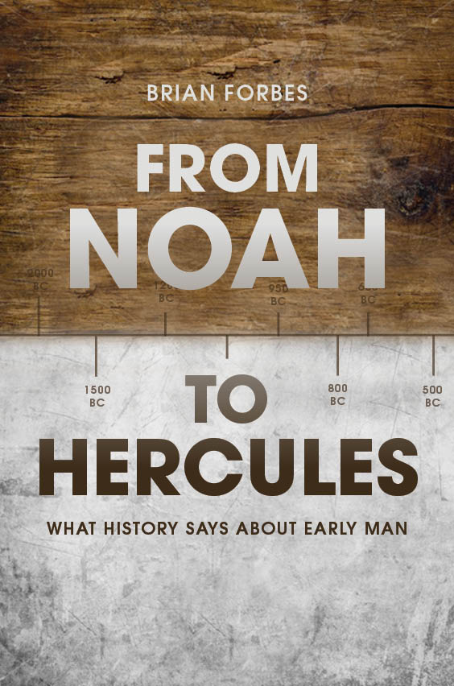
What History Tells Us About History
FromNoahtoHercules.com

Slide 2

By the standard of some,
I am an
expert

Slide 3
By the standard of others, I’m not

Slide 4
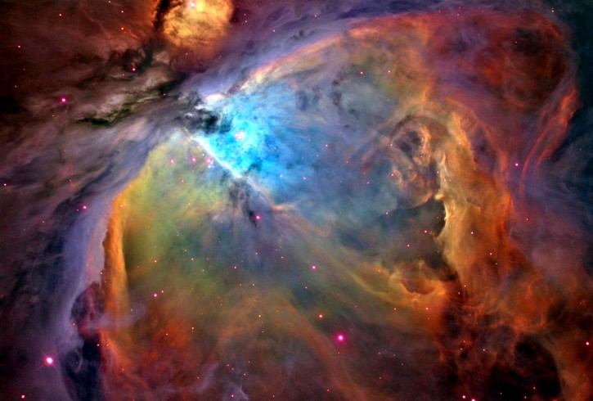
Against a perfect standard, nobody is an expert.
Compared to him, all people are foolish and have no knowledge at all! – Jer. 51:17

Slide 5

When compared with the age of the Earth, our lives are short.

Slide 6
Even old men have huge gaps in their historical knowledge.

Slide 7
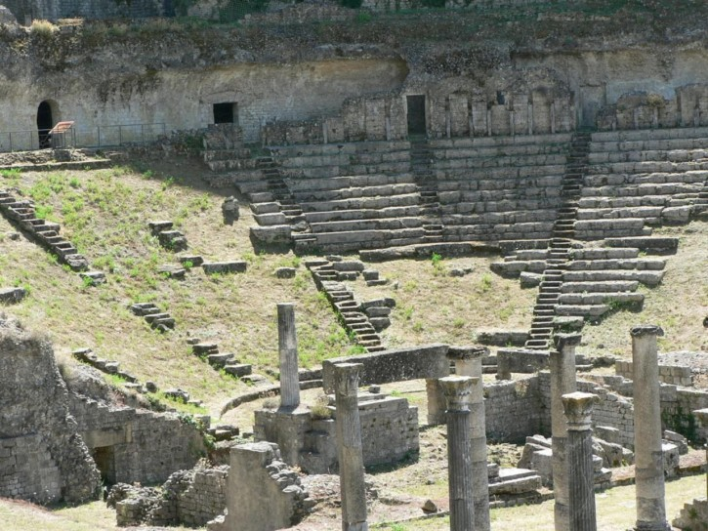
We cannot know history unless:
We were there
We figured it out forensically
We heard testimony

Slide 8
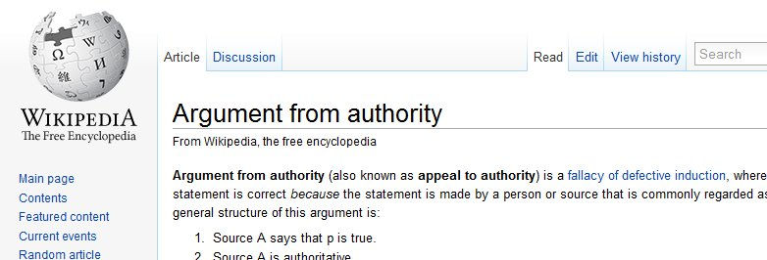
There is a logical fallacy called an appeal to authority.

Slide 9

It makes some sense that people of all stripes go to an expert for testimony.
Experts are often know things others do not.

Slide 10
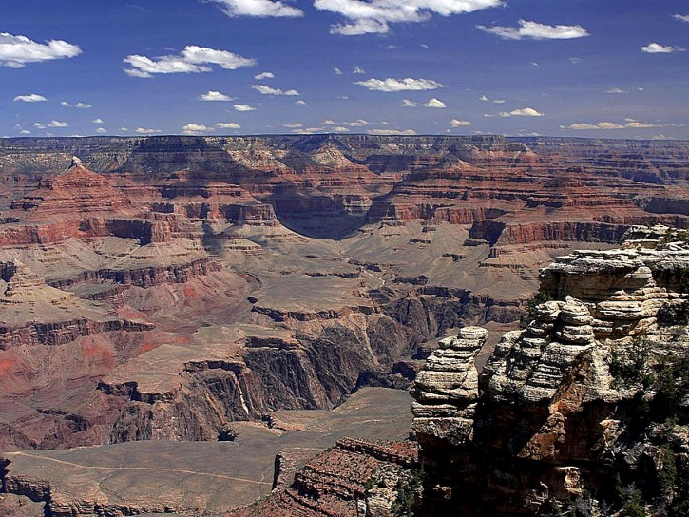
The fallacy applies when we assume that…
Whenever you and an expert disagree, YOU are wrong.

Slide 11


The most common objection to my evidence is an “appeal to authority” fallacy.

Slide 12

How can we know the truth about history?
Let’s look closer at the three options:
Be an Eye Witness -
The experts
were not
there, and
neither was I.
(We're collecting eye witnesses.)

Slide 13
  We can use forensics.
(appeal to science)

Slide 14
  We can hear testimony
(appeal to history)

Slide 15
Personal experience doesn’t apply.
Science requires assumptions, because not all the pieces are there.
Of the three options, historical testimony is most often neglected.

Slide 16
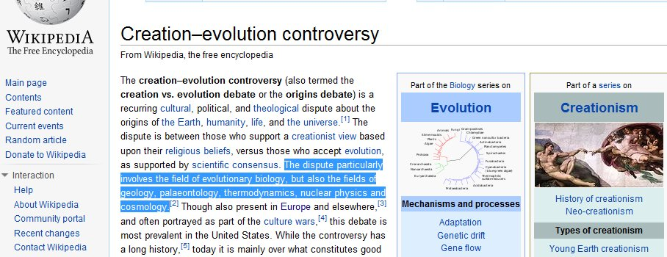
History really is neglected

Slide 17

I may not have been witness to the events we’re talking about, but I can quote the accounts of the people who were.

Slide 18
That’s a valid appeal to authority.

Slide 19
I’m not an expert in history, and you probably aren’t either.
That’s OK!
Nobody is more expert than an eye witness.

Slide 20
The “experts” are drawing from the same sources as I do in my book and these slides.
You can make up your own mind about the evidence, as I have done.

Slide 21
The experts need to argue the facts.
A demand for trust doesn’t count.

Slide 22
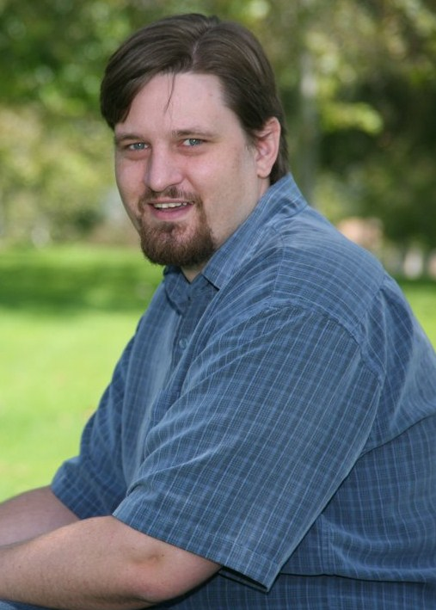
Me
I don’t know more about this
stuff than you can come by
with a few years of study.
I am much like a young Christian
evangelist.
I don’t know as much as an expert, but
what I do know, I know with certainty.

Slide 23
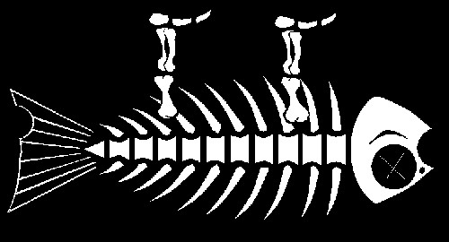
This Meeting
I’m a huge fan of this meeting.
You can download past
speeches from
Darwin is Dead . com.
I highly recommend the speeches given by Dennis Swift and Willie Dye. They present compelling evidence for their outrageous claims.
I intend to carry on that tradition.

Slide 24
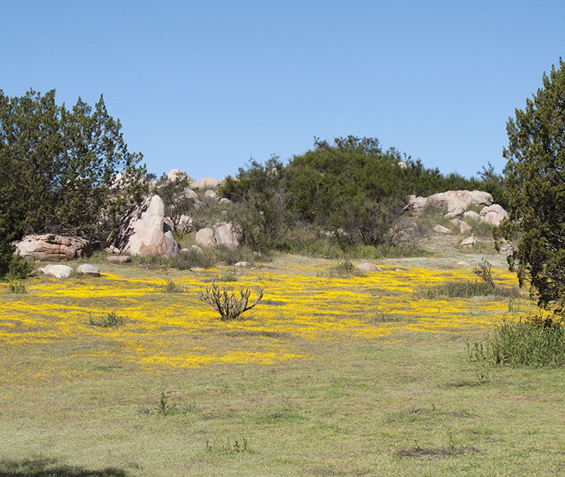
This Meeting and Me
(a short story of how I came to this meeting)
I had been studying Creation Science for a couple years, and I was regularly recording Creation Science shows.
Driving into church one Sunday morning, I saw a guy from one of those videos walking in the parking at my church.
I introduced myself, a bit star struck.
We then proceeded to worship, as usual.
He found me later, told me that God wanted Him to give me a DVD series about dinosaurs and the Bible.
We had lunch and discussed various topics.
He had spoken at this very meeting the night before.
Our lunch lit a fire in me, and its flame is still burning.
My passion might have fizzled if not for this community.

Slide 25
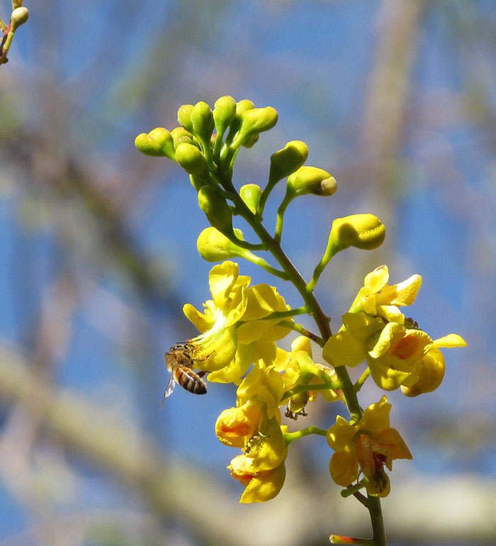
This Meeting and the World
In trying to find this group, I discovered just how few of these meetings are in OC.
It’s shocking how little interest there is in the topic of origins, especially in Christian circles.
We have the answers to how and why we are here.
The secular world is wrong!
We need to get ourselves out there and advertise!

Slide 26
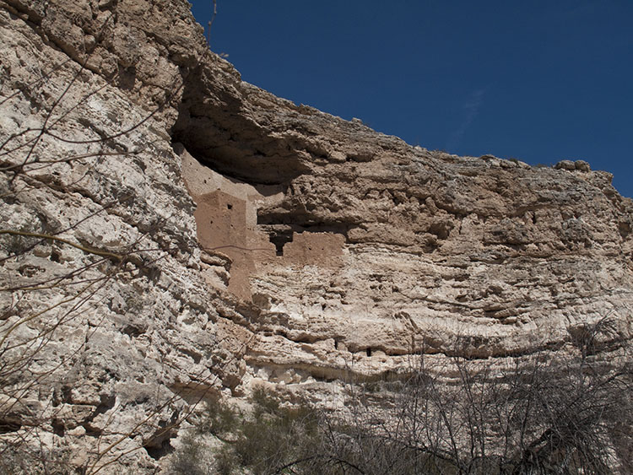
From Noah To Hercules . com
Tonight’s talk will be slightly different than my book, but the same conclusion:
Mythology supports the Biblical record and a young (six thousand year old) Earth!

Slide 27
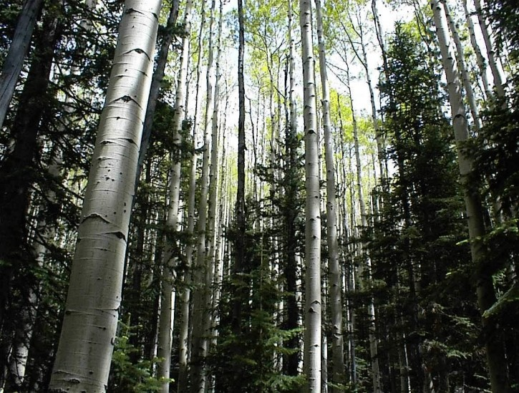
Outline
Science
Paganism
Jewish History
Conclusion

Slide 28
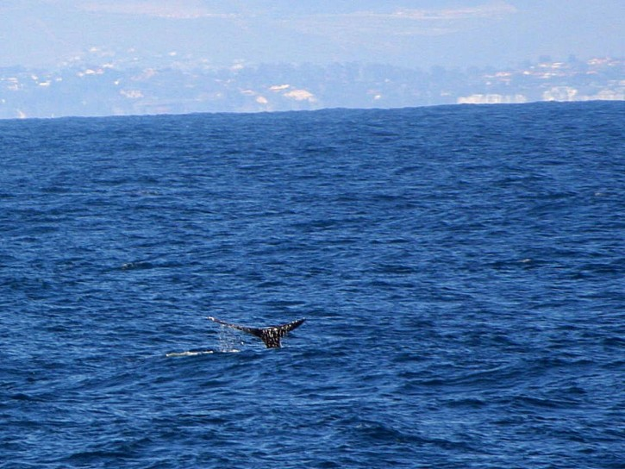
SCIENCE
Flowing water is powerful.
Dump a bucket of water on the ground, and you’ll have trenches.
Imagine dumping the ocean on the ground.

Slide 29


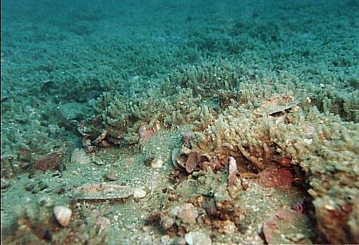
The Sea Floor

Slide 30
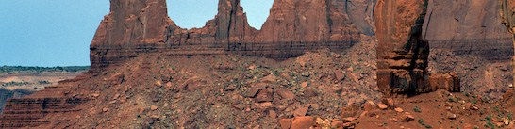
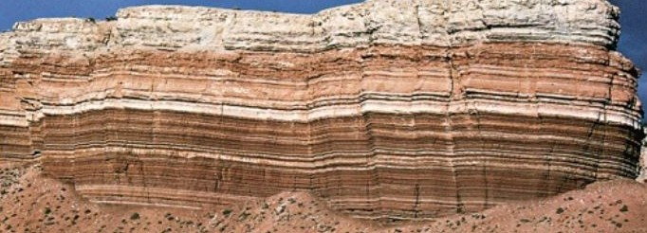
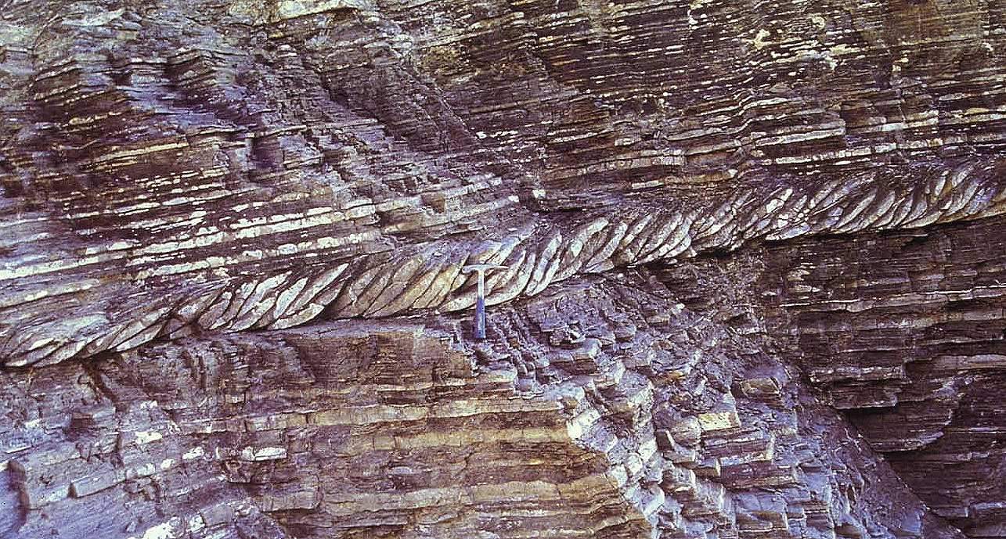
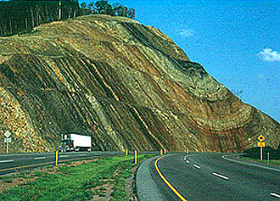
The Layers
There are no gopher holes, stream beds, or tree roots as you would expect over vast periods of time.

Slide 31
Power, Not Time

Slide 32
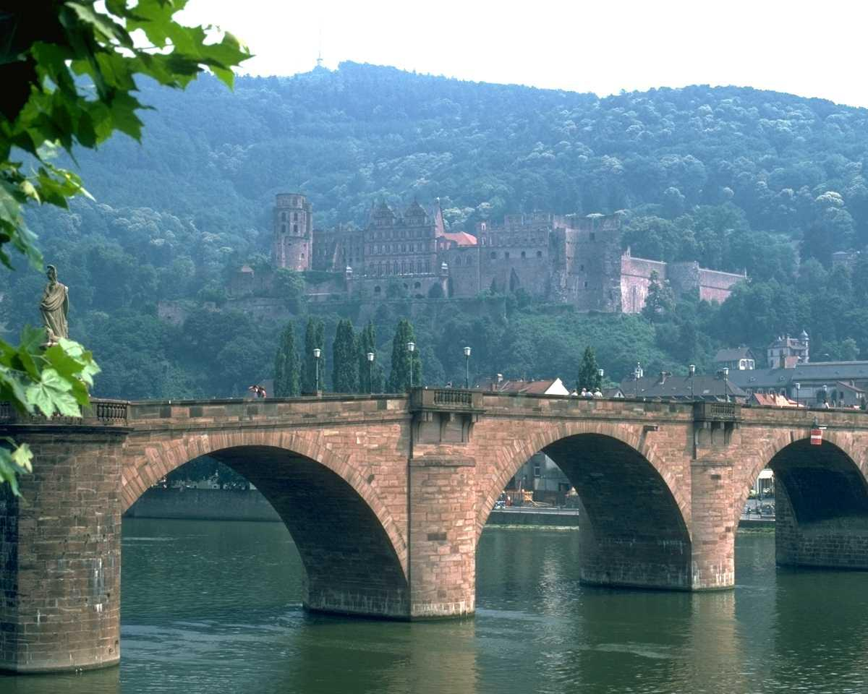

Lamarckism
Lamarck said that physical changes in the parents would be passed to the offspring.
Moles became blind from living underground,
Giraffes grew longer necks by reaching for higher branches.
Lamarckism has been falsified in science!
Source: http://www.creationism.org/books/TaylorInMindsMen/TaylorIMMb02.htm

Slide 33
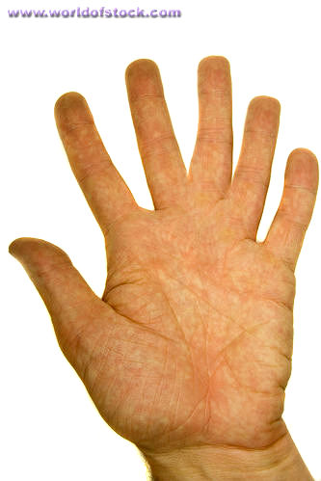
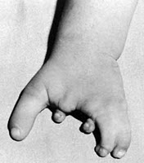
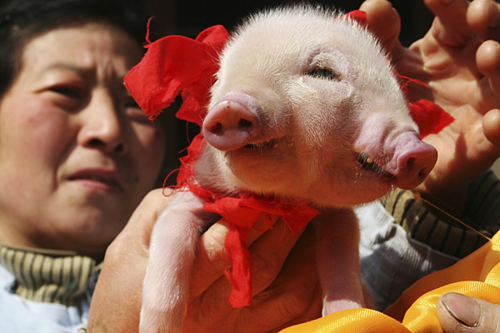
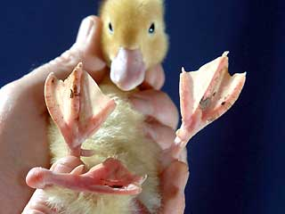
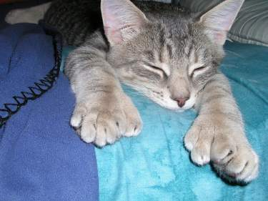
Another Mechanism?
Mutations, natural selection, and time.
Mutations invoke pity.
Mutations are not conducive to sexual reproduction.
Mutations are harmful.
http://www.nature.com/nature/journal/vaop/ncurrent/full/nature09352.html
Mutations are the official mechanism for evolution, but evolutionists still speak as though traits are developed by environmental pressures. Lamarckism is still the emotional support for the theory of evolution.
http://www.telegraph.co.uk/news/worldnews/1576177/Two-snouted-three-eyed-piglet-born-in-China.html
http://www.answersingenesis.org/articles/2011/02/26/news-to-note-02262011#one

Slide 34
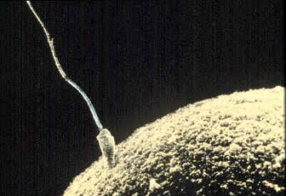
An argument against Theistic Evolution
- Sexual Reproduction -
Meiosis – divided cells have half the chromosomes as the parent cell – this happens only in sexual reproduction
Why would a cell do that? What a coincidence!
Why would a mammal mother grow breasts, and how would the mammal baby know how to use them?
Even if God sparked the life of the first cell, this is one of many major changes where God has to intervene again.
http://www.scienceagainstevolution.org/v8i5f.htm
http://www.scienceagainstevolution.org/v7i5f.htm

Slide 35

History, too, has something to say about catastrophe and genetic traits
But you will have to read my book for that.

Slide 36
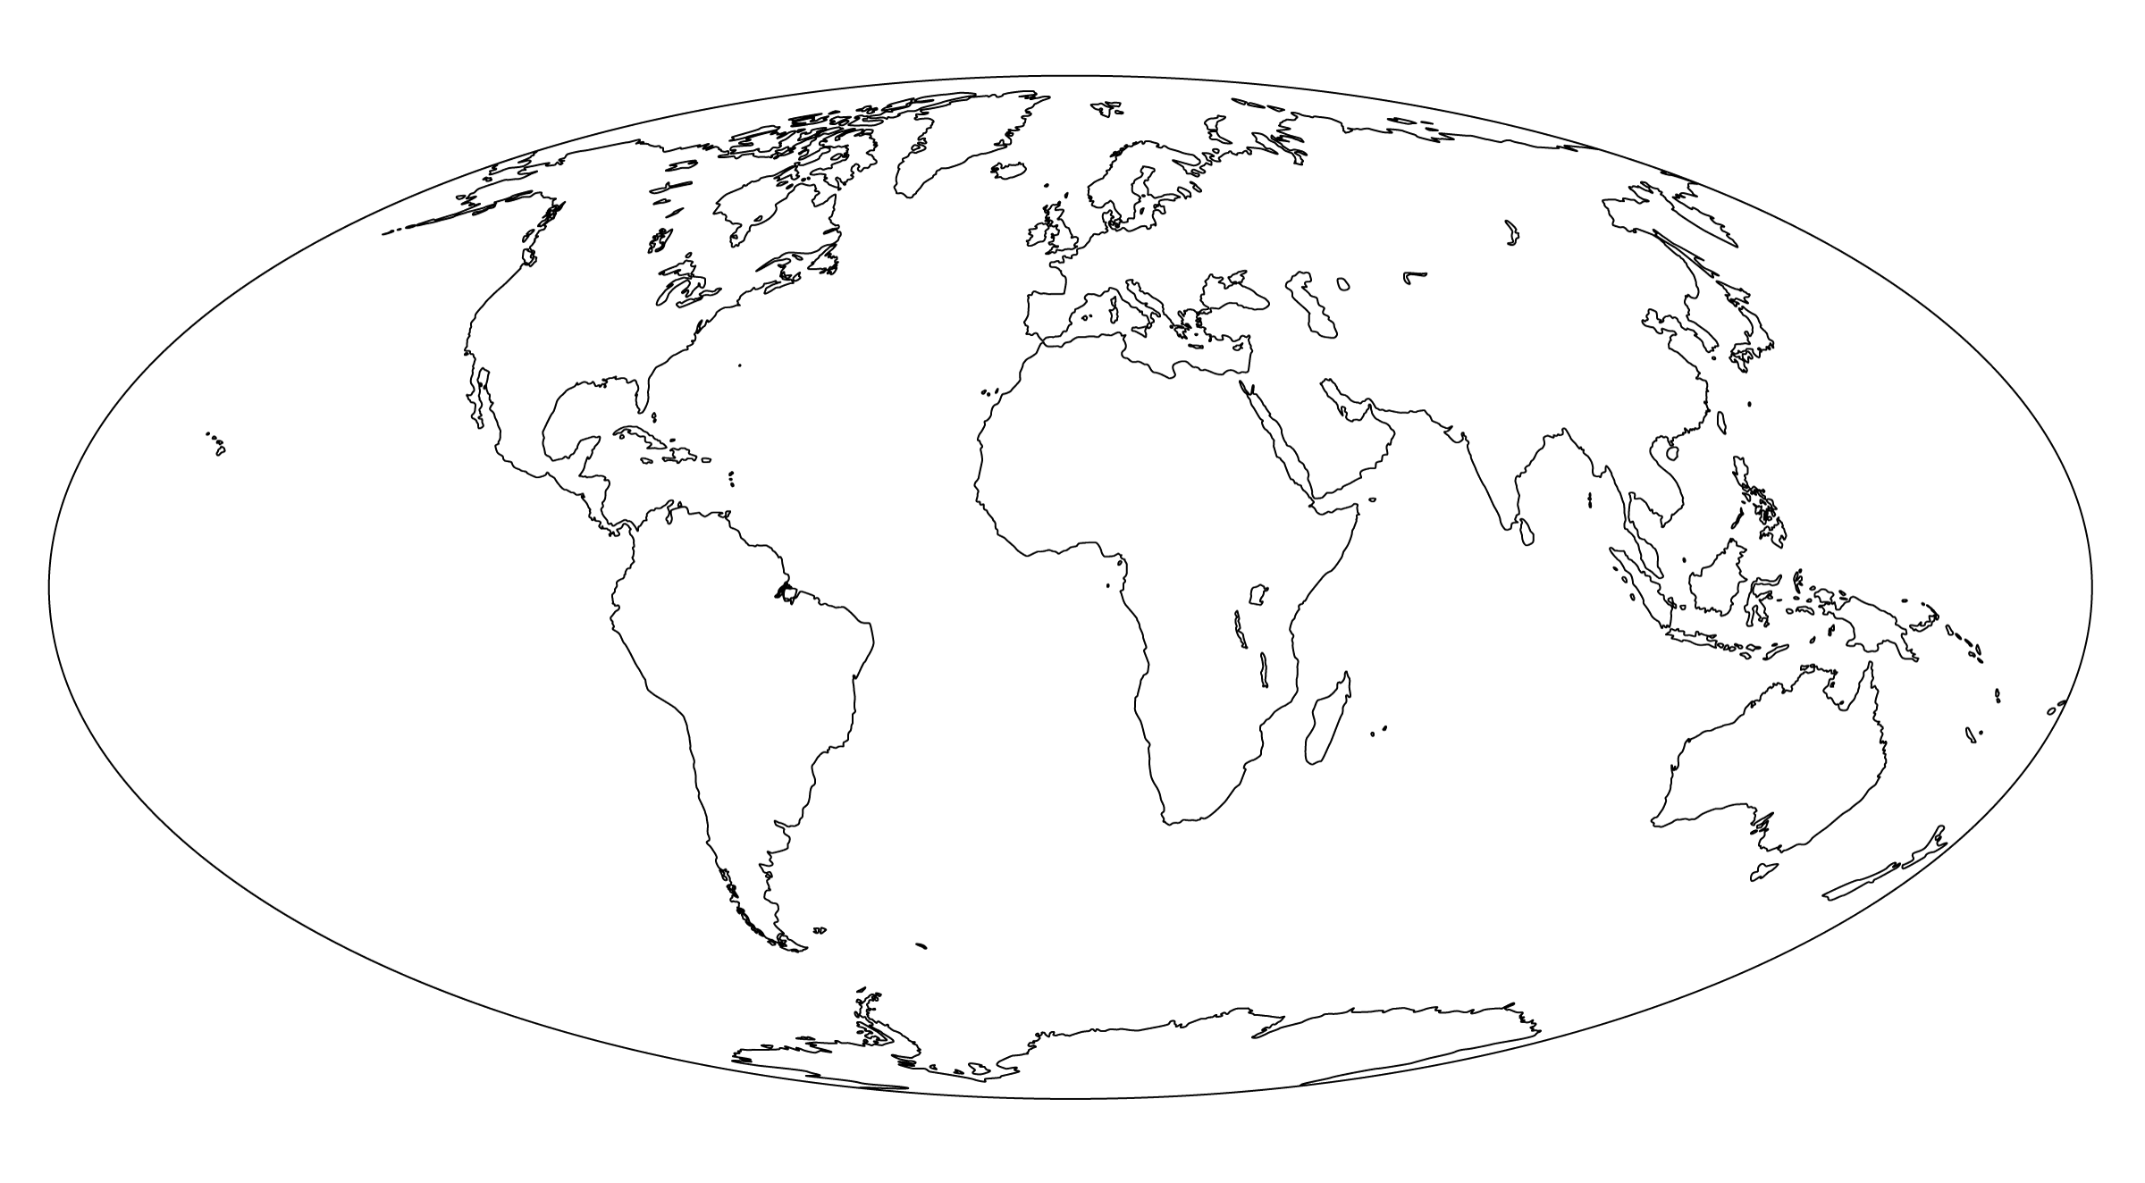
Paganism is Everywhere!
http://www.lowchensaustralia.com/names/gods.htm

Slide 37

From Greece

Slide 38
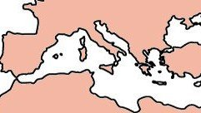
To Rome

Slide 39
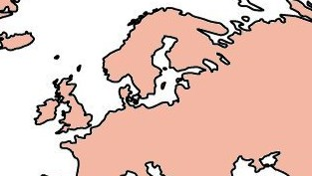
Germanic gods

Slide 40
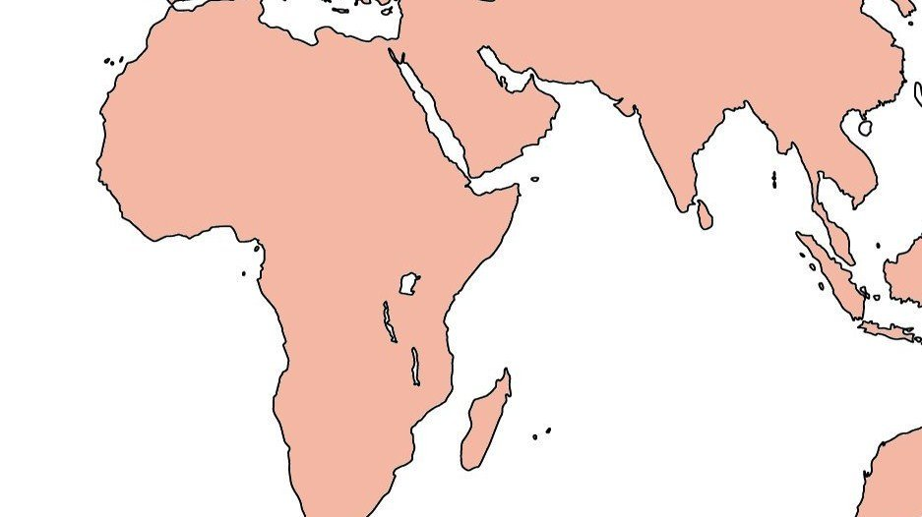
Africa

Slide 41
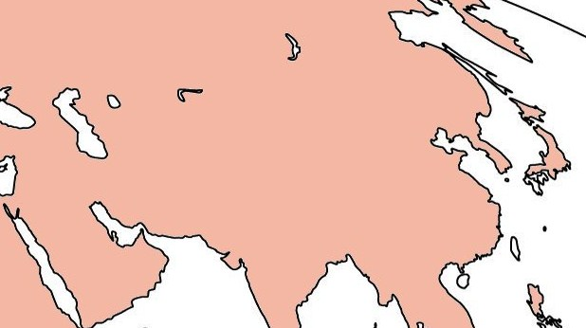
Asia

Slide 42
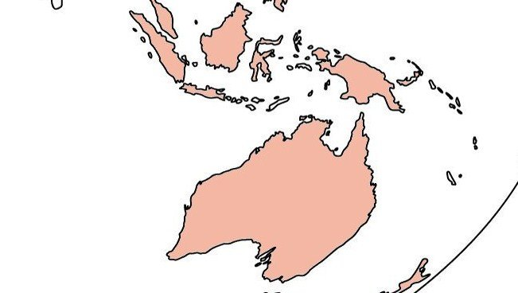
Australia

Slide 43
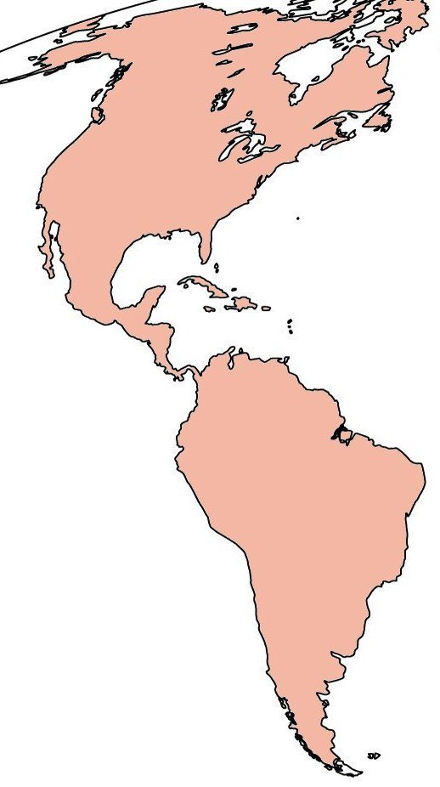
Americas

Slide 44
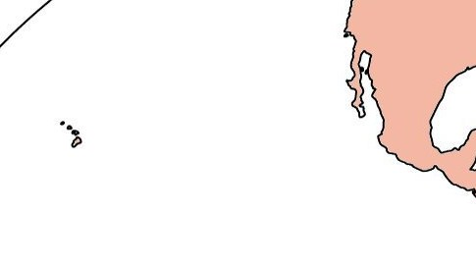
Even Hawaii

Slide 45
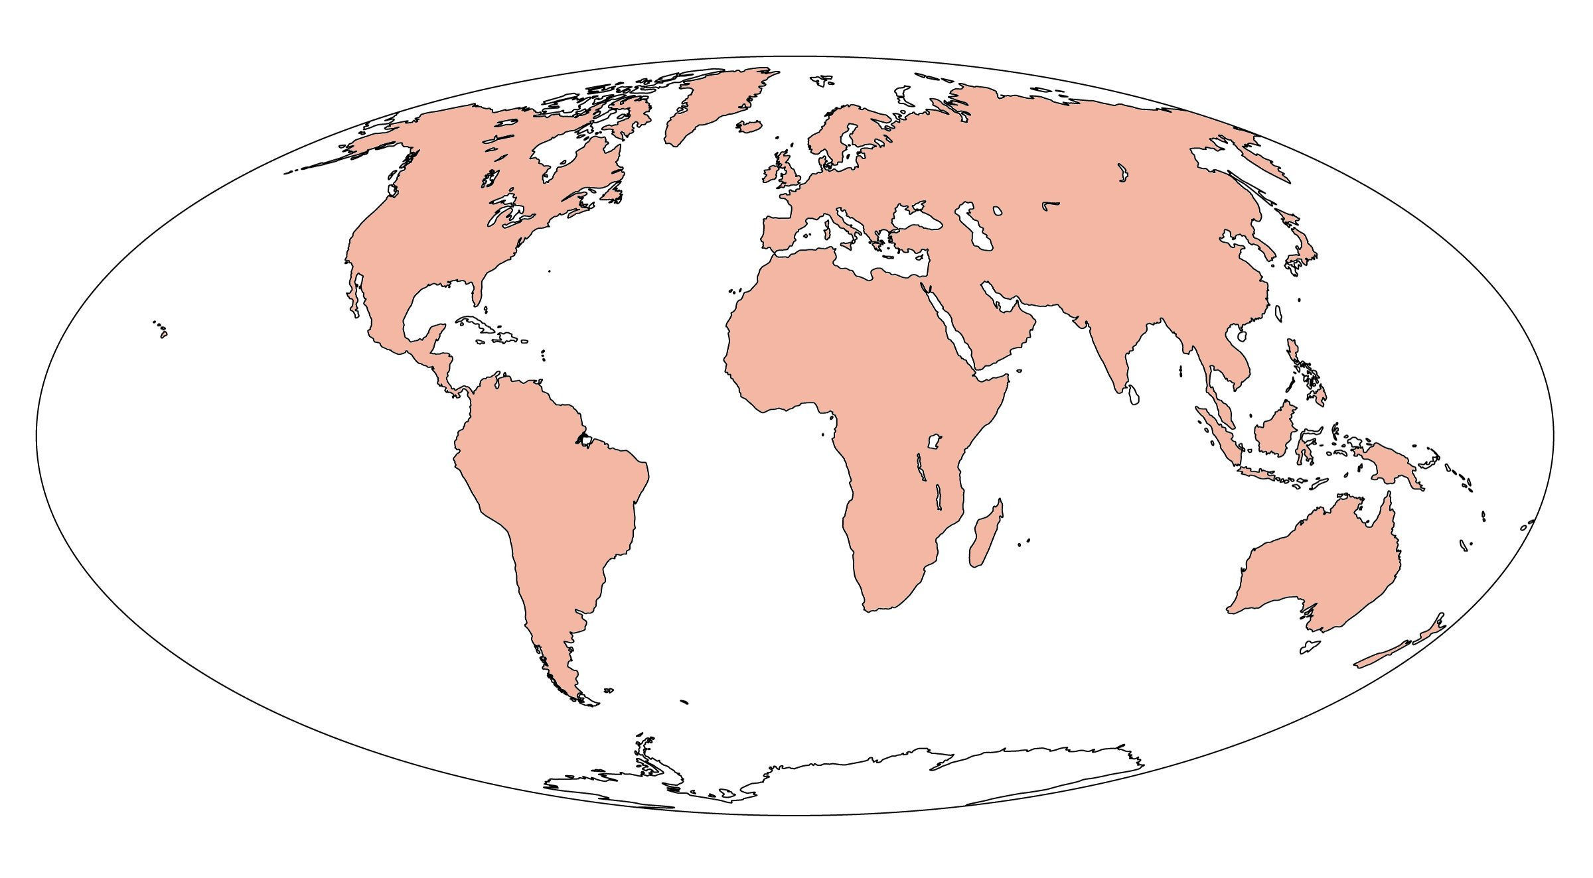
Everywhere!
http://www.lowchensaustralia.com/names/gods.htm

Slide 46

Why?

Slide 47
I’m not going to tell you.

Slide 48
Just kidding.

Slide 49
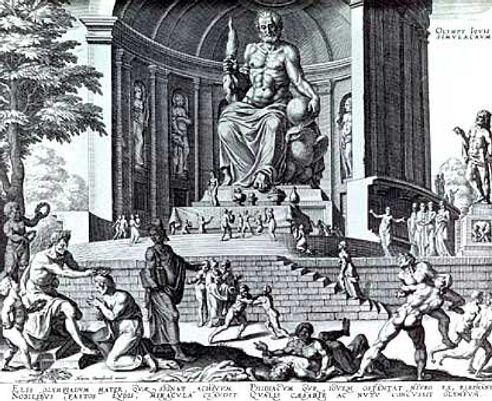
Similarities in Paganism
Polytheistic (many gods)
The gods have stories of their birth and how they came to power
The gods are often personifications of human abilities or things in nature
This is especially true of gods throughout the Mediterranean. We have lists that link the god of one region to a god of another region. Often, the only noticeable variation is the name

Slide 50
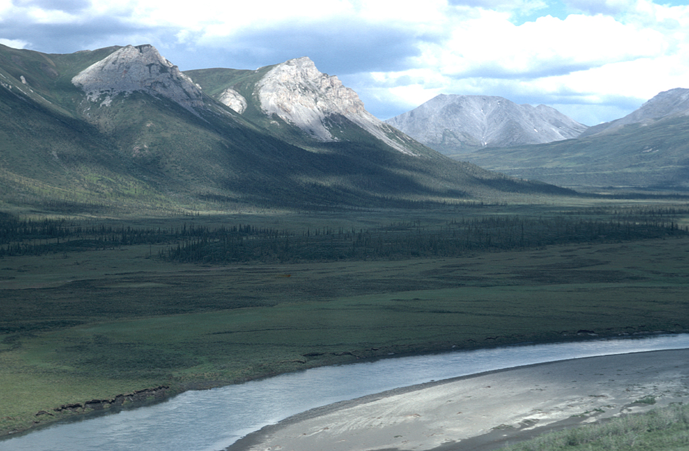
DAYS OF THE WEEK
An example of gods across language barriers is seen in the days of the week.
The week is almost always 7 days.
It almost always corresponds to 7 gods.

Slide 51
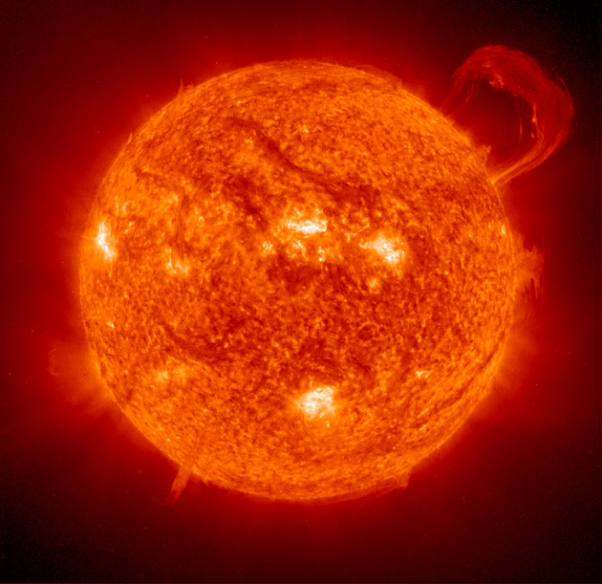
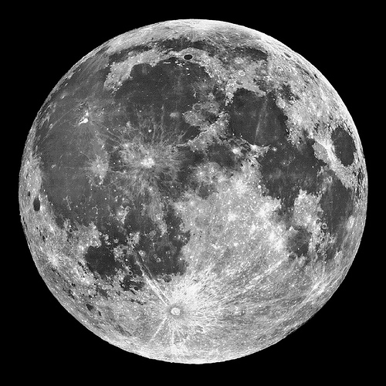
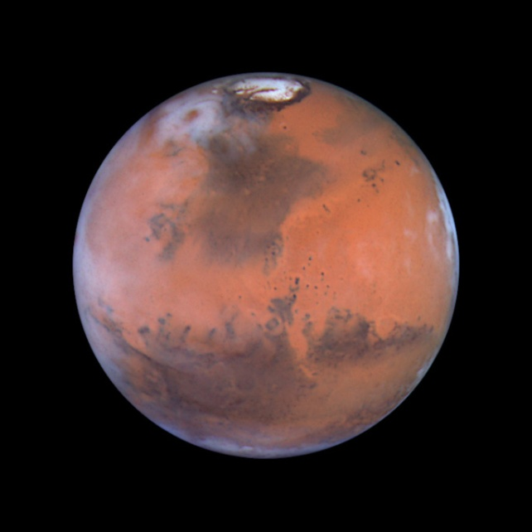
SUNDAY
MONDAY
TUESDAY
Sun's day
Latin: Solis
(Apollo)
Many languages changed to “Lord’s day”
Moon's day
Latin: Lūnae
(Diana)
Many languages
use “After Sunday”
Teiws's day
Latin: Mars
Tiw (or Týr) was the Norse god of War

Slide 52
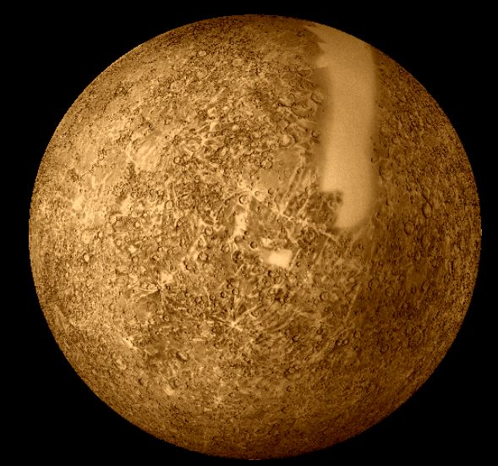
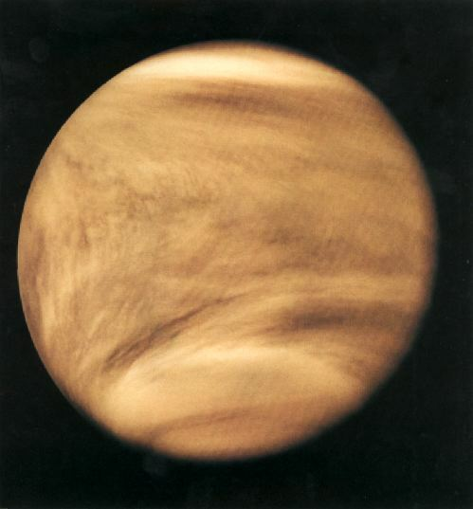
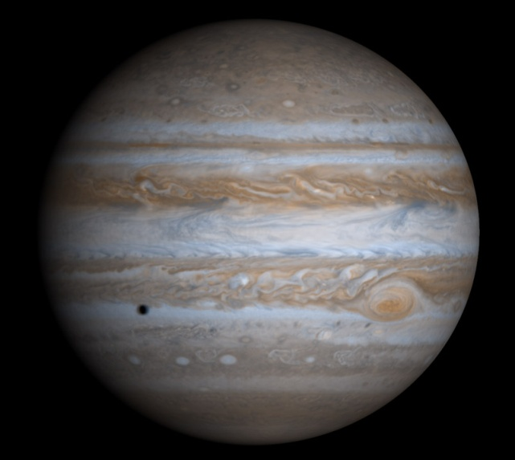
WEDNESDAY
THURSDAY
FRIDAY
Wōden’s day
Latin: Mercury
Odin (Norse)
Some languages use “mid-week”
Thor's day
Latin: Jupiter
Thunor is the god of thunder
Frige's day
Latin: Venus
An important Germanic goddess

Slide 53
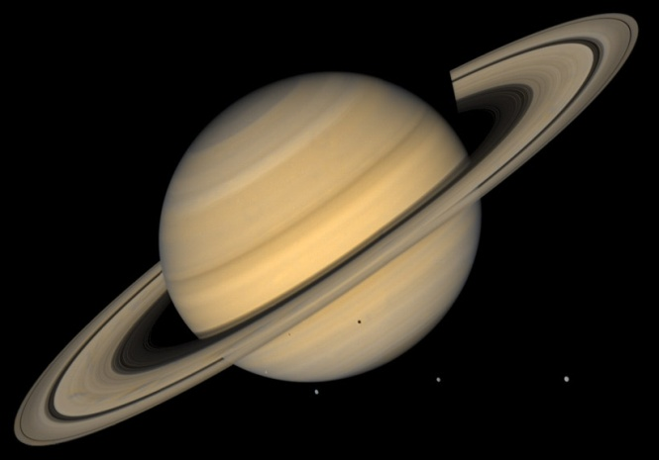
Saturday
Days of the month: Lunar cycle
Days of the year: Solar cycle
Why do most cultures have a seven day week?
Hindus have a seven day week
If the names were borrowed, why was Saturday the only name that came from Latin?
“…many royal families claimed descent from Odin…”
(Wodan - Wednesday)
Saturn’s day
Latin: Saturn
Many languages use “Sabbath”
(The Roman name is used)
Source: http://en.wikipedia.org/wiki/Week-day_names and elsewhere

Slide 54
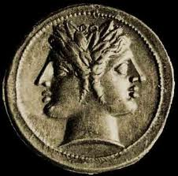

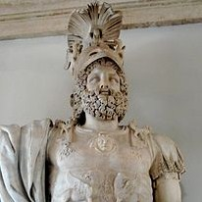
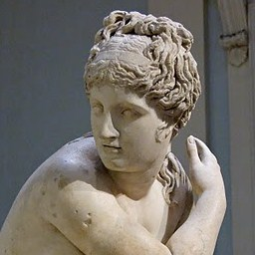
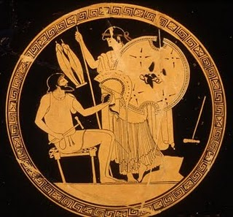
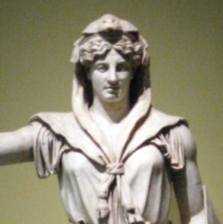
JULIAN CALENDAR
JANUARY
FEBRUARY
MARCH
Janus's month
Month of purification
Mars's month
APRIL
MAY
JUNE
Aphrodite's month
Maia's month
Juno's month

Slide 55
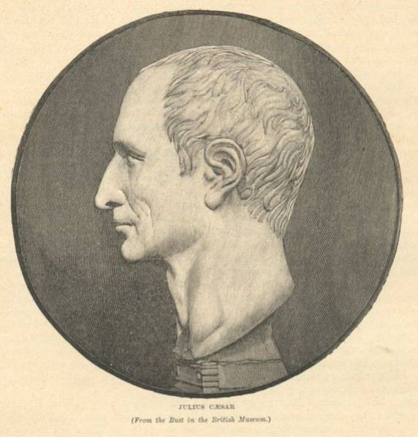





JULIAN CALENDAR
JULY
AUGUST
SEPTEMBER
Julius's month
Augustus’s month
Seventh month
OCTOBER
NOVEMBER
DECEMBER
Eigthth month
Ninth month
Tenth month

Slide 56
How we got our calendar
The original Roman year had 10 named months Martius …, and probably two unnamed months in the dead of winter…
The year began with Martius "March".
Numa Pompilius, the second king of Rome circa 700 BC, added … "January" and … "February".
After Februarius there was occasionally an additional month of Intercalaris "intercalendar". This is the origin of the leap-year day being in February.
In 46 BC, Julius Caesar reformed the Roman calendar...
…he renamed [July] after himself…
…Augustus Caesar ... completed the calendar ... he also renamed August after himself…
Source: http://www.crowl.org/Lawrence/time/months.html
Isaac Newton: http://www.newtonproject.sussex.ac.uk/catalogue/record/THEM00067

Slide 57

There are hundreds of examples where paganism remained in our language
Ocean – from the Titan god Oceanus
Atlantic – of Atlas, who holds the heavens
Europe – Europa was a wife of Zeus
Erotic – Eros was the god of romance
Hero – akin to Hera (protector), Heracles (the hero)
Hell – Hel was the Norse goddess of the dead
Saga – goddess of poetry
Fate – Greek goddesses who cut life strings

Slide 58
There are similarities between the gods of different cultures in traits, abilities, lineage, and name
GREEK
ROMAN
NORSE
Zeus
Cronus
Hera
Eros (m)
Apollo
Poseidon
Moirae (3 fates)
Jupiter / Jove
Saturn
Juno
Cupid (m)
Apollo
Neptune
Parcae (3 fates)
Thor or Odin
Tyr
Sif and Frigga
Freyja (f)
Dagur and Sol
Njörðr
Norns (3 fates)
There are also big differences

Slide 59

.
The relationships that can be drawn between the Greek and Roman myths can also be drawn for Egyptian and Babylonian myths.
The further you go from the Mediterranean, the more differences in the mythology.
No matter how far you go, there is
always some form of mythology
everywhere.
Isaac Newton: http://www.newtonproject.sussex.ac.uk/view/texts/normalized/THEM00098

Slide 60

A question on similarities
If the gods in one culture were borrowed from and older culture, why didn’t they retain the name, as is evident in “Saturn’s day” (Roman to Norse), Apollo (Greek to Roman), and Hercules (Roman) vs. Heracles (Greek)?
It seems clear to me that the myths existed before the languages diverged.
I’m not the only one who sees this.

Slide 61

It used to be customary to account for the similarities manifested by the various mother goddesses by assuming that there was constant cultural contact between separate nationalities, and, as a result, a not inconsiderable amount of "religious borrowing". Greece was supposed to have received its great goddesses from the western Semites, who had come under the spell of Babylonian religion. Archæological evidence, however, tends to disprove this theory. "The most recent researches into Mesopotamian history", writes Dr. Farnell, "establish with certainty the conclusion that there was no direct political contact possible between the powers in the valley of the Euphrates and the western shores of the Ægean in the second millennium B.C. In fact, between the nascent Hellas [Greece] and the great world of Mesopotamia [Babylon] there were powerful and possibly independent strata of cultures interposing.”
Source: http://www.sacred-texts.com/ane/mba/mba11.htm

Slide 62

Flood stories
Nations close to Israel had stories pretty similar to the Biblical account
Assyrian:
The gods, led by Enlil, agreed to cleanse the earth of an overpopulated humanity, but Utnapishtim was warned by the god Ea in a dream. He and some craftsmen built a large boat (one acre in area, seven decks) in a week. He then loaded it with his family, the craftsmen, and "the seed of all living creatures." The waters of the abyss rose up, and it stormed for six days. Even the gods were frightened by the flood's fury. Upon seeing all the people killed, the gods repented and wept. The waters covered everything but the top of the mountain Nisur, where the boat landed. Seven days later, Utnapishtim released a dove, but it returned finding nowhere else to land. He next returned a sparrow, which also returned, and then a raven, which did not return. Thus he knew the waters had receded enough for the people to emerge. Utnapishtim made a sacrifice to the gods. He and his wife were given immortality and lived at the end of the earth.
http://www.talkorigins.org/faqs/flood-myths.html

Slide 63
Flood stories
Some nations nearer to Israel had stories that were vastly different.
Lithuanian (Near Russia & Sweden):
From his heavenly window, the supreme god Pramzimas saw nothing but war and injustice among mankind. He sent two giants, Wandu and Wejas (water and wind), to destroy earth. After twenty days and nights, little was left. Pramzimas looked to see the progress. He happened to be eating nuts at the time, and he threw down the shells. One happened to land on the peak of the tallest mountain, where some people and animals had sought refuge. Everybody climbed in and survived the flood floating in the nutshell. God's wrath abated, he ordered the wind and water to abate. The people dispersed, except for one elderly couple who stayed where they landed. To comfort them, God sent the rainbow and advised them to jump over the bones of the earth nine times. They did so, and up sprang nine other couples, from which the nine Lithuanian tribes descended.
http://www.talkorigins.org/faqs/flood-myths.html

Slide 64
Flood stories
Even into Africa, they kept some key details.
Masai (East Africa):
Tumbainot, a righteous man, had a wife named Naipande and three sons, Oshomo, Bartimaro, and Barmao. When his brother Lengerni died, Tumbainot, according to custom, married the widow Nahaba-logunja, who bore him three more sons, but they argued about her refusal to give him a drink of milk in the evening, and she set up her own homestead. The world was heavily populated in those days, but the people were sinful and not mindful of God. However, they refrained from murder, until at last a man named Nambija hit another named Suage on the head. At this, God resolved to destroy mankind, except Tumbainot found grace in His eyes. God commanded Tumbainot to build an ark of wood and enter it with his two wives, six sons and their wives, and some of animals of every sort. When they were all aboard and provisioned, God caused a great long rain which caused a flood, and all other men and beasts drowned. The ark drifted for a long time, and provisions began to run low. The rain finally stopped, and Tumbainot let loose a dove to ascertain the state of the flood. The dove returned tired, so Tumbainot knew it had found no place to rest. Several days later, he loosed a vulture, but first he attached an arrow to one of its tail feathers so that, if the bird landed, the arrow would hook on something and be lost. The vulture returned that evening without the arrow, so Tumbainot reasoned that it must have landed on carrion, and that the flood was receding. When the water ran away, the ark grounded on the steppe, and its occupants disembarked. Tumbainot saw four rainbows, one in each quarter of the sky, signifying that God's wrath was over.
http://www.talkorigins.org/faqs/flood-myths.html

Slide 65
Flood stories
Some details that were not in the Bible might have been true.
Benua-Jakun (Malay Peninsula):
The ground we stand on is merely a skin covering an abyss of water. Long ago, Pirman, the deity, broke up this skin, flooding and destroying the world. However, Pirman had created a man and woman and placed them in a completely closed ship of pulai wood. When at last this ship came to rest, the couple nibbled their way out through its side, and they saw land stretching to the horizon in all directions. The sun had not yet been created, so it was dark; when it grew light, they saw seven small rhododendron shrubs and seven clumps of sambau grass. The couple bemoaned their lack of children, but in time the woman conceived in the calves of her legs, a male child coming from the right calf and a female from the left. That is why offspring from the same womb may not marry. All mankind are descended from that first pair.
http://www.talkorigins.org/faqs/flood-myths.html

Slide 66
Flood stories
Whispers of Babel and Eden
Tlingit (southern Alaska coast):
People were saved from a universal deluge in a giant ark. The ark struck a rock and split in two. The Tlingits were in one half of the ark, and all other people were in the other half. This explains why there is a diversity of languages.
Salinan (California):
The old woman of the sea, jealous of Eagle's power, came with her basket in which she carried the sea. She continually poured out water until it covered the land, almost to the top of Santa Lucia Peak where the animals gathered. Eagle borrowed Puma's whiskers, made a lariat from them, and lassoed the basket. The sea stopped rising, and the old woman died. Eagle told Dove to fetch up some mud, and he made the world from it. Eagle shaped the first people, a woman and two men, from elder-wood. After sweating in a sweat-house, he blew on them and gave them life. Then they had a great fiesta.
http://www.talkorigins.org/faqs/flood-myths.html

Slide 67
They carried more than Flood stories!
From Greece
Cronus learned from Gaia and Uranus that he was destined to be overcome by his own son, just as he had overthrown his father. As a result, although he sired the gods …, he devoured them all as soon as they were born, to preempt the prophecy. … Rhea sought Gaia to devise a plan to save them and to eventually get retribution on Cronus for his acts against his father and children. … Rhea secretly gave birth to Zeus in Crete, and handed Cronus a stone wrapped in swaddling clothes … which he promptly swallowed, thinking that it was his son.
http://en.wikipedia.org/wiki/Cronus

Slide 68
They carried more than Flood stories!
Tlingit (southern Alaska coast):
Yehl's wicked uncle had a young wife whom he was very fond and jealous of. He did not want any of his nephews to inherit his widow when he died, as Tlingit law dictates should happen, so he murdered each of Yehl's ten older brothers by drowning them or, according to some, by stretching them on a board and beheading them. When Yehl grew to manhood, his uncle tried to do the same to him. But Yehl's mother had conceived him by swallowing a round pebble she had found at low tide, and with another stone she had rendered him invulnerable. When the uncle tried to behead Yehl, his knife had no effect. In a rage, the uncle called for a flood, and a flood came and covered all the mountains.
http://www.talkorigins.org/faqs/flood-myths.html

Slide 69

We have established that:
Paganism was everywhere in
early history
The names of the pagan gods
were different, though their
character traits were the same
Many of the stories from Genesis and
other pagan myths were carried across
the globe

Slide 70

What makes Judaism so special?

Slide 71

Judaism
There are many reasons I give in my book of why I’d pick Judaism over other pagan sources
I will claim only one reason in this speech:
The Jewish record is the most detailed.

Slide 72


Jasher
I’m going to assume everyone here has read Genesis. (I bet most here have read commentaries on the smallest details of Genesis.)
I think Jasher is interesting, so I’m going to use it as a substitute for Genesis.
Genesis > Jasher

Slide 73

Jasher
Jasher recounts history from Adam to Moses
The origin of the book of Jasher isn’t certain
There aren’t any ancient manuscripts (1625)
Jasher means, “The book of the Upright”
Jasher is cited in Josh. 10:13 and 2 Sa. 1:18
2 Ti. 3:8 refers to Jannes and Jambres, who are not mentioned in the OT. They are in Jasher.
Jasher is NOT as reliable as the Bible, but is probably more reliable than pagan mythology.
Feel free to feel skeptical!
http://nazarenespace.ning.com/profiles/blog/show?id=2182335%3ABlogPost%3A95965&xgs=1&xg_source=msg_share_post&page=1#comments
http://nazarenespace.ning.com/group/thenewtestamentcanon/forum/topics/the-1625-book-of-jasher-is-not

Slide 74

Note the details of the Jewish record
Names are given for people without stories
2:16 And these are the names of the children of Cainan; the name of the first born Mahlallel, the second Enan, and the third Mered, and their sisters were Adah and Zillah; these are the five children of Cainan that were born to him.
3:13 And these are the generations of Enoch, Methuselah, Elisha, and Elimelech, three sons; and their sisters were Melca and Nahmah

Slide 75

Note the details of the Jewish record
Details that are not in Genesis, but are not contradictory.
1:12 Adam knew his wife Eve and she bore two sons and three daughters.
1:35-36 And at that time Cain also began to build a city: and he built the city and he called the name of the city Enoch, according to the name of his son; for in those days the Lord had given him rest upon the earth, and he did not move about and wander as in the beginning. And Irad was born to Enoch, and Irad begat Mechuyael and Mechuyael begat Methusael.

Slide 76

Note the details of the Jewish record
Though surreal, the numbers are consistent
4:11 And Lamech was one hundred and eighty years old when he took Ashmua, the daughter of Elishaa the son of Enoch his uncle, and she conceived.
5:1-6 And it was in the eighty-fourth year of the life of Noah, that Enoch the son of Seth died, he was nine hundred and five years old at his death. And in the one hundred and seventy ninth year of the life of Noah, Cainan the son of Enosh died, and all the days of Cainan were nine hundred and ten years, and he died. And in the two hundred and thirty fourth year of the life of Noah, Mahlallel the son of Cainan died, and the days of Mahlallel were eight hundred and ninety-five years, and he died. And Jared the son of Mahlallel died in those days, in the three hundred and thirty-sixth year of the life of Noah; and all the days of Jared were nine hundred and sixty-two years, and he died. And all who followed the Lord died in those days, before they saw the evil which God declared to do upon earth. And after the lapse of many years, in the four hundred and eightieth year of the life of Noah, when all those men, who followed the Lord had died away from amongst the sons of men, and only Methuselah was then left

Slide 77

Note the details of the Jewish record
There are logically consistent motives
5:11 And the Lord granted them a period of one hundred and twenty years, saying, If they will return, then will God repent of the evil, so as not to destroy the earth.
6:11 And on that day, the Lord caused the whole earth to shake, and the sun darkened, and the foundations of the world raged, and the whole earth was moved violently, and the lightning flashed, and the thunder roared, and all the fountains in the earth were broken up, such as was not known to the inhabitants before; and God did this mighty act, in order to terrify the sons of men, that there might be no more evil upon earth.

Slide 78

Note the details of the Jewish record
There are logically consistent motives
6:17 And the sons of men assembled together, about seven hundred thousand men and women, and they came unto Noah to the ark.
(note: they came to the ark to break into it, because the flood waters were scary)
There are a lot of little details about how the ark sat on the raging flood, and what Noah did in response.

Slide 79

Note the details of the Jewish record
There’s more detail all around
5:15 Noah went and took a wife, and he chose Naamah the daughter of Enoch, and she was five hundred and eighty years old.
5:35 Then Noah took the three daughters of Eliakim, son of Methuselah, for wives for his sons, as the Lord had commanded Noah.
7:9 And the sons of Tiras were Benib, Gera, Lupirion and Gilak; these are the sons of Japheth according to their families, and their numbers in those days were about four hundred and sixty men.
7:50 And Terah [Abram’s father] took a wife and her name was Amthelo the daughter of Cornebo

Slide 80

Note the details of the Jewish record
There were interactions you might not have suspected.
9:5 And when Abram came out from the cave, he went to Noah and his son Shem, and he remained with them to learn the instruction of the Lord and his ways, and no man knew where Abram was, and Abram served Noah and Shem his son for a long time.
(note: when you do the math, these dates work out. The relationships work out as well.)

Slide 81

Jasher Interpretation
If Jasher was written after Genesis, why does it have all the extra, irrelevant detail?
All the dates and relationships are consistent.
If it was written from oral tradition, why are there so many names and numbers?
It would make sense if something like this was a source text Moses used to compile Genesis.

Slide 82

“Outrageous” claims in the Jewish record
The flood:
This is in records across the globe
Incest:
This is also in other records (Zeus married his sister Hera, Cronus married his sister Rhea)
Long lives:
This is harder to show, but this is also in other records

Slide 83

Ages of Kings
(Egyptian - from Eusebius)
The total time, which the Egyptians assign to the gods and demi-gods and spirits is 24,900 lunar years - which is the equivalent of 2,206 solar years. If you compare this figure with the chronology of the Hebrews, you will find almost the same number of years. … According to the Hebrews, there were 2,242 years in all from Adam until the flood.
(note: many cultures have the same number of monarchs as the Hebrews from Creation to the Flood)

Slide 84
This quote from:
Travels of Noah into Europe
(Some say this source is unreliable)
This their goddess Isis … was at least four hundred and fifty years old, as she that was born in the first year of the reign of Semiramis queen of Babylon, and lived in the whole at the least six hundred and sixteen years, for she was living after the first destruction and desolation of Troy … as almost all writers have delivered in their opinions to the same purpose and effect.
(Were his sources unreliable?)

Slide 85
Ages of Ancestors
(From Josephus)
Now I have for witnesses to what I have said, all those that have written Antiquities, both among the Greeks and barbarians; for even Manetho, who wrote the Egyptian History, and Berosus, who collected the Chaldean Monuments, and Mochus, and Hestieus, and, besides these, Hieronymus the Egyptian, and those who composed the Phoenician History, agree to what I here say: Hesiod also, and Hecatseus, Hellanicus, and Acusilaus; and, besides these, Ephorus and Nicolaus relate that the ancients lived a thousand years. But as to these matters, let every one look upon them as he thinks fit.
[11 sources!]

Slide 86

Let’s put it all together!
How is paganism connected to Judaism?

Slide 87

Nations Were Named for Their Ancestors
“For it was hitherto in fashion for the eastern nations to deify the founders of their kingdoms.” ~ Isaac Newton
From Scripture:
Sons of Levi (Num. 3) Levites
Sons of Israel (Num. 26) Israelites
Sons of Canaan – Canaanites
Sons of Shem – Semite (Gen 10)
Eber – Hebrew (Gen 10)
Aram – Aramaic (Gen 10)
Moabites & Ammonites (Gen. 19)
From History:
Brutus (for Britain)
Egyptus (for Egypt)
Romulus (for Rome)
Hispalus (for Spain)
Ityopp'is (for Ethiopia)
Hellen (Hellas, a name for Greece)
Tros (for the Trojans and Troy)
Just about every ancient nation in history starts up at roughly the same time.
See also: Josephus, Antiquities, ch. 6
http://en.wikipedia.org/wiki/List_of_country_name_etymologies
http://www.attalus.org/translate/eusebius5.html
http://www.newtonproject.sussex.ac.uk/view/texts/normalized/THEM00098

Slide 88

Summary
Paganism was everywhere
Early man celebrated their early kings and ancestors by naming days and months after them.
There are similarities between gods of different cultures, the name often being the only discernable difference.
The flood account is in cultures everywhere.
The Jewish record is more detailed and more reliable than the other early histories.
The Jews were not the only culture to attribute long life to the ancestors.
We have the names of those who started the nations. Many of the nations revered their ancestors as gods.

Slide 89
Why isn’t this common knowledge?

Slide 90

And Abram asked his father, saying, “Father, tell me where is God who created heaven and earth, and all the sons of men upon earth, and who created thee and me.” And Terah answered his son Abram and said, “Behold those who created us are all with us in the house.” And Abram said to his father, “My lord, shew them to me I pray thee;” and Terah brought Abram into the chamber of the inner court, and Abram saw, and behold the whole room was full of gods of wood and stone, twelve great images and others less than they without number. And Terah said to his son, “Behold these are they which made all thou seest upon earth, and which created me and thee, and all mankind.” And Terah bowed down to his gods, and he then went away from them, and Abram, his son, went away with him. […] And Abram saw on the day when he was sitting amongst them, that they had no voice, no hearing, no motion, and not one of them could stretch forth his hand to eat. And Abram mocked them, and said, “Surely the savory meat that I prepared has not pleased them, or perhaps it was too little for them, and for that reason they would not eat;” […] and Abram sat before them all day, thinking perhaps they might eat. […] And in the evening of that day in that house Abram was clothed with the spirit of God. And he called out and said, “Wo unto my father and this wicked generation, whose hearts are all inclined to vanity, who serve these idols of wood and stone which can neither eat, smell, hear nor speak, who have mouths without speech, eyes without sight, ears without hearing, hands without feeling, and legs which cannot move; like them are those that made them and that trust in them.”

Slide 91
And when Abram saw all these things his anger was kindled against his father, and he hastened and took a hatchet in his hand, and came unto the chamber of the gods, and he broke all his father's gods. And when he had done breaking the images, he placed the hatchet in the hand of the great god which was there before them, and he went out; […] And when Terah saw this his anger was greatly kindled, and he hastened and went from the room to Abram. And he found Abram his son still sitting in the house; and he said to him, “What is this work thou hast done to my gods?” And Abram answered Terah his father and he said, “Not so my lord, for I brought savory meat before them, and when I came nigh to them with the meat that they might eat, they all at once stretched forth their hands to eat before the great one had put forth his hand to eat. And the large one saw their works that they did before him, and his anger was violently kindled against them, and he went and took the hatchet that was in the house and came to them and broke them all, and behold the hatchet is yet in his hand as thou seest.” […] and Terah said to Abram his son in his anger, “What is this tale that thou hast told? Thou speakest lies to me.” […] And Abram answered his father and said to him, “And how canst thou then serve these idols in whom there is no power to do any thing? Can those idols in which thou trustest deliver thee? Can they hear thy prayers when thou callest upon them? Can they deliver thee from the hands of thy enemies, or will they fight thy battles for thee against thy enemies, that thou shouldst serve wood and stone which can neither speak nor hear? […] And forget the Lord God who made heaven and earth? […] Did not our fathers in days of old sin in this matter, and the Lord God of the universe brought the waters of the flood upon them and destroyed the whole earth? […] Now therefore my father refrain from this, and bring not evil upon thy soul and the souls of thy household.” And Abram hastened and sprang from before his father, and took the hatchet from his father's largest idol, with which Abram broke it and ran away.

Slide 92

Moral of the story
It is clear to anyone who reads this record that Terah knew that his idols were useless. He chose to believe in them anyway.
Likewise, people who actually study the counter arguments to the theory of evolution can’t possibly believe in it. Yet, for whatever reason, they choose to believe in it anyway.
Many people actually decide to reject God. Many people decide to follow the people who reject God. Men are more wicked than good, and what truth our fathers knew is eventually lost to time, drowned out by the false.

Slide 93

We are sinful.
We are stupid.
We need a Shepherd.

Slide 94

Another fallacy
We already talked about an appeal to authority fallacy. There is another fallacy associated with this information. It is an “appeal to the populous.” They object, because most people believe it is false.

Slide 95

In questions of science, the authority of a thousand is not worth the humble reasoning of a single individual.
- Galileo Galilei

Slide 96

In the case of my evidence, and the evidence of this group in general, we should not appeal to the highly educated, or to the masses.
Put aside your prejudice and
look at the evidence itself.
Become the expert.
Convert the masses.

Slide 97

This presentation was different than my book. How?
This presentation:
Many people appeal to authority or popular opinion.
I used very little science.
There are traces of Paganism and flood stories in our culture and elsewhere (everywhere).
The Jewish record is detailed.
My book:
I deal with the nature of bias.
I elaborate on the most solid scientific data I’ve come across.
I quote pagan sources who claim that pagan gods are our deified ancestors, a Jewish and a Christian historian that add dates, names, and other details, thereby removing any doubt.
There is so much to history, I haven’t even begun to show just how often it confirms the Bible!
This is worthy of a lifetime of study.

Slide 98
Other resources
Bill Cooper, After the Flood & The Table of Nations
Arthur C. Custance, Noah's Three Sons
Eusebius, Cronicle
Josephus, Antiquities of the Jews
From Noah to Hercules . com
It would be impossible to get through even one of these resources and still believe in evolution, but when you put them together, you have a free, power pack of faith building materials.
Special thanks to thefingerworks.com for your amazing photos.

Slide 99
What History Tells Us About History
FromNoahtoHercules.com

