Slide 1
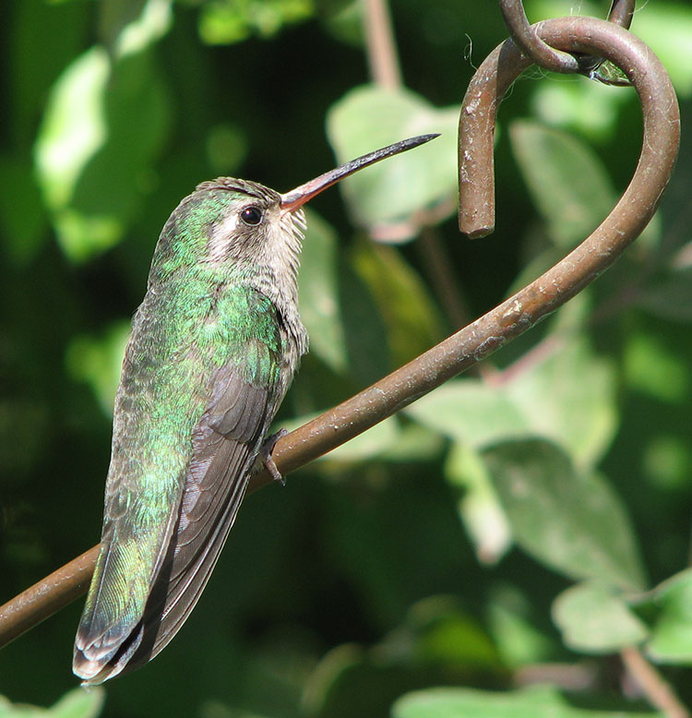
The Role of Bias In the Origins Debate
By Brian Forbes http://FromNoahtoHercules.com

Slide 2
Early in my adulthood, I had a friend from my church who went to my school; he and I were both committed young earth creationists.

Slide 3
We both liked to read. We both liked to learn.

Slide 4
He seemed to me to have a slight edge on his past reading. I valued his input as a scholar.

Slide 5
As we talked one day, he told me that educated Creationists made him mad, that they were liars. I listened in shock.

Slide 6
I still had a lot to learn.

Slide 7
The impression I had was that the more a man learned, the more he accepted evolution and rejected ancient superstitions.
It seemed to me that the claim that “all real scientists believe in evolution” was based in truth.

Slide 8
I had a nagging question in the back of my mind:
If most of the scientists 200 years ago were all Biblical Creationists, why did evolution take center stage in the modern academic world?

Slide 9
I knew that acceptance of the Theory of Evolution is also a rejection of the historical account of Adam and Eve. I knew that if I started cutting out the various accounts of scripture, it wouldn't be long before I doubted all of scripture.

Slide 10
I wasn't in a good place to doubt God, so I avoided the topic.

Slide 11
For years, I held the position that scripture might be true, but the evidence probably contradicted it.

Slide 12
During this time, however, I was praying. I was looking at the New Testament scriptures, especially the Gospels. I devoted myself to sermons and music that allowed me to worship my Maker. I was growing.

Slide 13
My unsure foundation became exposed in private conversations with my wife.
She began to pray for me.

Slide 14
My home group went to the ICR museum, (now the Creation & Earth History Museum) and a few of the questions I had were answered.

Slide 15
The next week, I really began to look into the science. The more I saw, the more I got excited about YEC.

Slide 16
After years of study, and trying to keep an open mind, I've settled into my position.
I find it highly doubtful that any atheist could ever convert me from my conviction that God is real and the Earth started a normal week before Adam was formed out of dirt.

Slide 17
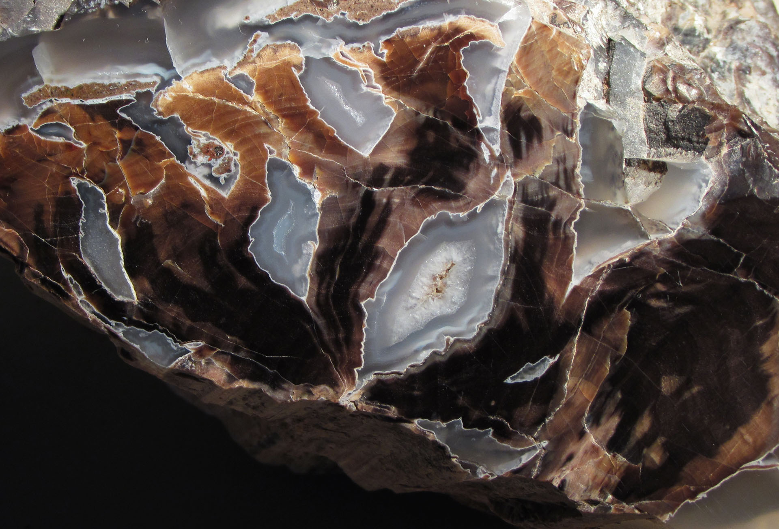
It may seem at first glance that I was convinced by the evidence. Although I think that is true in part, I do not think that is the entire story.

Slide 18
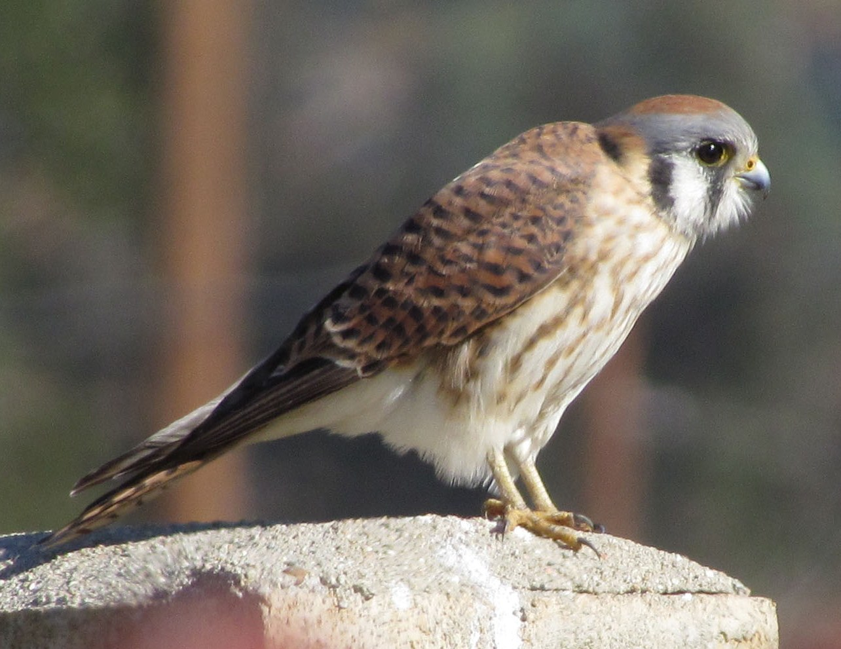
I do NOT aim to present here that the evidence is on the side of Creation.

Slide 19
It is, but that's beside the point.

Slide 20
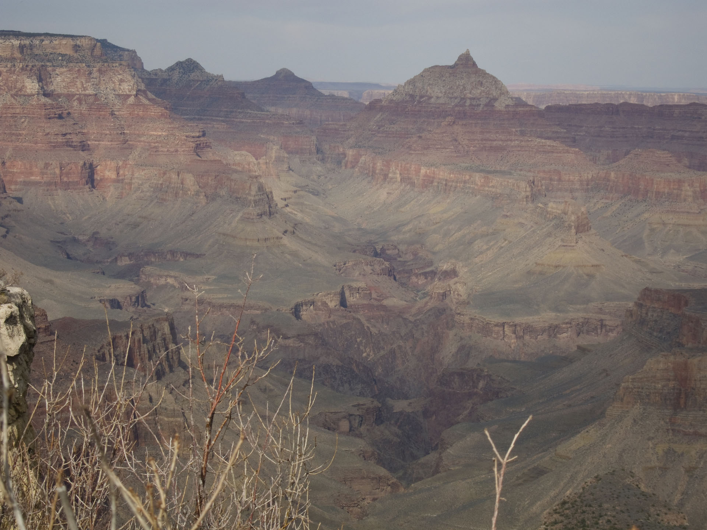
I aim to show that any evidence presented to us will invariably take a back seat to the fertility of the soil in our hearts.

Slide 21
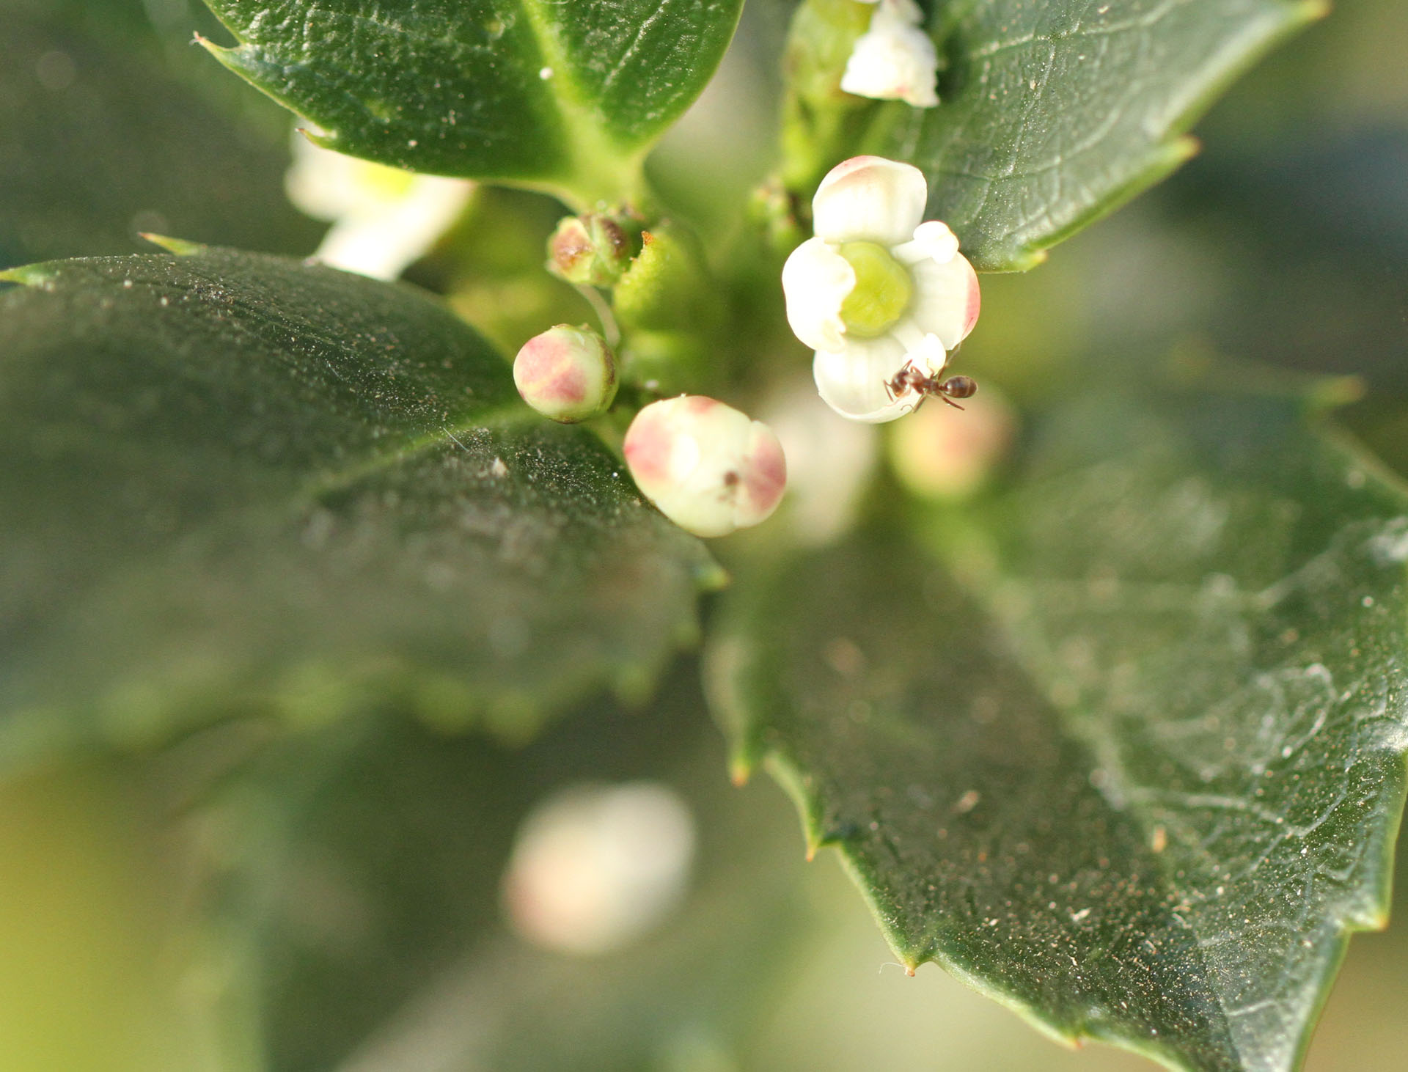
It is our bias that determines what we are able to see and accept for evidence.

Slide 22
Bias defined: An emotional inclination to a particular view.
Bias will often influence how you accept or reject evidence.

Slide 23
Any position that has allowed for human evaluation will include bias.

Slide 24
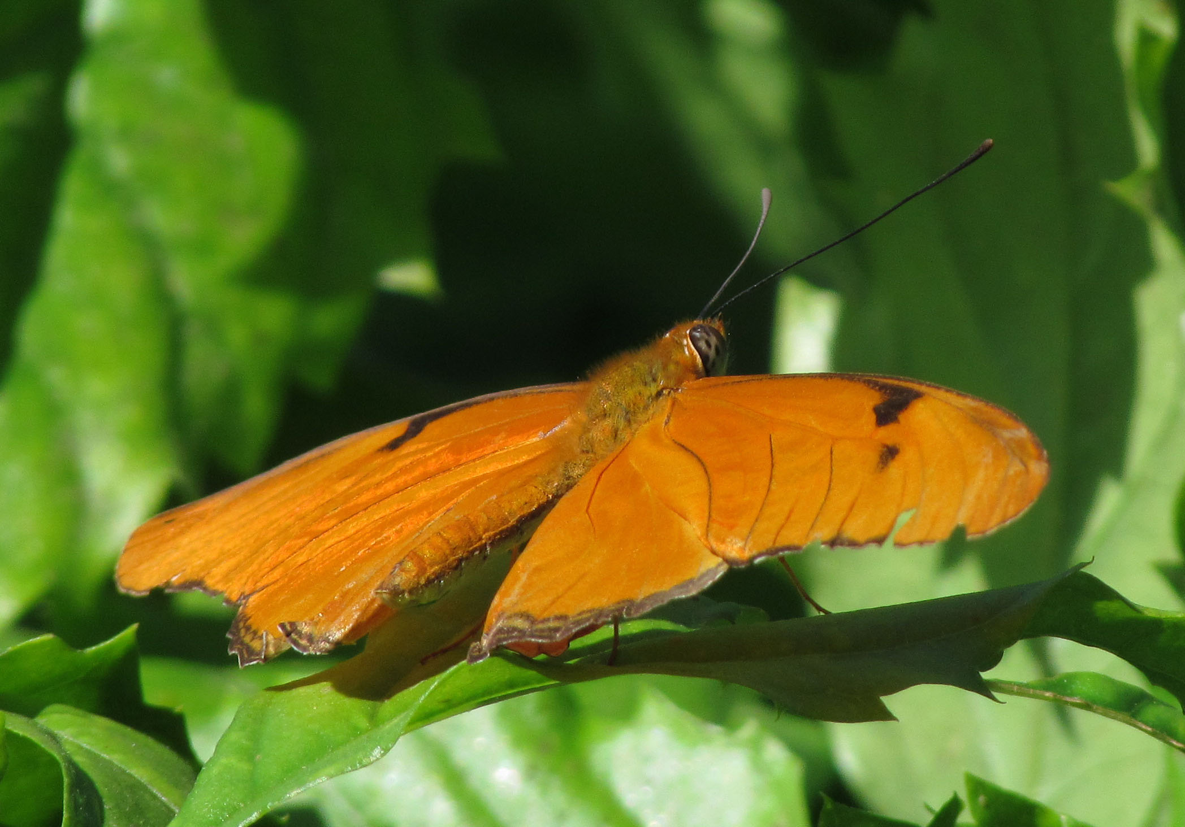
The question is not if there is bias.
The question is what does your bias support.
…and I can prove it.

Slide 25
The question is not if there is bias.
The question is what does your bias support.
…and I can prove it. (I think…)

Slide 26
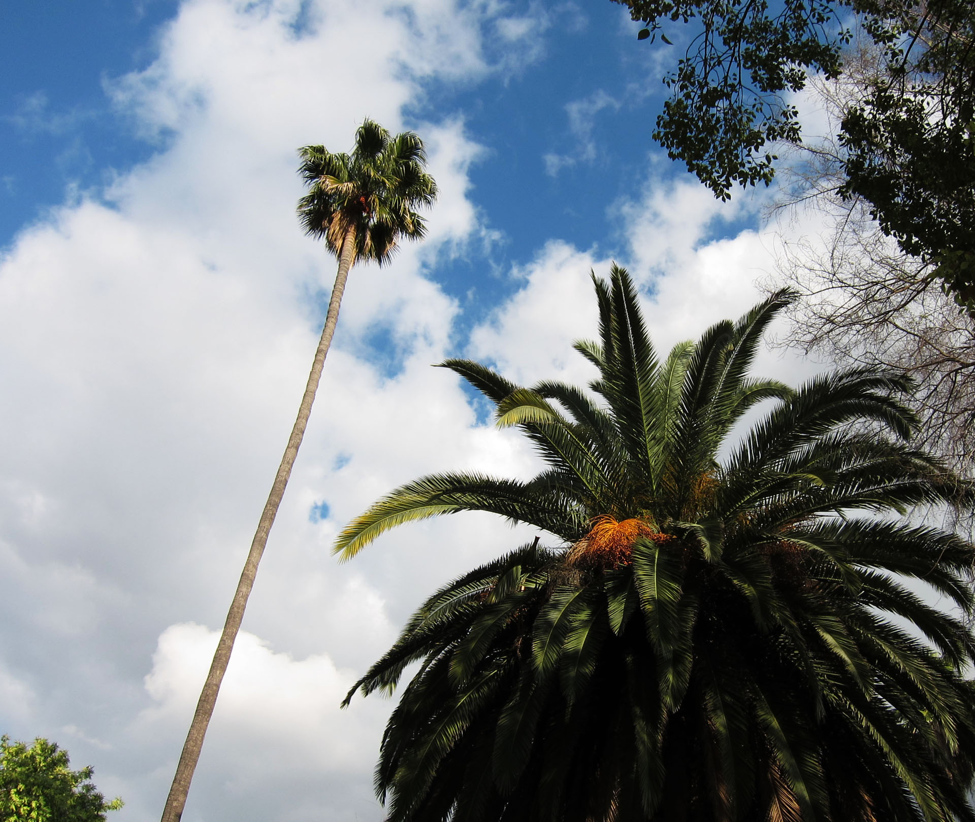
Science is supposed to be based in objectivity - raw facts that lead to unemotional conclusions.

Slide 27
The scientific method can be traced through: René Descartes – who rid his mind of all bias Francis Bacon – who described science in terms of cause and effect (experiments) Karl Popper – falsifiability They defined how we can know things without appealing to feeling. They set limits for “science” or knowledge.

Slide 28
If it ain’t falsifiable, it ain’t science.

Slide 29
Science works like Mathematics
Both work great if:
Your equation is correct
Your logic is sound
Your variables are accurate
Your experiments and assumptions are solid
You’re not missing something
Like thrust in Newton’s gravity
Like spiritual and unrepeatable events

Slide 30
Science works like Mathematics
Let’s assume that you can measure a man’s weight by his height.
http://www.nhlbisupport.com/bmi/

Slide 31
Science works like Mathematics
See BMI (body mass index) for a better ratio
Let’s assume that you can measure a man’s weight by his height.
If you input the proper variables, you will get the same answer every time.
A 6’-0” man is 72” tall. A 180 lb weight is normal.
A 5’-0” woman is 60” tall. A 150 lb weight is normal.
http://www.nhlbisupport.com/bmi/

Slide 32
Science works like Mathematics
See BMI (body mass index) for a better ratio
Let’s assume that you can measure a man’s weight by his height.
If you input the proper variables, you will get the same answer every time.
A 6’-0” man is 72” tall. A 180 lb weight is normal.
A 5’-0” woman is 60” tall. A 150 lb weight is normal.
You will likely notice that we are assuming inches and lbs.
182 mm (72”) would be 455 kg (1000 lbs) The equation only works in inches and lbs.
http://www.nhlbisupport.com/bmi/

Slide 33
Science works like Mathematics
See BMI (body mass index) for a better ratio
Let’s assume that you can measure a man’s weight by his height.
If you input the proper variables, you will get the same answer every time.
A 6’-0” man is 72” tall. A 180 lb weight is normal.
A 5’-0” woman is 60” tall. A 150 lb weight is normal.
You will likely notice that we are assuming inches and lbs.
182 mm (72”) would be 455 kg (1000 lbs) The equation only works in inches and lbs.
It will be obvious to most that there are assumptions in my equation. The ratio of height to weight isn’t constant in real life. (12” baby = 30 lbs)
http://www.nhlbisupport.com/bmi/

Slide 34
Science works like Mathematics
See BMI (body mass index) for a better ratio
Let’s assume that you can measure a man’s weight by his height.
If you input the proper variables, you will get the same answer every time.
A 6’-0” man is 72” tall. A 180 lb weight is normal.
A 5’-0” woman is 60” tall. A 150 lb weight is normal.
You will likely notice that we are assuming inches and lbs.
182 mm (72”) would be 455 kg (1000 lbs) The equation only works in inches and lbs.
It will be obvious to most that there are assumptions in my equation. The ratio of height to weight isn’t constant in real life. (12” baby = 30 lbs)
Assuming this works in all cases (fat, muscular, missing limbs) would result in wrong conclusions!
http://www.nhlbisupport.com/bmi/

Slide 35
Science works like Mathematics
See BMI (body mass index) for a better ratio
Let’s assume that you can measure a man’s weight by his height.
If you input the proper variables, you will get the same answer every time.
A 6’-0” man is 72” tall. A 180 lb weight is normal.
A 5’-0” woman is 60” tall. A 150 lb weight is normal.
You will likely notice that we are assuming inches and lbs.
182 mm (72”) would be 455 kg (1000 lbs) The equation only works in inches and lbs.
It will be obvious to most that there are assumptions in my equation. The ratio of height to weight isn’t constant in real life. (12” baby = 30 lbs)
Wrong assumptions can be worse than inaccurate experimental data.
http://www.nhlbisupport.com/bmi/

Slide 36
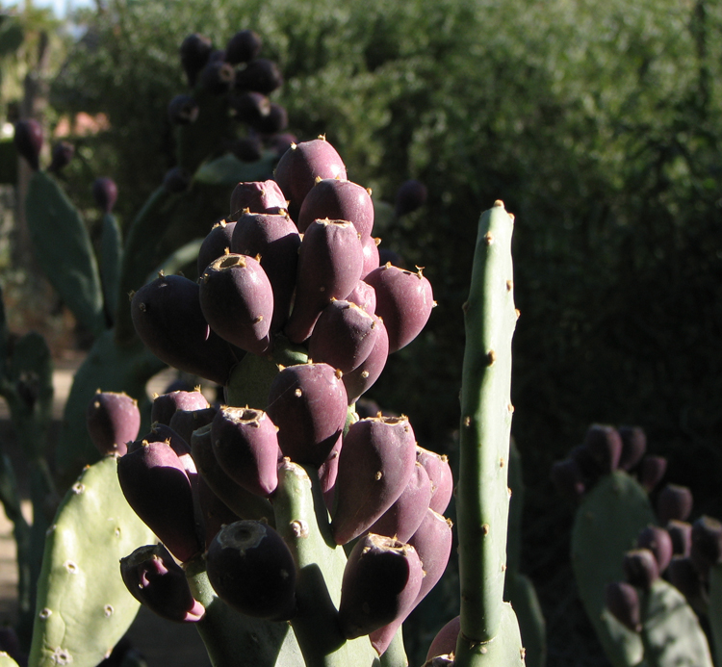
Science isn’t the only source of knowledge.
If science is not used cautiously, it can be very unreliable.

Slide 37
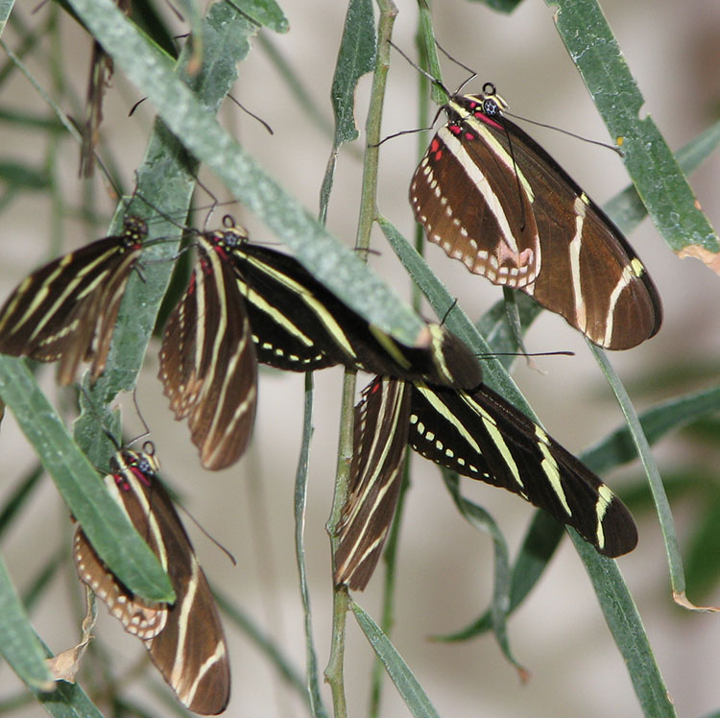
Scientists have been wrong in the past.

Slide 38
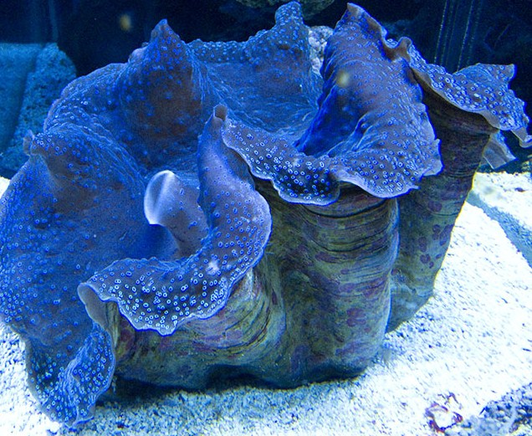
Blood letting – This probably killed George Washington Washing hands – this revolutionized surgery, thanks to Dr. Joseph Lister. Spontaneous generation – Francesco Redi showed that flies do not come from rotting meat.
We were obviously wrong with these!

Slide 39
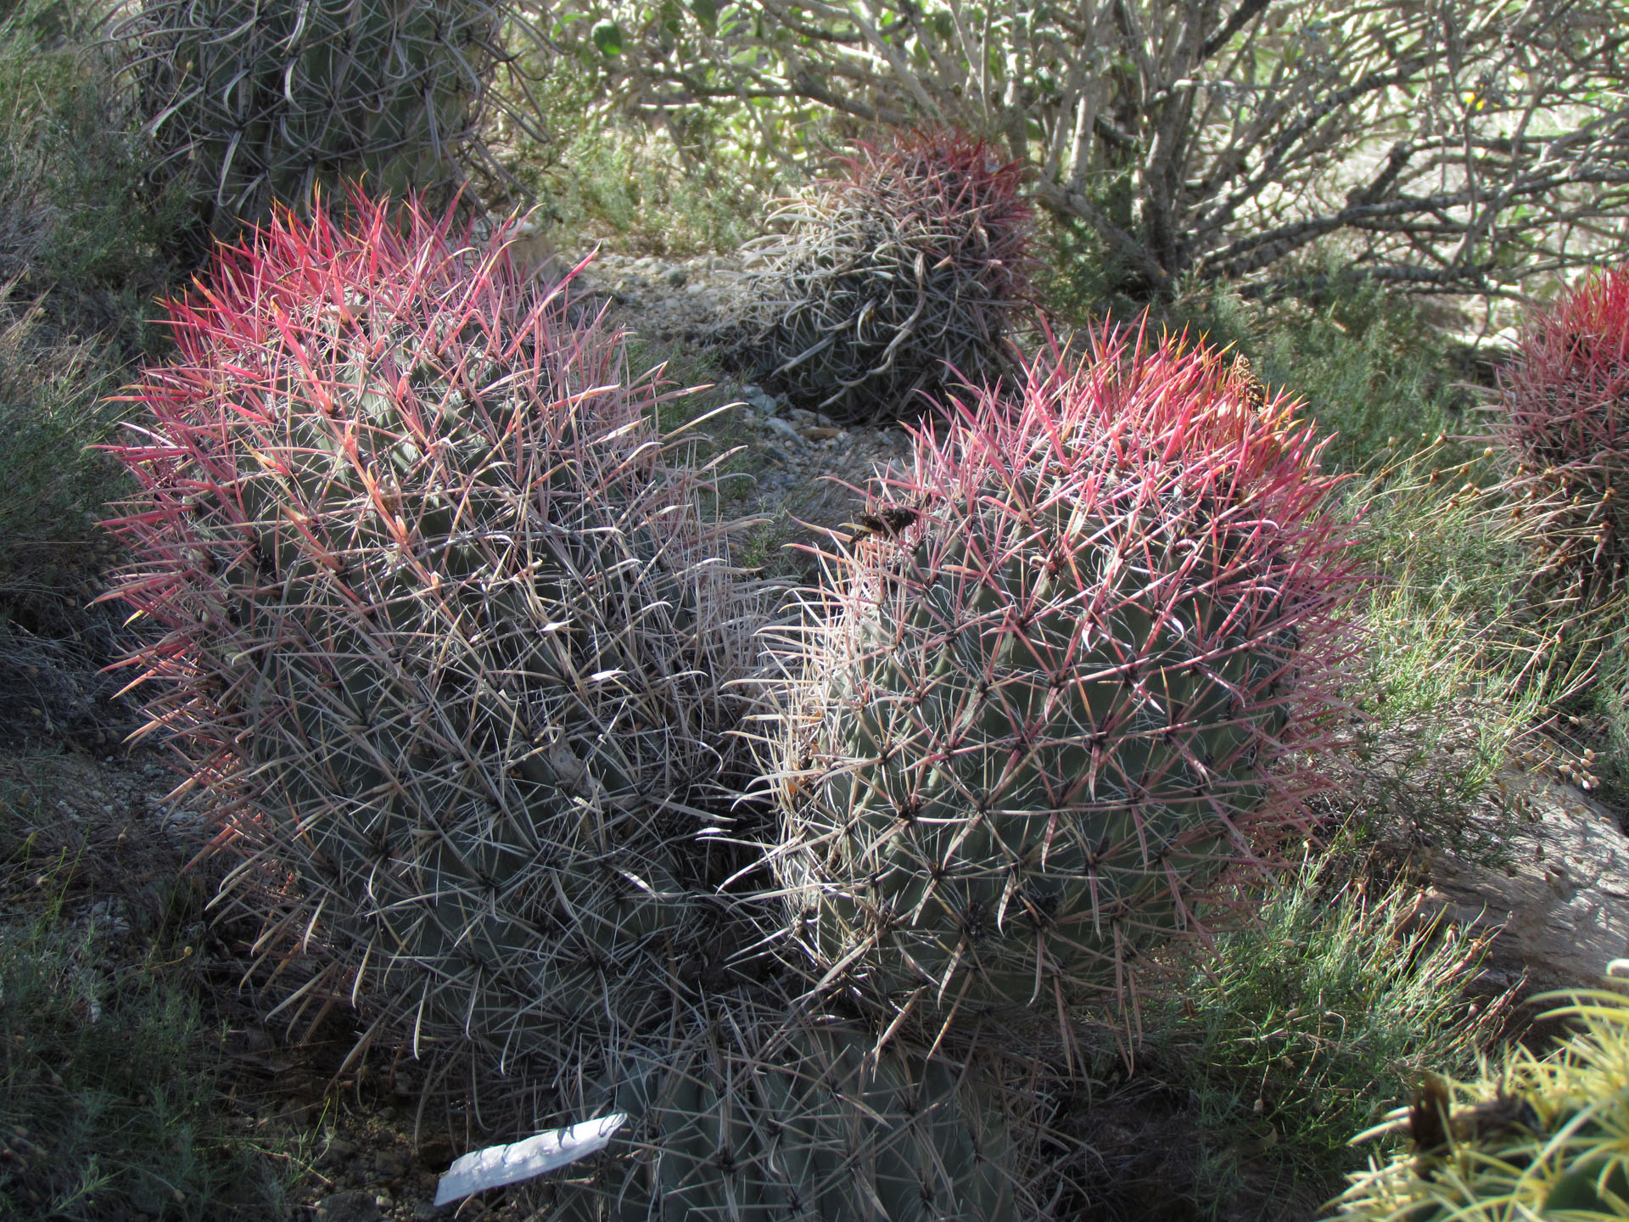
I have some serious questions about modern science too.

Slide 40
I have some serious questions about modern science too.
Keep in mind that I don’t know very much about physics.

Slide 41
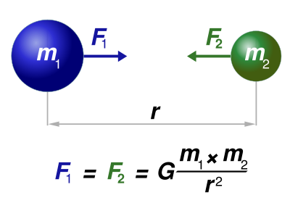
Gravity:
There seem to me to be problems in modern science

Slide 42
Gravity:
There seem to me to be problems in modern science
Gravitational force gets exponentially weaker every time distance is doubled.

Slide 43
Gravity:
There seem to me to be problems in modern science
Gravitational force gets exponentially weaker every time distance is doubled.
It likewise gets exponentially stronger in massive objects

Slide 44
Gravity:
There seem to me to be problems in modern science
Gravitational force gets exponentially weaker every time distance is doubled.
It likewise gets exponentially stronger in massive objects
If a black hole (large mass) won’t let light (small mass) escape, what kind of explosion could allow escape from the singularity before the big bang?

Slide 45
Gravity:
There seem to me to be problems in modern science
Gravitational force gets exponentially weaker every time distance is doubled.
(a very big one!)
It likewise gets exponentially stronger in massive objects
If a black hole (large mass) won’t let light (small mass) escape, what kind of explosion could allow escape from the singularity before the big bang?
If Mars and the moon can’t hold gasses to their surface, How could swirling gas (very low mass) come together to form a star?

Slide 46
Gravity:
There seem to me to be problems in modern science
Gravitational force gets exponentially weaker every time distance is doubled.
It likewise gets exponentially stronger in massive objects
If a black hole (large mass) won’t let light (small mass) escape, what kind of explosion could allow escape from the singularity before the big bang?
If Mars and the moon can’t hold gasses to their surface, How could swirling gas (very low mass) come together to form a star?
Can gravity really hold galaxies together?

Slide 47
Gravity:
There seem to me to be problems in modern science
I have never even taken a physics class. I have no idea if this evaluation will stand up to scrutiny.

Slide 48
Gravity:
There seem to me to be problems in modern science
I have never even taken a physics class. I have no idea if this evaluation will stand up to scrutiny.
It is my bias. I will assume my guesses are right until someone shows me that they’re wrong.

Slide 49
Gravity:
There seem to me to be problems in modern science
I have never even taken a physics class. I have no idea if this evaluation will stand up to scrutiny.
It is my bias. I will assume my guesses are right until someone shows me that they’re wrong. I would rather be right, so I will defend my idea.

Slide 50
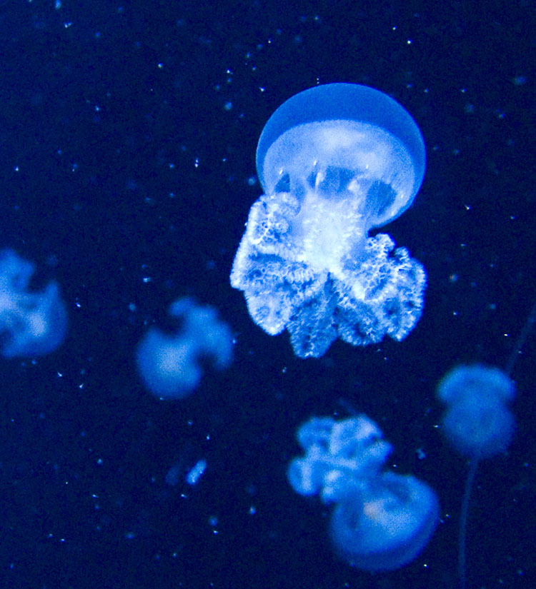
Everyone does what I do.
Learn a little

Slide 51
Everyone does this.
Learn a little
Ask a question

Slide 52
Everyone does this.
Learn a little
Ask a question
Assume an answer

Slide 53
Everyone does this.
Learn a little
Test your answer
Ask a question
Assume an answer

Slide 54
Everyone does this.
Learn a little
Test your answer
Ask a question
Assume an answer

Slide 55
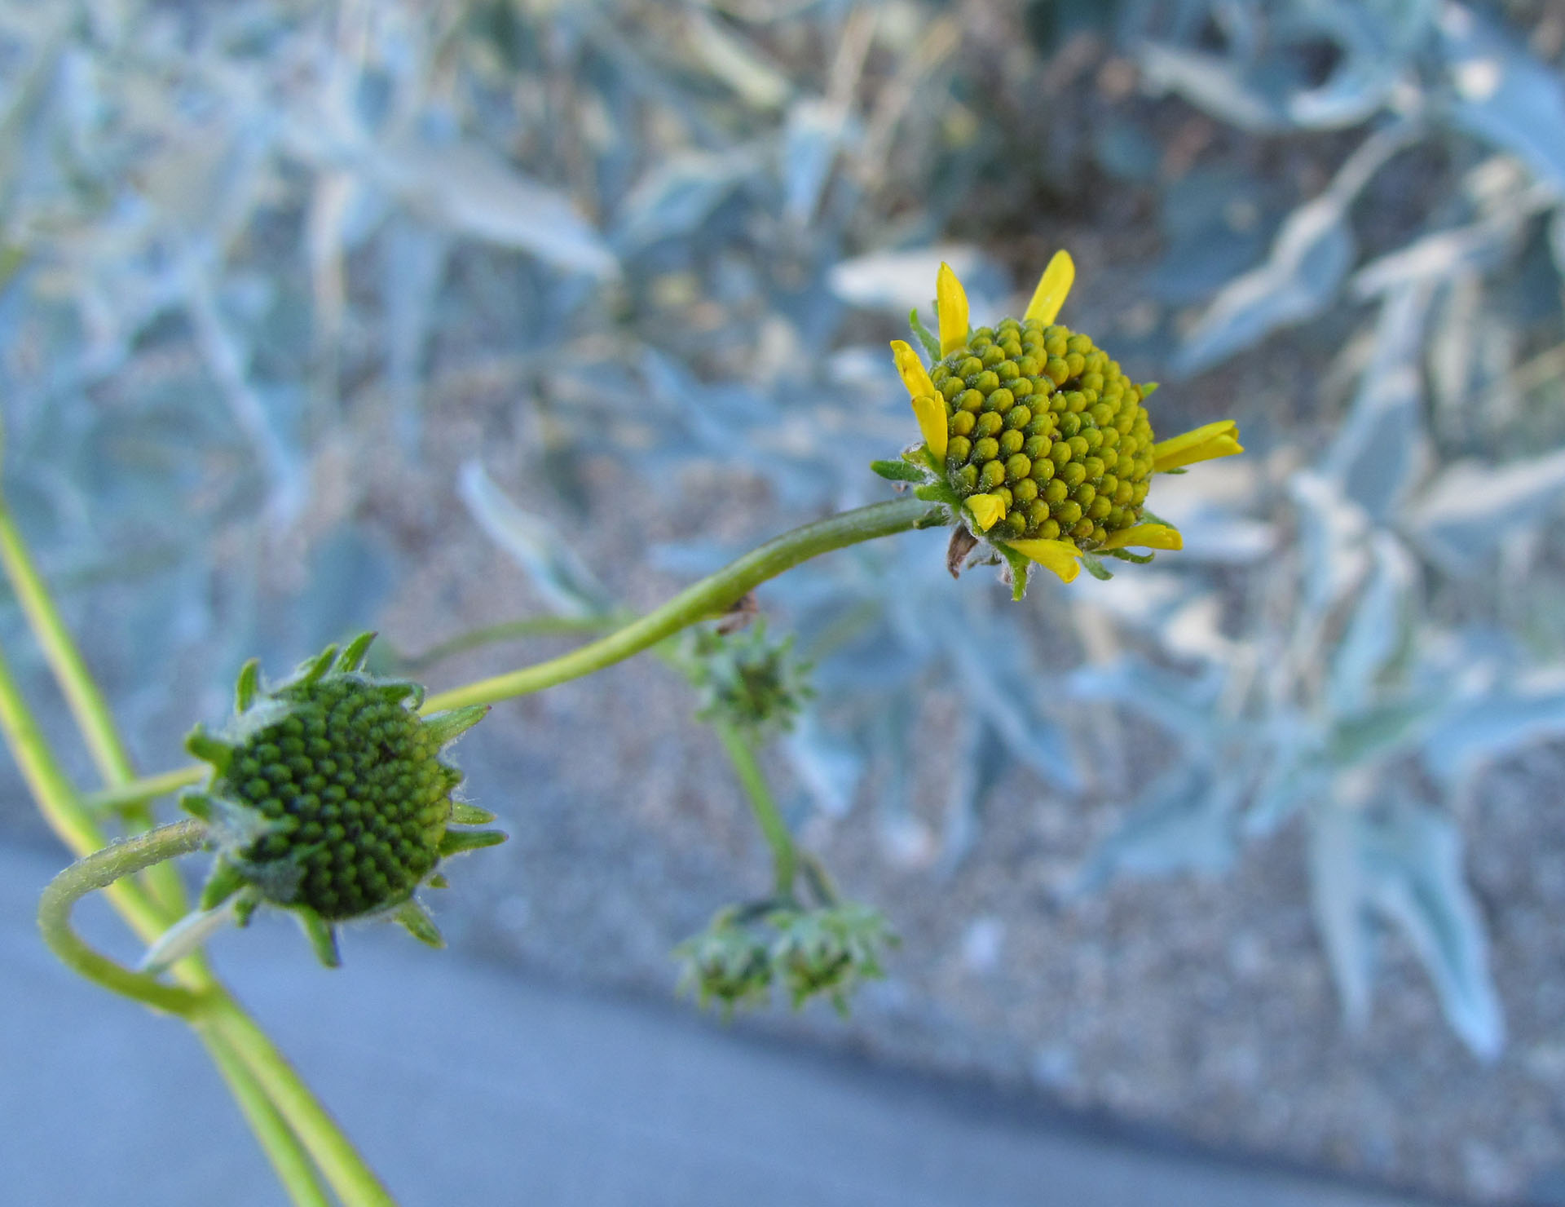
Bias is built into the scientific method.

Slide 56
Bias is built into the scientific method.
Question
Observe
Hypothesis
Experiment
Analyze the data
Conclusion

Slide 57
Bias is built into the scientific method.
Question
Observe
Hypothesis
Experiment
Analyze the data
Conclusion
Bias!

Slide 58
Bias is built into the scientific method.
Question
Observe
Hypothesis
Experiment
Analyze the data
Conclusion
Bias!
Attempt to overcome bias

Slide 59
Bias is built into the scientific method.
Question
Observe
Hypothesis
Experiment
Analyze the data
Conclusion
Bias!
Attempt to overcome bias
Then it creeps right back in!

Slide 60
Even math has bias.

Slide 61
Even math has bias.

Slide 62
We can learn to see bias in science too.
Watch video for:
Existing assumptions
Assumptions are challenged
Evidence challenged to save the assumptions
Assumptions are rescued by a creative explanation of the data

Slide 63
We can learn to see bias in science.

Slide 64
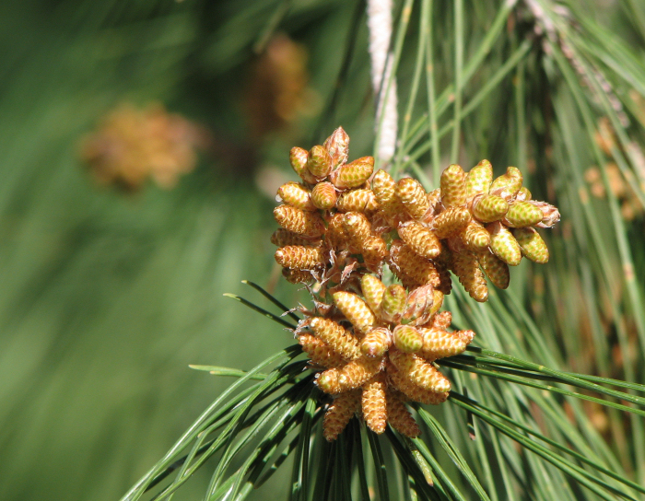
It could be said that the more you know, the less you assume.

Slide 65
It could be said that the more you know, the less you assume.
This is also often true: The more you think you know, the more has been assumed.

Slide 66
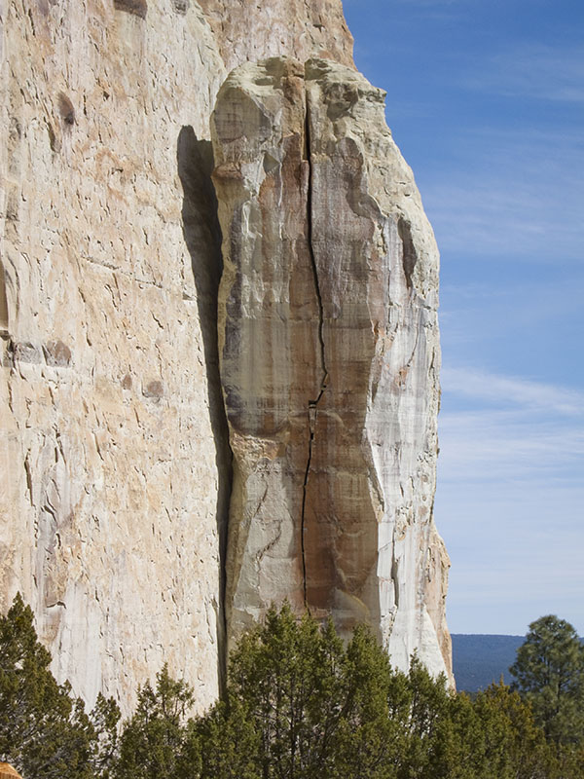
Sometimes your position is determined by a single nonempirical assumption.

Slide 67
Sometimes your position is determined by a single nonempirical assumption.
Abortion: An embryo is a human child, killing it is murder. vs. An embryo is a part of the woman, a woman has a right to make choices about her own body.

Slide 68
Sometimes your position is determined by a single nonempirical assumption.
Death penalty: God says that killers should be killed. (Gen 9:6) vs. If killing is wrong, nobody should ever kill.

Slide 69
Sometimes your position is determined by a single nonempirical assumption.
Spanking: Solomon said that if you don't spank your child, you deliver his soul to hell. vs. It's never ok to hit your children.

Slide 70
Sometimes your position is determined by a single nonempirical assumption.
Fossils require water: The fossils are proof of a flood. vs. The animals died next to water, because sediments are necessary for a fossil to form.

Slide 71
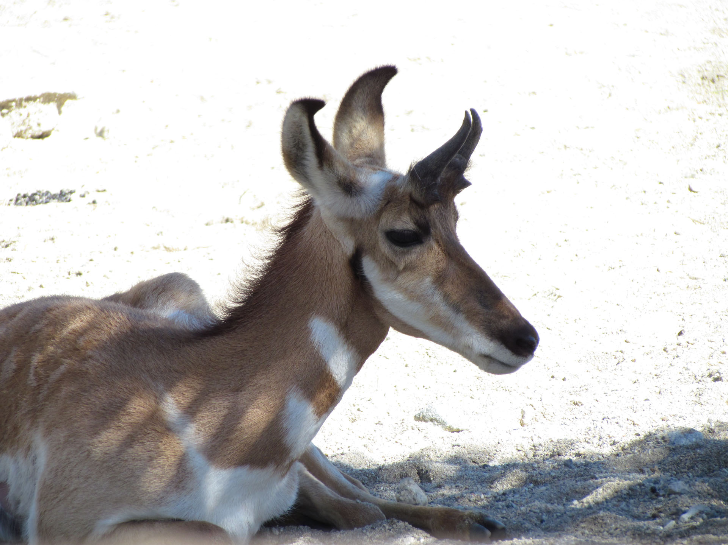
Most of those issues are decided on a whim.
Whichever “sounds” more plausible or is more consistent with your past life experience will often become your position.

Slide 72
Who can blame you for jumping to conclusions?
There’s too much in life to know!

Slide 73
How long do you practice before you decide that you’re not good at piano?
When should we have kids?
The beach or the museum?
Where’s the empirical data to help you form these conclusions?

Slide 74
We make lots of choices every day; we can’t research them all.
We can’t question them all.
There’s just not enough time.
Here’s more examples…

Slide 75
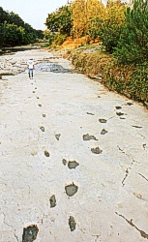
Paluxy river tracks “Even Creationists are being too skeptical, what motive do the discoverers of the tracks have to lie?” vs. “We can’t trust them because there wasn’t anyone reliable there to witness the discovery."

Slide 76
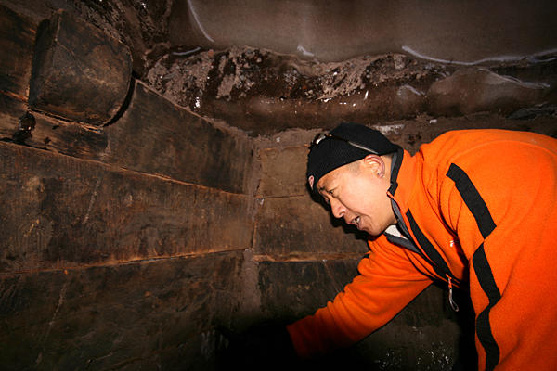
Noah's ark search – They have photographs of wood on Mt. Ararat. What else could it be? vs. Someone is looking to make a quick buck on gullible people.

Slide 77
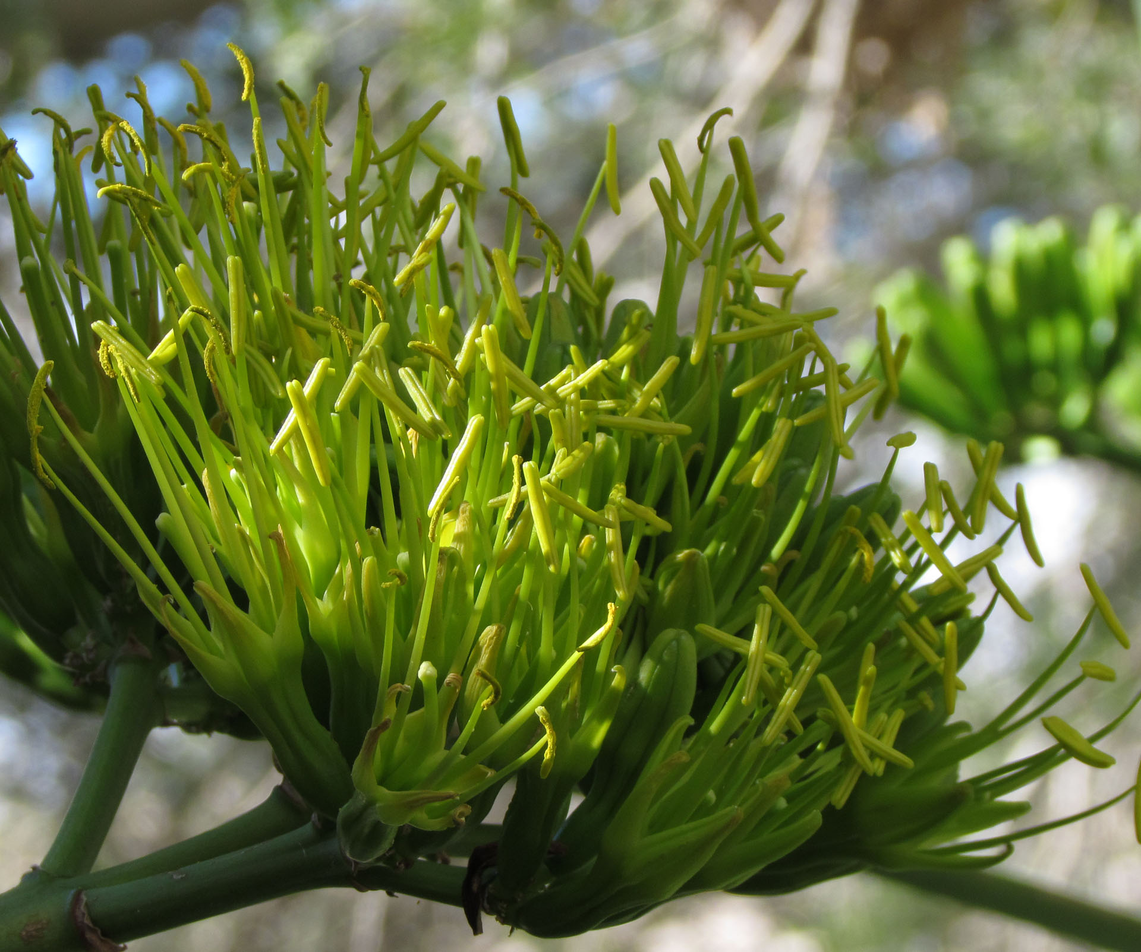
Nearly ALL of the world's scientists accept Neo-Darwinism. vs. Hebrews 11 speaks of the men of Genesis as though they were real historical figures.

Slide 78
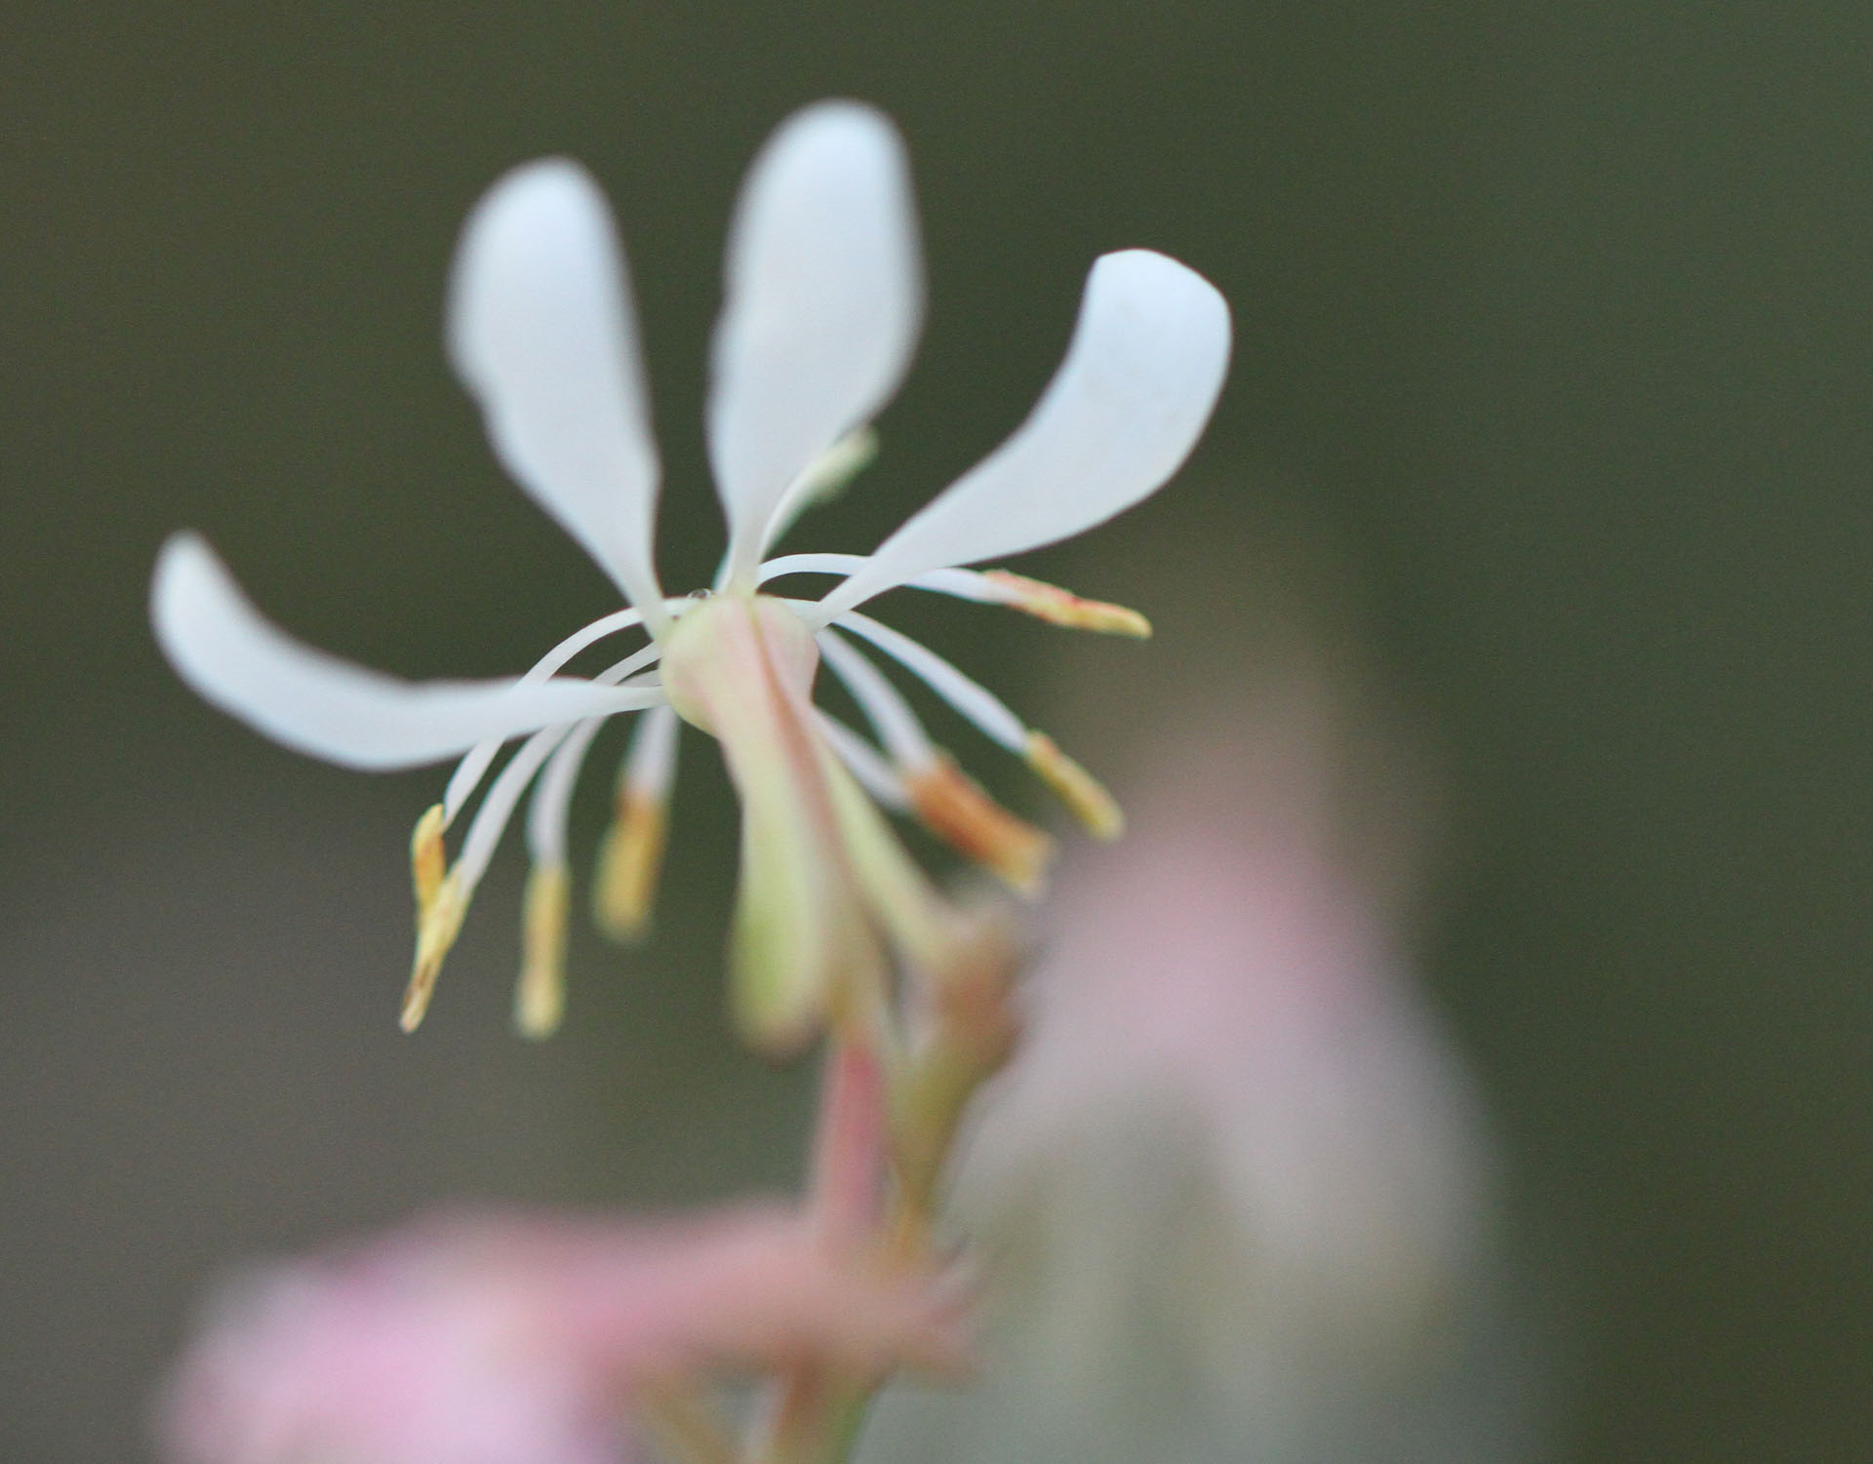
All those positions are usually not held on scientific grounds. We make these choices by what feels right to us.

Slide 79
All those positions are usually not held on scientific grounds. We make these choices by what feels right to us.
Sometimes we accept a position when it wouldn’t take much to verify it.

Slide 80
Have you ever heard these claims?
“The founding fathers were all deists.” “Abe Lincoln was gay.”
All you have to do is read about these men to see these claims are false.

Slide 81
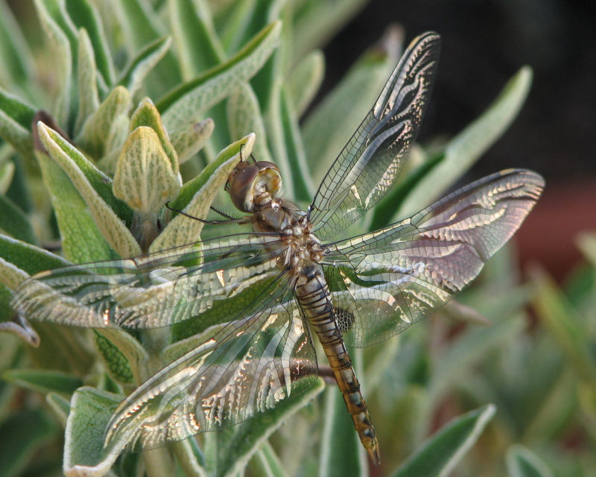
Research can influence your position on all these topics.

Slide 82
Research can influence your position on all these topics.
Most people I’ve talked to haven’t really researched any of them.

Slide 83
Research can influence your position on all these topics.
Most people I’ve talked to haven’t really researched any of them.
Answering one question exposes two more assumptions.

Slide 84
Research can influence your position on all these topics.
Most people I’ve talked to haven’t really researched any of them.
Answering one question exposes two more assumptions. Is it even possible to form conclusions without some bias?

Slide 85
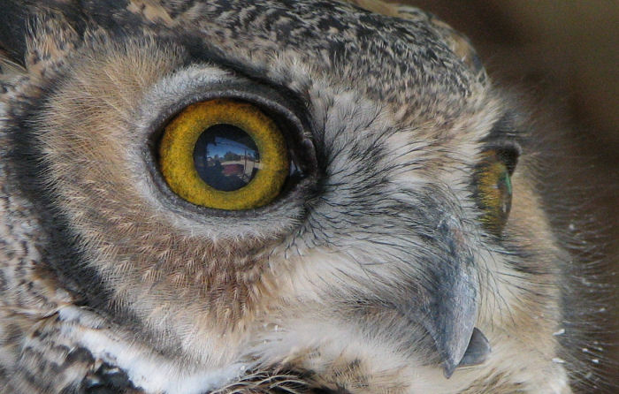
In presenting this idea to some people, I have been accused of being a feeler instead of a thinker. They say that because I think in terms of bias, I’m projecting it on everyone else.

Slide 86
It is true that everyone has different standards for truth. Some are more logical. Some withhold judgment.
Certainly, we can use evidence to convince people.

Slide 87
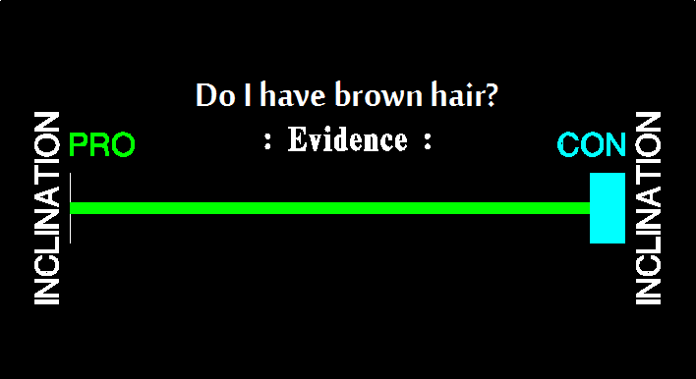
Choice Charts When does bias apply?

Slide 88
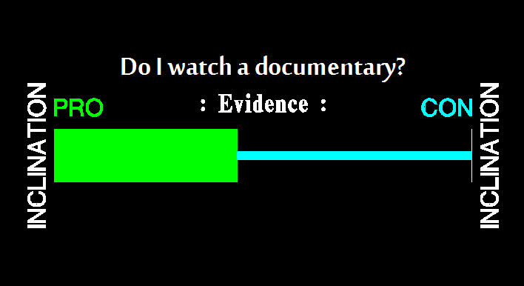
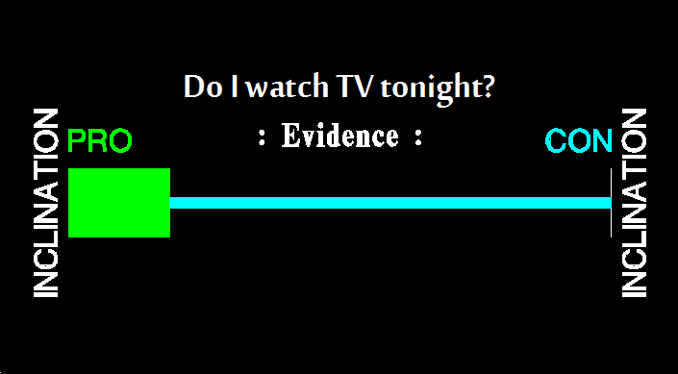
Choice Charts When does bias apply?

Slide 89
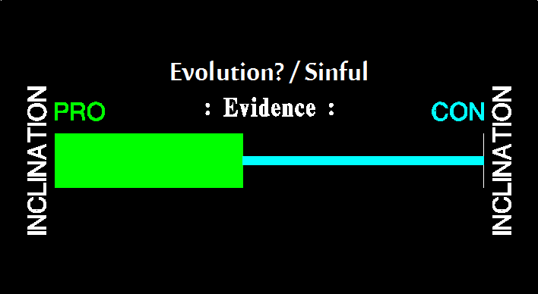
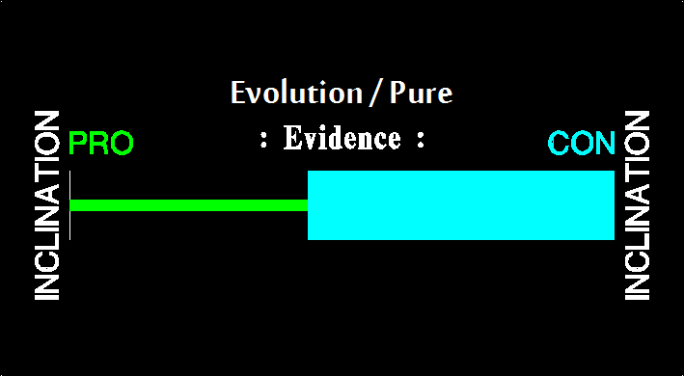
Choice Charts When does bias apply?

Slide 90
If you think back on my examples, It’s logically clear: You can’t research everything! You have to decide to trust along the way. Some trust mom. Some trust their teachers. Some only trust science (actually, scientists). No matter who you decide to trust, you’re excluding contrary testimony.

Slide 91
“Scientists remove their bias.”

Slide 92
“Scientists remove their bias.”
If this is done with sincerity, there will be more objectivity, however…

Slide 93
“Scientists remove their bias.”
If this is done with sincerity, there will be more objectivity, however…
You’re not removing bias as much as you are shifting your perspective. You might be accepting evidence that you wouldn’t before.

Slide 94
“Scientists remove their bias.”
If this is done with sincerity, there will be more objectivity, however…
You’re not removing bias as much as you are shifting your perspective. You might be accepting evidence that you wouldn’t before.
An unbiased person might accept evidence to show that my hair is blonde.

Slide 95
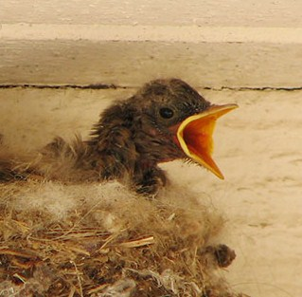
Insults
http://www.scienceagainstevolution.org/v16i1e.htm

Slide 96
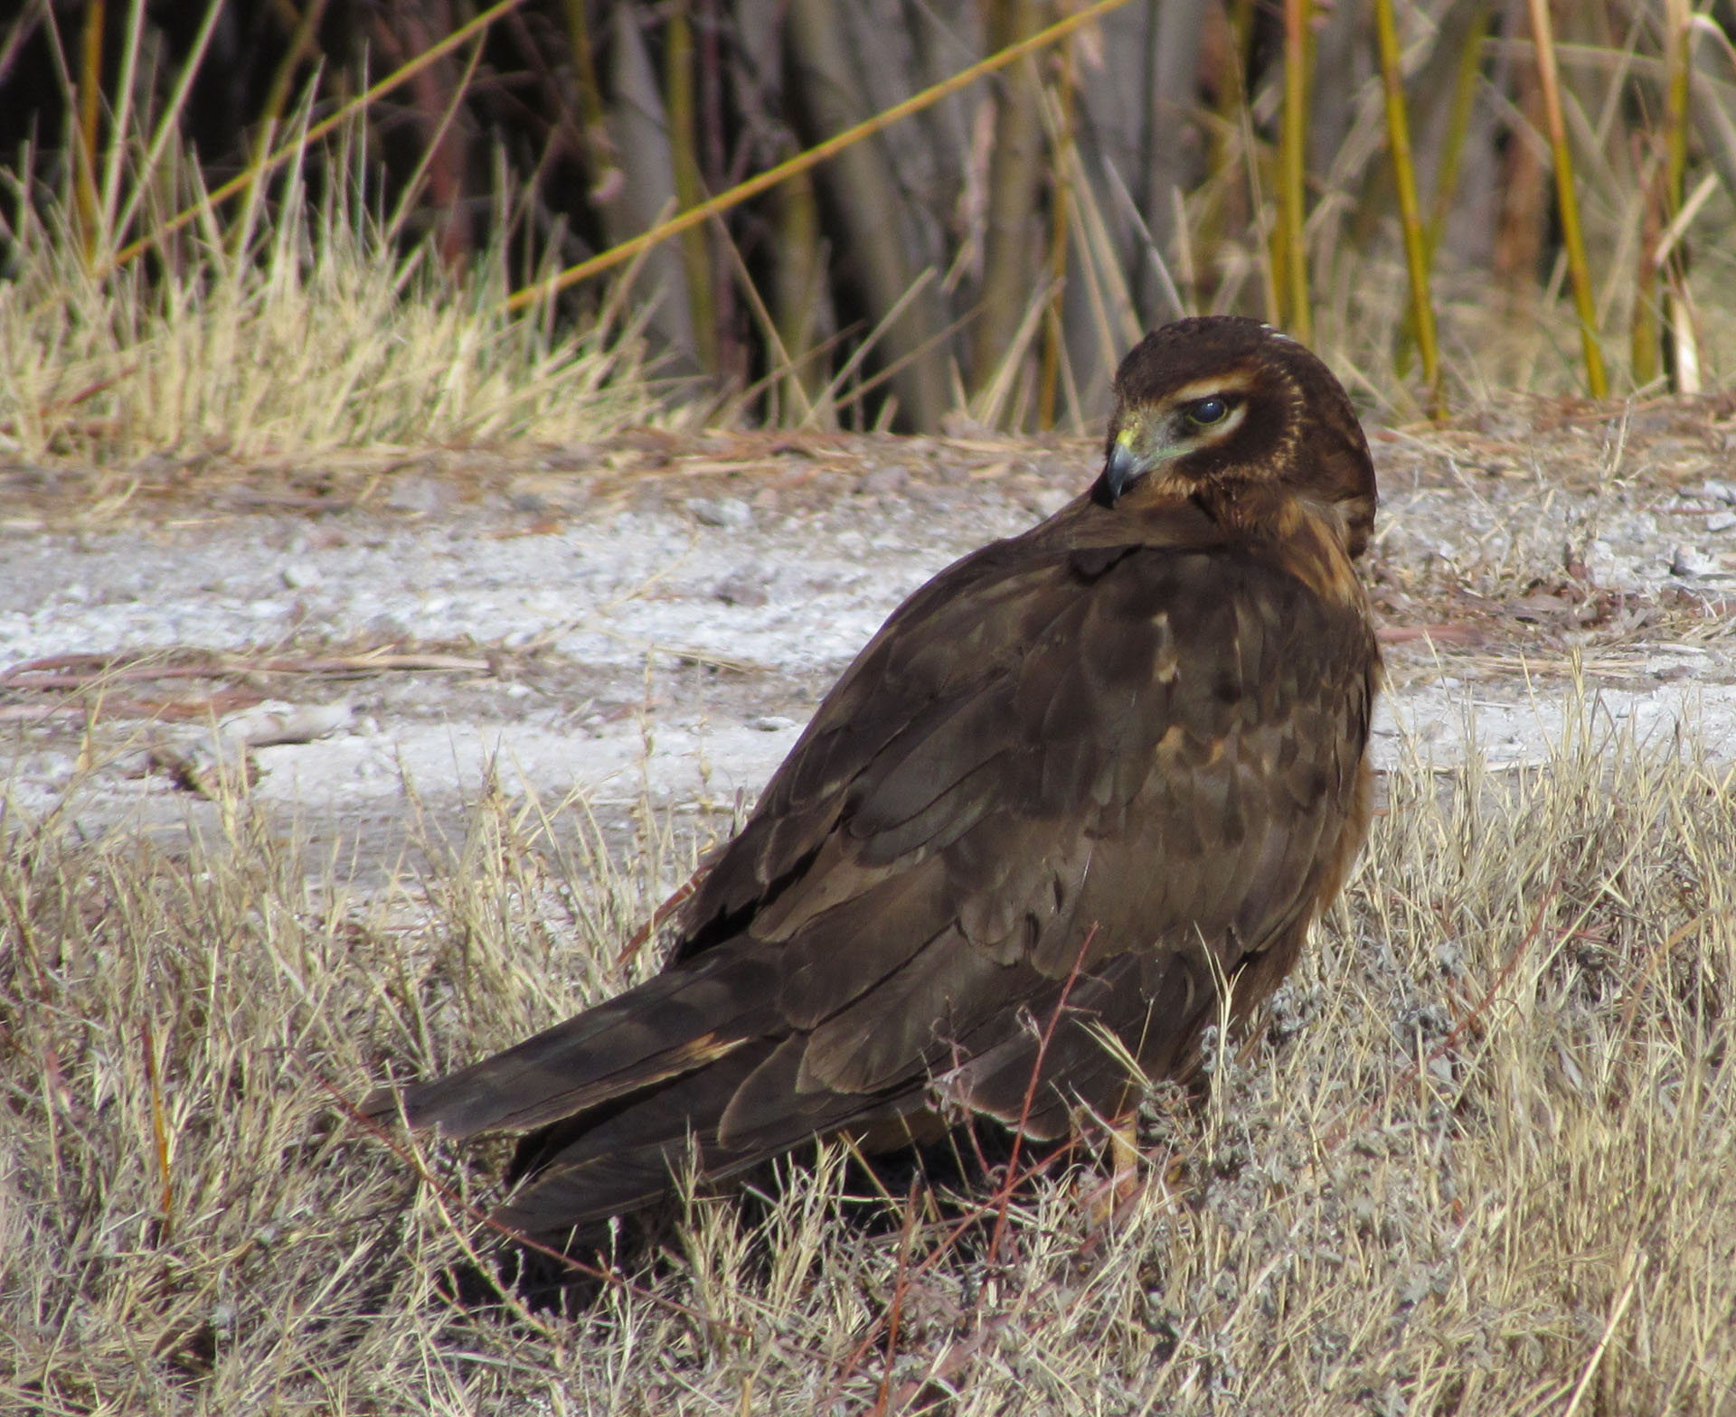
These quotes are from a recently published email debate about how science is against evolution.
http://www.scienceagainstevolution.org/v16i1e.htm

Slide 97
These quotes are from a recently published email debate about how science is against evolution.
“You're a just a common liar.” “Creationists aren't biologists.” “You have sufficient background to pick apart a high school curriculum.”
http://www.scienceagainstevolution.org/v16i1e.htm

Slide 98
These quotes are from a recently published email debate about how science is against evolution.
“You're a just a common liar.” “Creationists aren't biologists.” “You have sufficient background to pick apart a high school curriculum.”
Comments like this are common in debates about evolution. Insults can get to you if you let them.
http://www.scienceagainstevolution.org/v16i1e.htm

Slide 99
In fact, many people take positions to avoid insults.
http://www.scienceagainstevolution.org/v16i1e.htm

Slide 100
I almost believed in evolution because “all real scientists do”.
http://www.scienceagainstevolution.org/v16i1e.htm

Slide 101
Peter predicted that they would scoff:
“…in the last days there will be scoffers who will laugh at the truth and do every evil thing they desire. … They deliberately forget that God made the heavens by the word of his command, and he brought the earth up from the water and surrounded it with water. Then he used the water to destroy the world with a mighty flood.” ~ 2 Peter 3

Slide 102
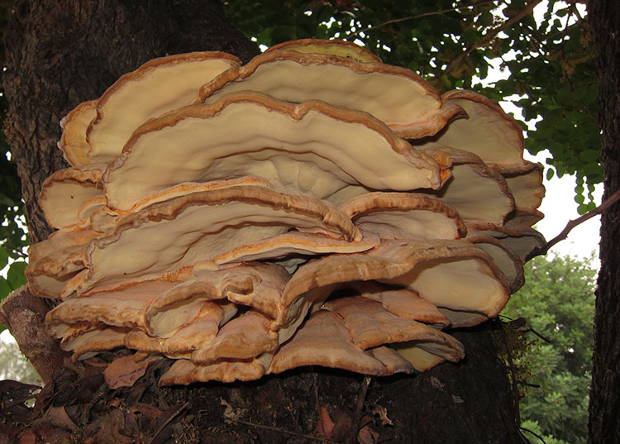
It’s not only the religious who have faith. Evolutionists make some outrageous, biased, faith filled claims, too.

Slide 103
Convergent evolution: http://www.newscientist.com/article/dn21015-zoologger-the-first-reptile-with-a-true-placenta.html "Backboned animals have evolved live birth no fewer than 132 times…" "What is difficult, however, is nourishing unborn young the way mammals do. [...] It now appears that it evolved at least twice: once in mammals, and once in an obscure African lizard... ...placental feeding has evolved in skinks not once, but three times."

Slide 104
Do you see the bias?
I think you’d be surprised how many people don’t.
They claim that they are completely objective, that they only use empirical facts.

Slide 105
~ Granville Penn
“It is one thing to accumulate data, and another thing to reason soundly upon them when accumulated...”
“[T]he question [of geology] is a compound question; it is both physical and historical; for it seeks the historical truth of a physical fact.”
“Why, then, wantonly and viciously, without a pretense of authority, choose the supposition [that God formed the world imperfectly]? It is entirely a decision of choice […] the reason is no party in it…“
http://www.answersingenesis.org/articles/gtp/granville-penn

Slide 106
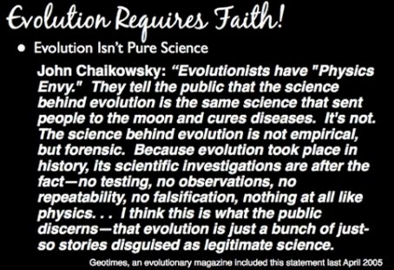

Slide 107
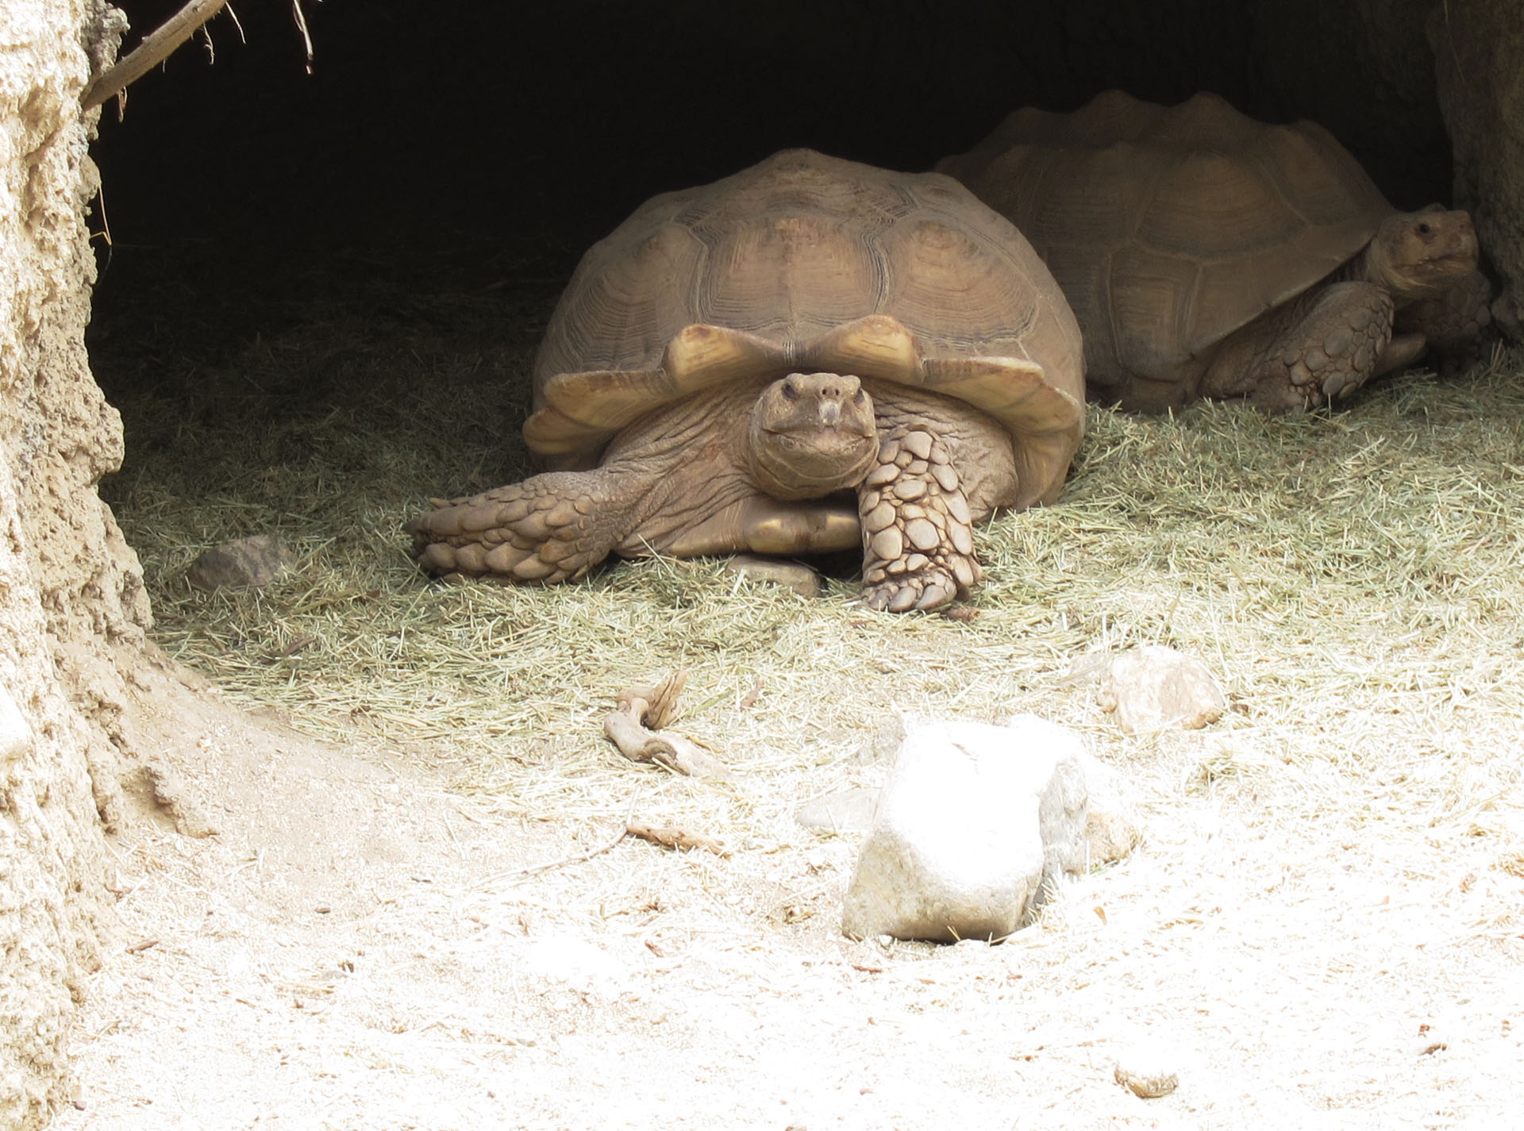
Don’t ask IF you are susceptible to bias.
You are!
Ask yourself which bias you’d rather start with.

Slide 108
Bias does NOT make your decisions for you.
Bias shapes which evidences you’re inclined to accept as true.
Another way to say the same thing: Who have you chosen to trust?

Slide 109
There is a single bias that influences whether you love my book. It is this…

Slide 110
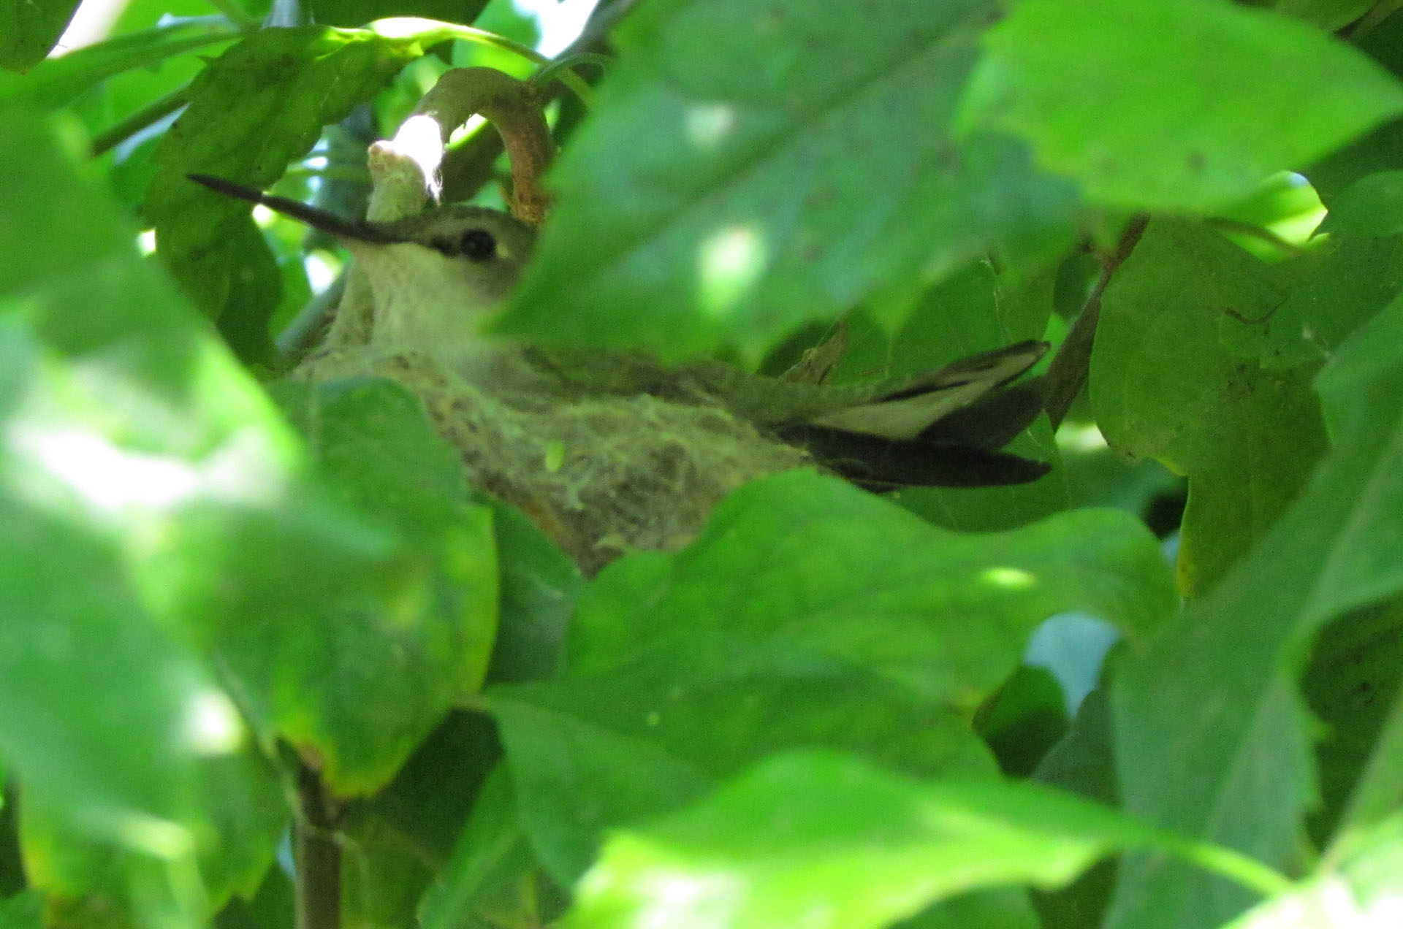
Do you accept the testimonies of the ancient historians?

Slide 111
Either you do…
… or you don’t.

Slide 112
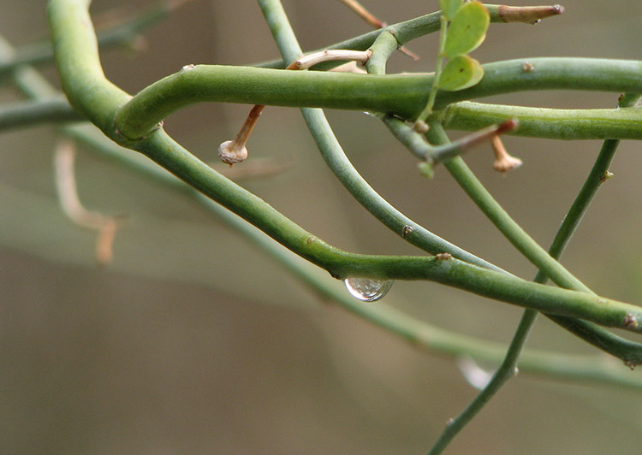
There are many truths about ancient cultures that don’t vary much.
They were all pagans
They made Idols
They sacrificed animals to their gods
Their gods had birth stories
They deified their leaders and ancestors
They remembered firsts: foundations of cities and temples agriculture writing star gazing

Slide 113
Abram was a notable exception. He saw the folly of Paganism, and he served the supreme God, the maker of heaven and earth.

Slide 114
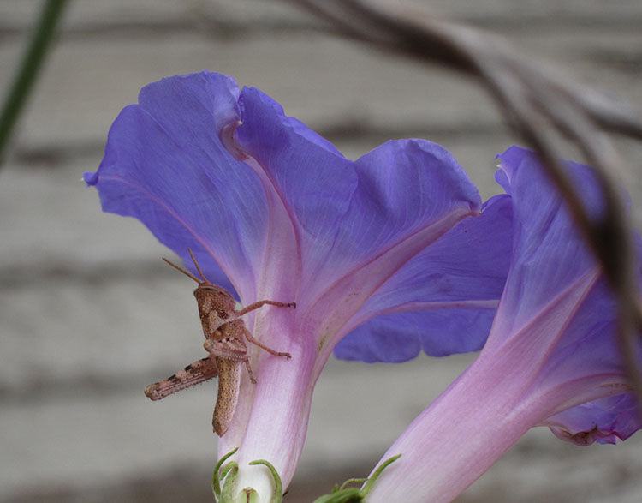
Why did anyone believe in the gods?

Slide 115
Why did anyone believe in the gods?
It was stupid…
Hesiod says Chaos came from nothing, then Earth (Gaia).
Chaos gave birth to: day, night
Earth gave birth to: sky, and others
}
Asexual reproduction

Slide 116
Why did anyone believe in the gods?
It was stupid…
Hesiod says Chaos came from nothing, then Earth (Gaia).
Chaos gave birth to: day, night
Earth gave birth to: sky, and others
The question of who made the Unmade Maker (aka God) makes no sense philosophically. The question of who made Chaos and Earth does make sense, and the pagans, had they survived, would have no answer. What was there before Chaos and Earth?
}
Asexual reproduction

Slide 117
Why did anyone believe in the gods?
It was stupid…
Hesiod says Chaos came from nothing, then Earth (Gaia).
Chaos gave birth to: day, night
Earth gave birth to: sky, and others
Uranus (sky) and Gaia (earth) had Cronus (among others)
In fact, every time the two meet, babies pop out.
}
Asexual reproduction

Slide 118
Why did anyone believe in the gods?
(ll. 116-138) Verily at the first Chaos came to be, but next wide-bosomed Earth, the ever-sure foundations of all (4) the deathless ones who
hold the peaks of snowy Olympus, and dim Tartarus in the depth of the wide-pathed Earth, and Eros (Love), fairest among the deathless gods, who
unnerves the limbs and overcomes the mind and wise counsels of all gods and all men within them. From Chaos came forth Erebus and black Night;
but of Night were born Aether (5) and Day, whom she conceived and bare from union in love with Erebus. And Earth first bare starry Heaven,
equal to herself, to cover her on every side, and to be an ever-sure abiding-place for the blessed gods. And she brought forth long Hills,
graceful haunts of the goddess-Nymphs who dwell amongst the glens of the hills. She bare also the fruitless deep with his raging swell, Pontus,
without sweet union of love. But afterwards she lay with Heaven and bare deep-swirling Oceanus, Coeus and Crius and Hyperion and Iapetus, Theia
and Rhea, Themis and Mnemosyne and gold-crowned Phoebe and lovely Tethys. After them was born Cronos the wily, youngest and most terrible of
her children, and he hated his lusty sire. (Hesiod)
--
Then the son from his ambush stretched forth his left hand and in his right took the great long sickle with jagged teeth, and swiftly lopped
off his own father's members and cast them away to fall behind him. And not vainly did they fall from his hand; for all the bloody drops that
gushed forth Earth received, and as the seasons moved round she bare the strong Erinyes and the great Giants with gleaming armour, holding long
spears in their hands and the Nymphs whom they call Meliae (8) all over the boundless earth. And so soon as he had cut off the members with
flint and cast them from the land into the surging sea, they were swept away over the main a long time: and a white foam spread around them
from the immortal flesh, and in it there grew a maiden. (Hesiod) - Castration of Uranus by Cronus --
(ll. 453-491) But Rhea was subject in love to Cronos and bare splendid children, Hestia (18), Demeter, and gold-shod Hera and strong Hades,
pitiless in heart, who dwells under the earth, and the loud-crashing Earth-Shaker, and wise Zeus, father of gods and men, by whose thunder the
wide earth is shaken. These great Cronos swallowed as each came forth from the womb to his mother's knees with this intent, that no other of
the proud sons of Heaven should hold the kingly office amongst the deathless gods. For he learned from Earth and starry Heaven that he was
destined to be overcome by his own son, strong though he was, through the contriving of great Zeus (19). Therefore he kept no blind outlook,
but watched and swallowed down his children: and unceasing grief seized Rhea. But when she was about to bear Zeus, the father of gods and men,
then she besought her own dear parents, Earth and starry Heaven, to devise some plan with her that the birth of her dear child might be
concealed, and that retribution might overtake great, crafty Cronos for his own father and also for the children whom he had swallowed down.
And they readily heard and obeyed their dear daughter, and told her all that was destined to happen touching Cronos the king and his stout-
hearted son. So they sent her to Lyetus, to the rich land of Crete, when she was ready to bear great Zeus, the youngest of her children. Him
did vast Earth receive from Rhea in wide Crete to nourish and to bring up. Thither came Earth carrying him swiftly through the black night to
Lyctus first, and took him in her arms and hid him in a remote cave beneath the secret places of the holy earth on thick-wooded Mount Aegeum;
but to the mightily ruling son of Heaven, the earlier king of the gods, she gave a great stone wrapped in swaddling clothes. Then he took it in
his hands and thrust it down into his belly: wretch! he knew not in his heart that in place of the stone his son was left behind, unconquered
and untroubled, and that he was soon to overcome him by force and might and drive him from his honours, himself to reign over the deathless
gods.
It was stupid…
Hesiod says Chaos came from nothing, then Earth (Gaia).
Chaos gave birth to: day, night
Earth gave birth to: sky, and others
Cronus ate his kids until baby Zeus was replaced by a rock.
Cronus swallowed the rock. Zeus later castrated his father.
The “member” fell to earth and made more children.
}
Asexual reproduction

Slide 119
Why did anyone believe in the gods?
It was stupid…
Zeus […] made women to be an evil to mortal men […] And he gave them a second evil to be the price for the good they had: whoever avoids marriage and the sorrows that women cause, and will not wed, reaches deadly old age without anyone to tend his years, and though he at least has no lack of livelihood while he lives, yet, when he is dead, his kinsfolk divide his possessions amongst them. And as for the man who chooses the lot of marriage and takes a good wife suited to his mind, evil continually contends with good; for whoever happens to have mischievous children, lives always with unceasing grief in his spirit and heart within him; and this evil cannot be healed. (Hesiod, y700BC)

Slide 120
Why did anyone believe in the gods?
It was stupid…
Are you convinced?

Slide 121
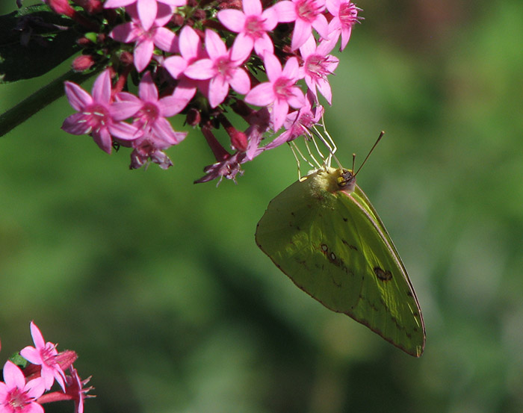
Why did anyone believe in the gods?
It was historical…
Our founder Dardanus, as fame has sung,
And Greeks acknowledge, from Electra sprung:
Electra from the loins of Atlas came;
Atlas, whose head sustains the starry frame.
Your sire is Mercury, whom long before
On cold Cyllene's top fair Maia bore.
Maia the fair, on fame if we rely,
Was Atlas' daughter, who sustains the sky.
Thus from one common source our streams divide;
Ours is the Trojan, yours th' Areadian side. ~ Virgil, Aeneid

Slide 122
Why did anyone believe in the gods?
It was historical…
[In India] it is the custom, instead of making obeisance, to offer prayers to the kings and to all who are in authority and of superior rank. ~ Strabo

Slide 123
Why did anyone believe in the gods?
It was historical…
[Several famous women] became the first ancestors of the larger part of the race of human beings, giving birth to those who, because of their high achievements, came to be called gods and heroes... ~ Diodorus

Slide 124
Why did anyone believe in the gods?
It was historical…
[T]he kingdom was divided among the sons of Uranus [Noah], the most renowned of whom were Atlas [Japheth?] and Cronus [Ham]. Of these sons Atlas received as his part the regions on the coast of the ocean, and he not only gave the name of Atlantians to his peoples but likewise called the greatest mountain in the land Atlas. They also say that he perfected the science of astrology and was the first to publish to mankind the doctrine of the sphere; and it was for this reason that the idea was held that the entire heavens were supported upon the shoulders of Atlas […]
~ Diodorus

Slide 125
Why did anyone believe in the gods?
It was historical…
[T]here are other gods, they say, who were terrestrial, having once been mortals, but who, by reason of their sagacity and the good services […] attained immortality […] Their names, when translated, are in some cases the same as those of the celestial gods, while others have a distinct appellation […] Some of the priests, however, say that Hephaestus was their first king, since he was the discoverer of fire and received the rule because of this service to mankind […]
~ Diodorus

Slide 126
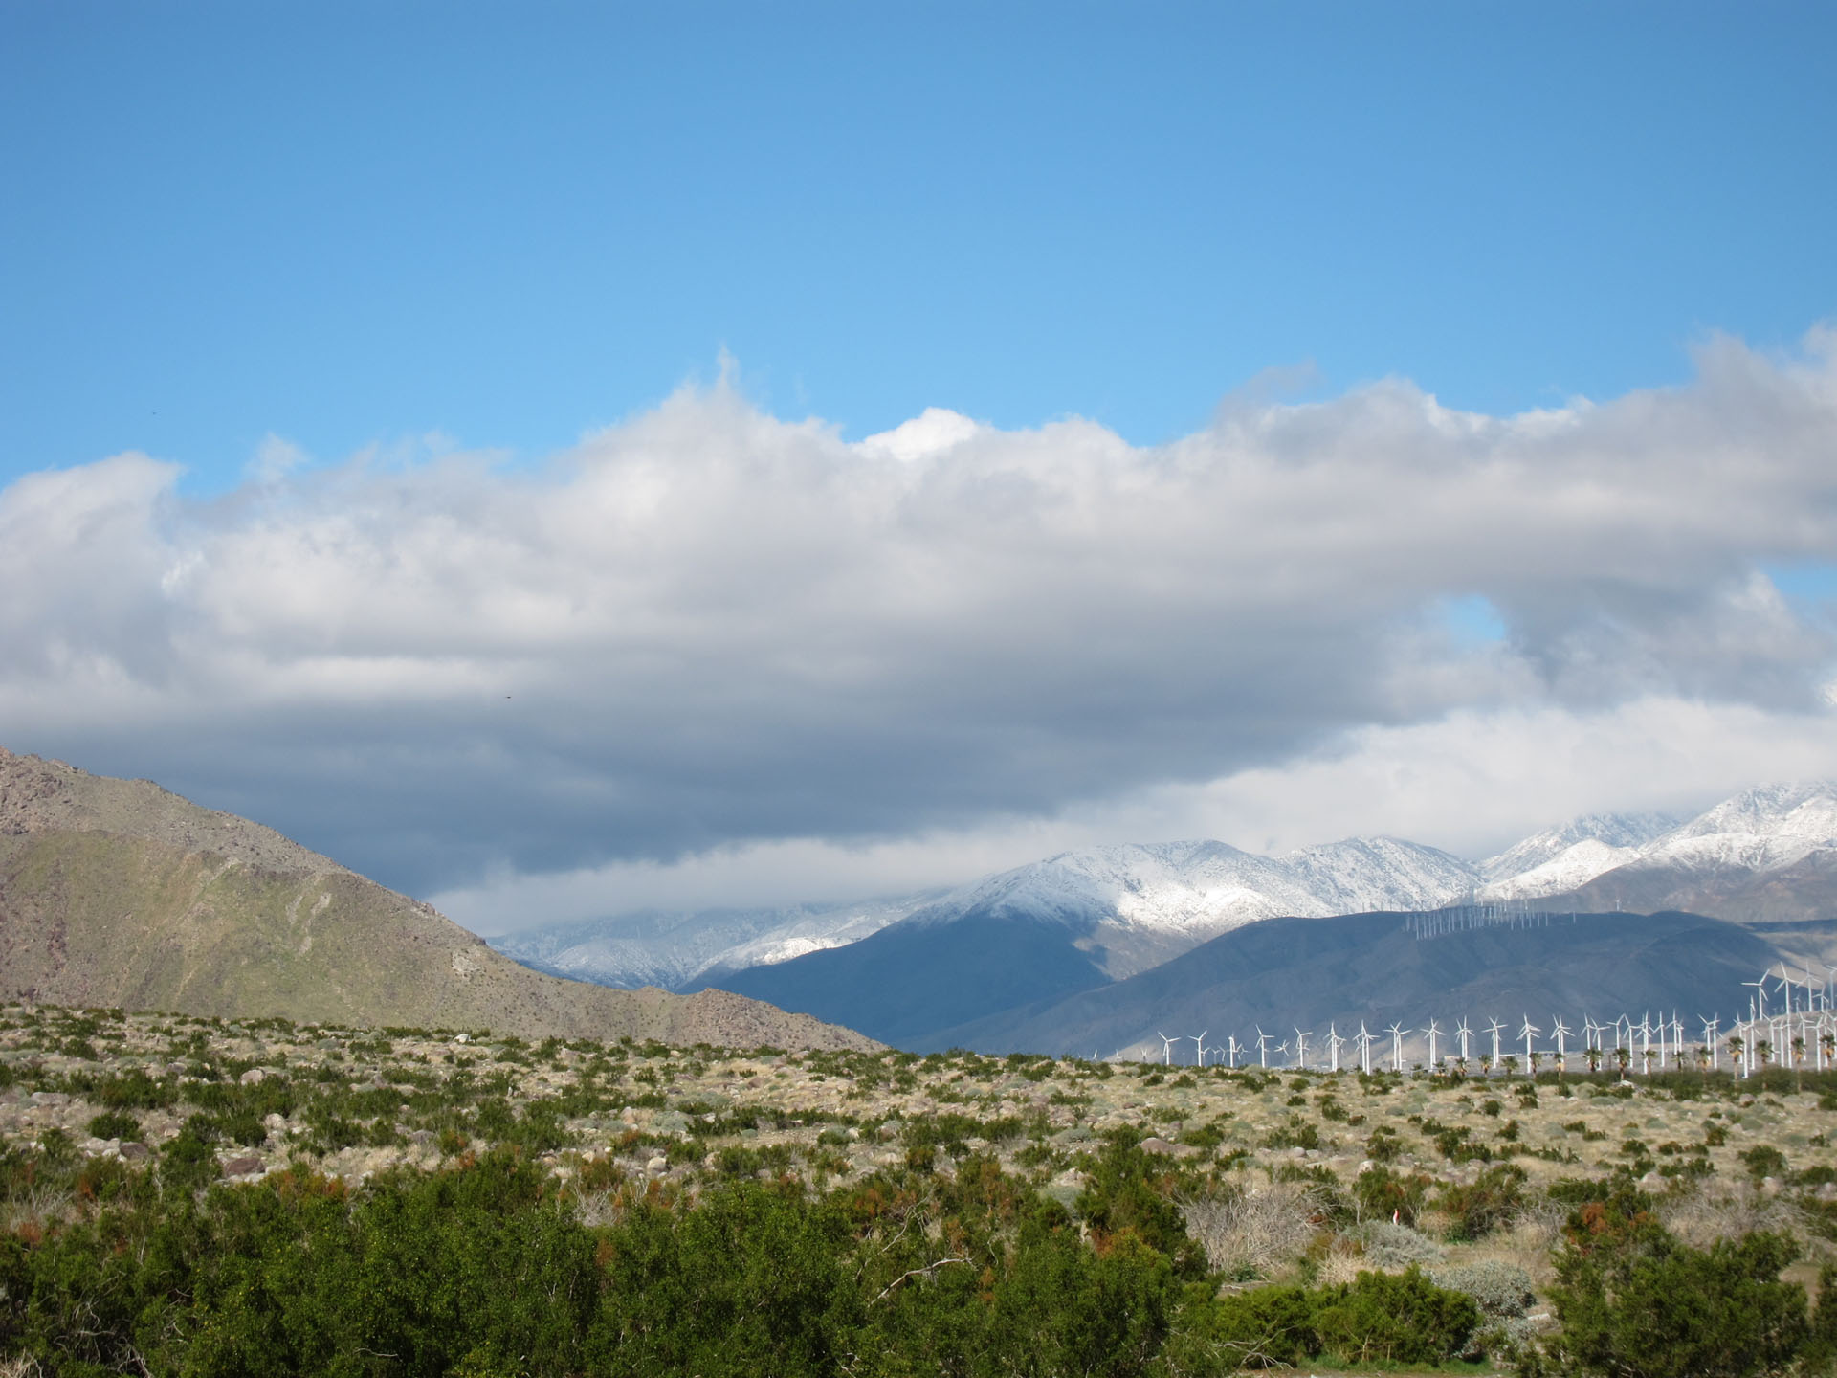
Why did anyone believe in the gods?
Though based in history, the myths were corrupted.
Pagans sacrificed animals
Pagans had a 7 day week (Julian calendar), many included a Sabbath day
Cronus castrated his father
Ham looked on his father’s nakedness.
Hyginus, Fabulae 143: (Babel) "Men for many centuries before lived without town or laws, speaking one tongue under the rule of Jove [Zeus]. But after Mercurius [Hermes] had explained [or created] the languages of men (whence he is called ermeneutes, ‘interpreter’, for Mercurius in Greek is called Ermes; he too, divided the nations), then discord arose among mortals, which was not pleasing to Jove [Zeus]."

Slide 127
Why did anyone believe in the gods?
Though based in history, the myths were corrupted.
Those who founded nations were recorded in books and monuments, and their stories were embellished with time.
The priests of ornate temples kept records and argued about the details.
Can we reach behind the myths to find some truth?

Slide 128
Why did anyone believe in the gods?
Though based in history, the myths were corrupted.
When historians say that the histories disagree, they're talking about a difference of years or the order of names in a genealogy. They are not often saying that they are completely different made up events. All these ancient sources tell the same stories. The "gods" had children, the demigods. They had more children, which eventually led to nations, whose patriarch (father) was known. They knew his name and his story. To say that the histories contradict is deceptive. They differ on the lesser details.

Slide 129
Why did anyone believe in the gods?
Though based in history, the myths were corrupted.
"The version which Eusebius gives of the Epitome of Manetho shows considerable differences from Africanus, both in the names of kings and in the length of their reigns.“ (W.G. Waddell, Manetho)
These stories (and others) are consistent across many language groups and geographical boundaries.

Slide 130
Why did anyone believe in the gods?
Though based in history, the myths were corrupted.
“[T]he barbarians, by sticking to the same things always, keep a firm hold on every detail, while the Greeks, on the other hand, aiming at the profit to be made out of the business, keep founding new schools and, wrangling with each other over the most important matters of speculation, bring it about that their pupils hold conflicting views, and that their minds, vacillating throughout their lives and unable to believe at all with firm conviction, simply wander in confusion.” ~ Diodorus

Slide 131
Tlingit (southern Alaska coast):
Yehl's wicked uncle had a young wife whom he was very fond and jealous of. He did not want any of his nephews to inherit his widow when he died, as Tlingit law dictates should happen, so he murdered each of Yehl's ten older brothers by drowning them or, according to some, by stretching them on a board and beheading them. When Yehl grew to manhood, his uncle tried to do the same to him. But Yehl's mother had conceived him by swallowing a round pebble she had found at low tide, and with another stone she had rendered him invulnerable. When the uncle tried to behead Yehl, his knife had no effect. In a rage, the uncle called for a flood, and a flood came and covered all the mountains.
http://www.talkorigins.org/faqs/flood-myths.html

Slide 132
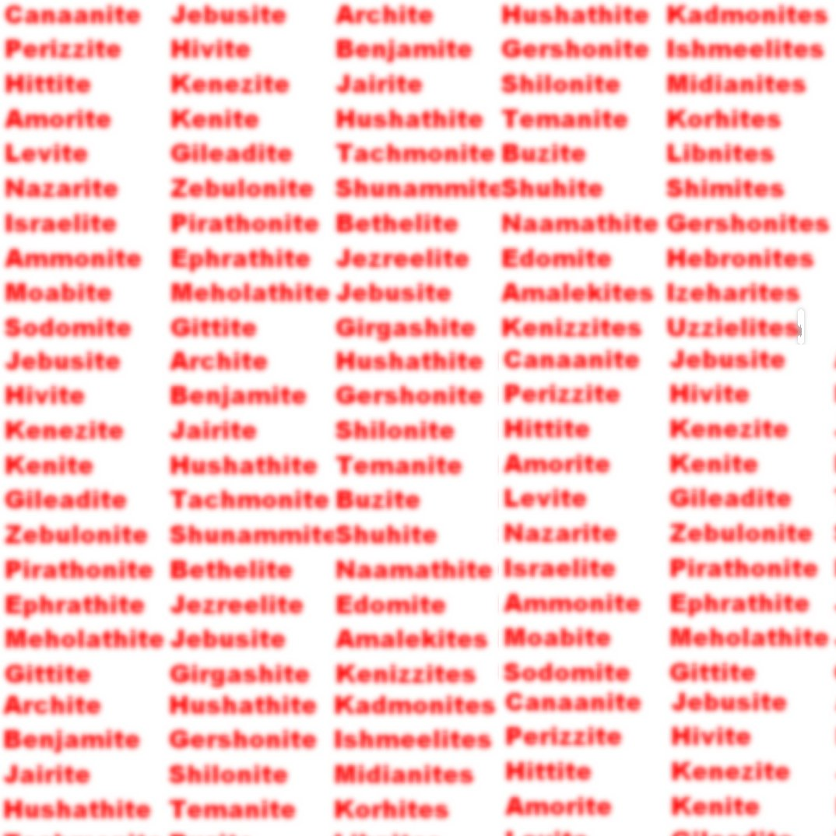
Nations Were Named for Their Ancestors
From Scripture:
Sons of Levi (Num. 3) Levites
Sons of Israel (Num. 26) Israelites
Sons of Canaan – Canaanites
Sons of Shem – Semite (Gen 10)
Eber – Hebrew (Gen 10)
Aram – Aramaic (Gen 10)
Moabites & Ammonites (Gen. 19)
From History:
Brutus (for Britain)
Egyptus (for Egypt)
Romulus (for Rome)
Hispalus (for Spain)
Ityopp'is (for Ethiopia)
Hellen (Hellas, a name for Greece)
Tros (for the Trojans and Troy)
“For it was hitherto in fashion for the eastern nations to deify the founders of their kingdoms.” ~ Isaac Newton
Just about every ancient nation in history starts up at roughly the same time.
See also: Josephus, Antiquities, ch. 6
http://en.wikipedia.org/wiki/List_of_country_name_etymologies
http://www.attalus.org/translate/eusebius5.html
http://www.newtonproject.sussex.ac.uk/view/texts/normalized/THEM00098

Slide 133
I spent so much time on bias, there’s no more time to explore the history.

Slide 134
It is my personal opinion that secular History shows evidence of a young earth and a global flood better than any branch of science.

Slide 135
You’ll have to read my book.

Slide 136
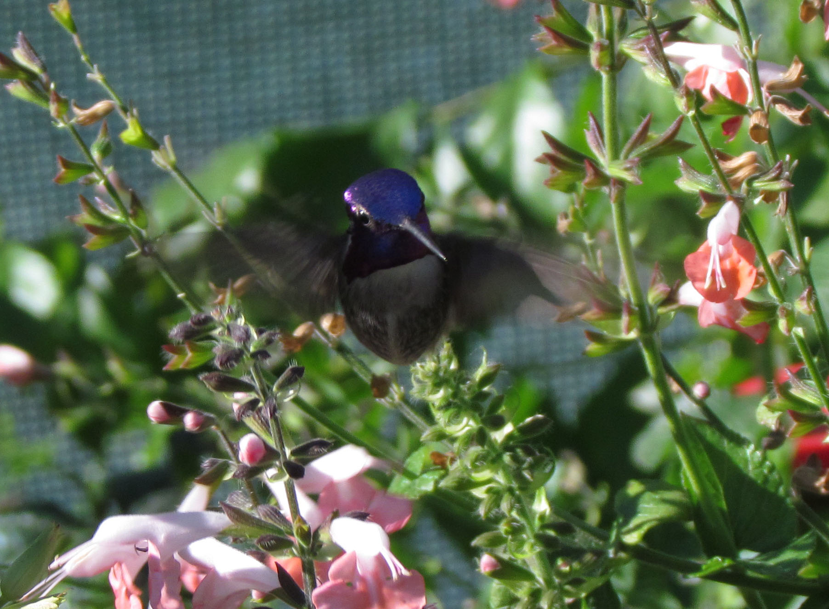
You can't talk a man out of a position he didn't talk himself into.
Personal anecdotes:
I have a friend who is a huge fan of fiction. I have encouraged him (I have begged him) to read my favorite fantasy series, but he has refused, because, he said, it doesn’t sound interesting. My son will look at foods that he has enjoyed in the past, though he doesn’t remember enjoying them, and he will refuse to eat them. He doesn’t like ‘em.
The specific question was to do with DNA – why couldn’t God have made animals in their current forms?

Slide 137
You can't talk a man out of a position he didn't talk himself into.
“And I know laymen who understand these basic issues of genetics better than some supposedly ‘professional biologists’. In fact, one Professor of Genetics at a university was shocked into reason by his wife, who has no academic qualifications — like you, he scoffed at her supposed ignorance, but God used something she said to break through his evolutionized outlook…” ~ Don Batten, Ph.D.
http://creation.com/a-pair-of-dogs-wolves-on-noahs-ark-couldnt-have-produced-all-dog-varieties-today
The specific question was to do with DNA – why couldn’t God have made animals in their current forms?

Slide 138
Choice is powerful!
Israelites were told to make a choice to change their focus. "This is a sacred day before our Lord. Don't be dejected and sad..." So the people went away ... to celebrate with great joy because they had heard God's words and understood them. ~ Nehemiah 8
Think happy thoughts!

Slide 139
I have some chosen biases.

Slide 140
I have some chosen biases:
God is real

Slide 141
I have some chosen biases:
God is real
We are here for a purpose

Slide 142
I have some chosen biases:
God is real
We are here for a purpose
Love is of certain value

Slide 143
I have some chosen biases:
God is real
We are here for a purpose
Love is of certain value
What I do matters in the end

Slide 144
I have some chosen biases:
God is real
We are here for a purpose
Love is of certain value
What I do matters in the end
Let’s be honest, the evidence for these is not 100% conclusive. There is room for faith.

Slide 145
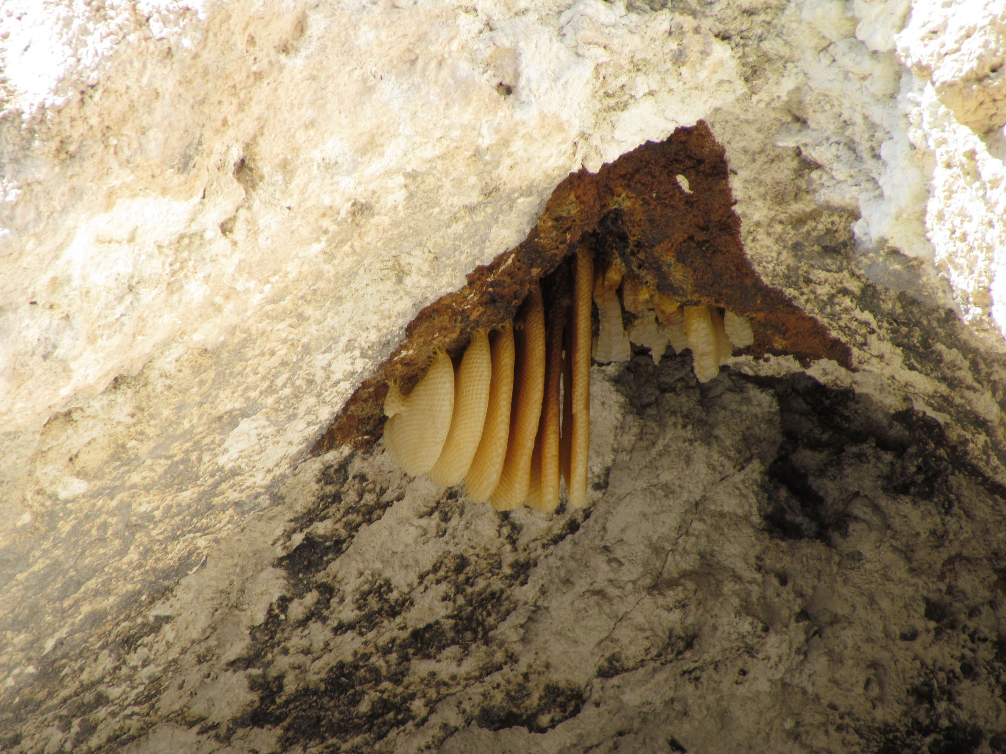
Why did God put people in the garden with forbidden fruit?

Slide 146
Why did God put people in the garden with forbidden fruit?
God wants to be chosen!

Slide 147
Those who reject Him are rejected by Him. “But when Pharaoh saw that the frogs were gone, he hardened his heart.” ~ Ex. 8:15 “So the LORD hardened Pharaoh's heart…” ~ Ex. 10:27
Or was it the other way around? “But I will cause Pharaoh to be stubborn so I can multiply my miraculous signs and wonders in the land of Egypt.” ~ Ex. 7:3
It’s both. “For the LORD sees every heart and understands and knows every plan and thought. If you seek him, you will find him. But if you forsake him, he will reject you forever.” ~ 1 Ch. 28:9

Slide 148
Was Pharaoh stupid? No way! His answer to Moses was actually quite clever.
But Pharaoh replied, "You're just lazy! You obviously don't have enough to do. If you did, you wouldn't be saying, 'Let us go, so we can offer sacrifices to the LORD.‘ ~ Ex. 5:17
Was it a matter of empirical evidence? “Pharaoh's magicians tried to do the same thing with their secret arts, but this time they failed. And the gnats covered all the people and animals. "This is the finger of God!" the magicians exclaimed to Pharaoh. But Pharaoh's heart remained hard and stubborn. He wouldn't listen to them, just as the LORD had predicted.” ~ Ex. 8:18-19

Slide 149
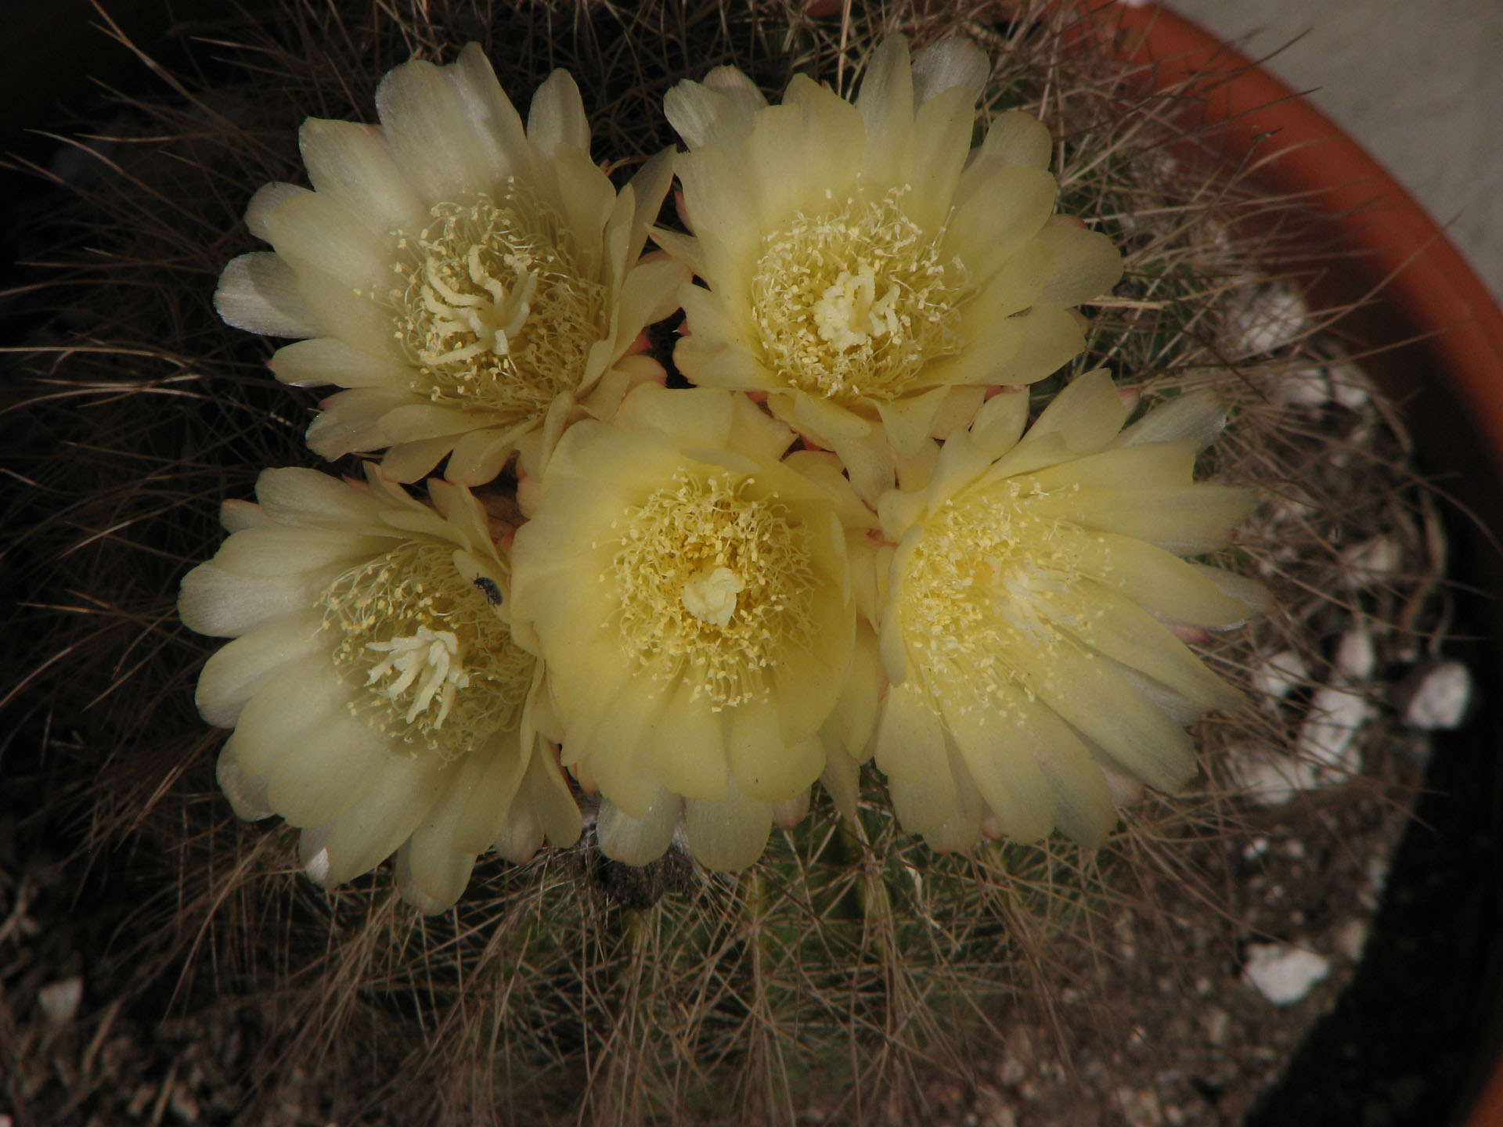
I wasn’t won over by the evidence alone.
My wife prayed for me, and I looked for God with sincerity.

Slide 150
I chose faith!

Slide 151
The evidence was the tool.
My Maker made me new.

Slide 152
So, search your heart. Do you have a bias?
God can prove anything, but He sometimes makes us choose.
Why?

Slide 153
It’s sort of the point, isn’t it?
Our choices prove our faith.
Our choices demonstrate our love.

Slide 154
Remember what Pharaoh did.
He chose selfishness.
God hardened his heart.

Slide 155
Jesus did miracles in front of the Pharisees. Remember what He said.
Luke 16:27-31 "Then the rich man said, 'Please, Father Abraham, send him to my father's home. … I want him to warn them about this place of torment so they won't have to come here when they die.‘ "But Abraham said, 'Moses and the prophets have warned them. … If they won't listen to Moses and the prophets, they won't listen even if someone rises from the dead.'"

Slide 156
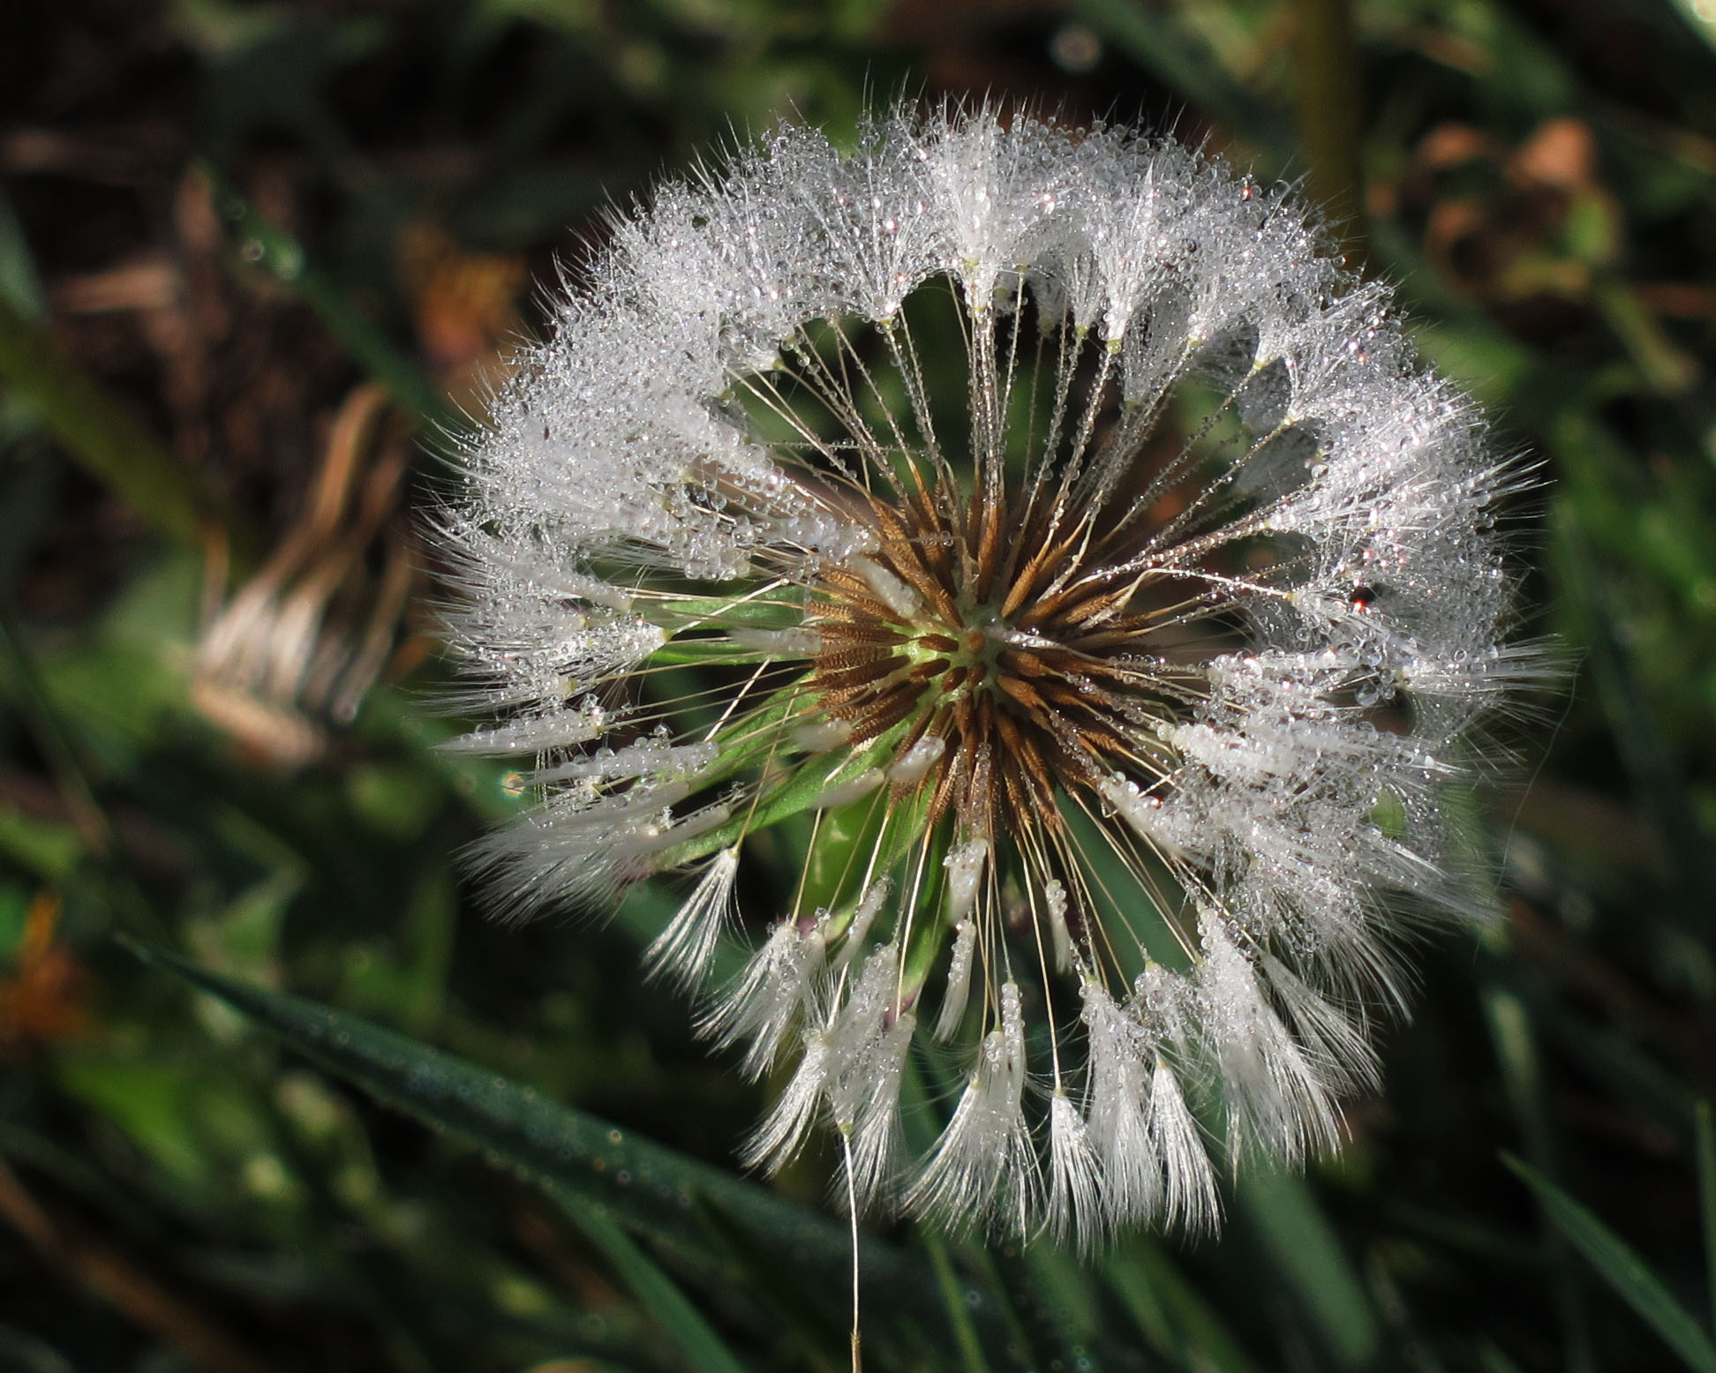
What sets Genesis apart from the other Pagan myths?
Jesus spoke of Adam. Matthew 19:4 "Haven't you read the Scriptures?" Jesus replied. "They record that from the beginning 'God made them male and female.' Jesus spoke of the Flood. Luke 17:27 In those days before the flood, the people enjoyed banquets and parties and weddings right up to the time Noah entered his boat and the flood came to destroy them all.
Jesus vouched for Moses. Luke 10:26 Jesus replied, "What does the law of Moses say? How do you read it?"

Slide 157
I believe Jesus.

Slide 158
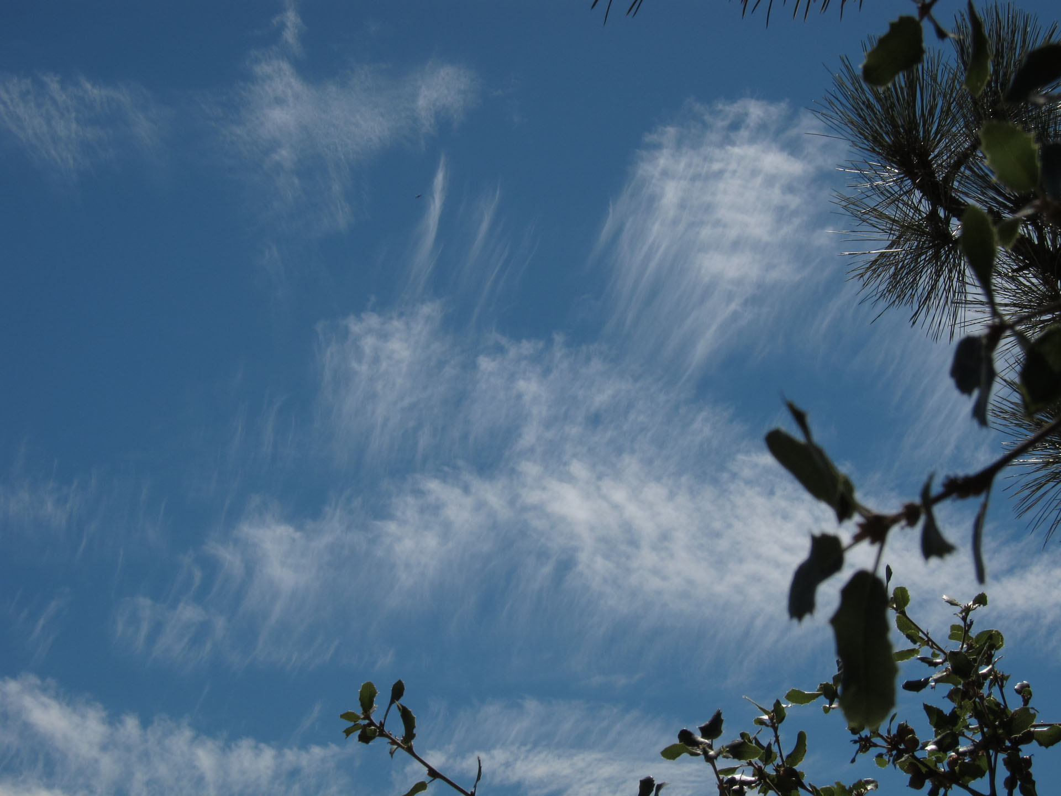
Call me biased.

Slide 159
What is the quality of your soil?

Slide 160
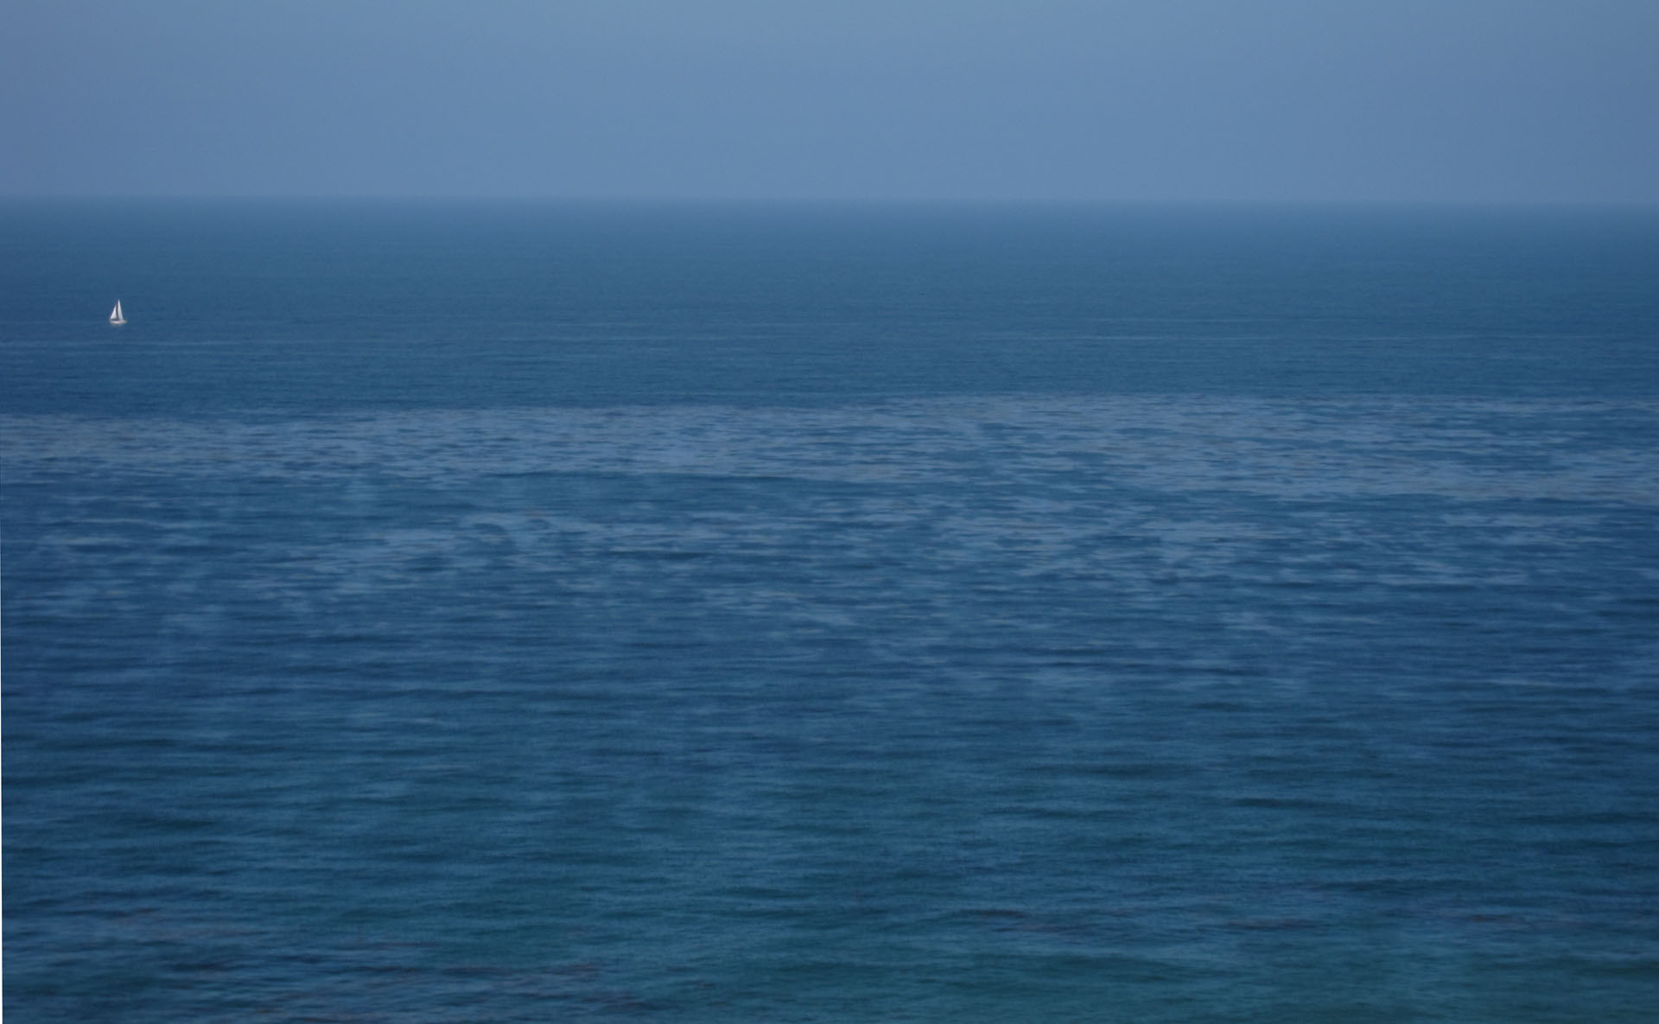
For more information, visit: http://FromNoahtoHercules.com/
Recommended reading:
After the Flood by Bill Cooper
Genealogies of the kings of Europe back to Noah
In the Minds of Men by Ian Taylor
The origin of bias in the Theory of Evolution
Chronicle by Eusebius
Ancient history written with the proper bias.
These are free online, so no excuses!
Special thanks to http://thefingerworks.com for the amazing pictures!

